Slide 1
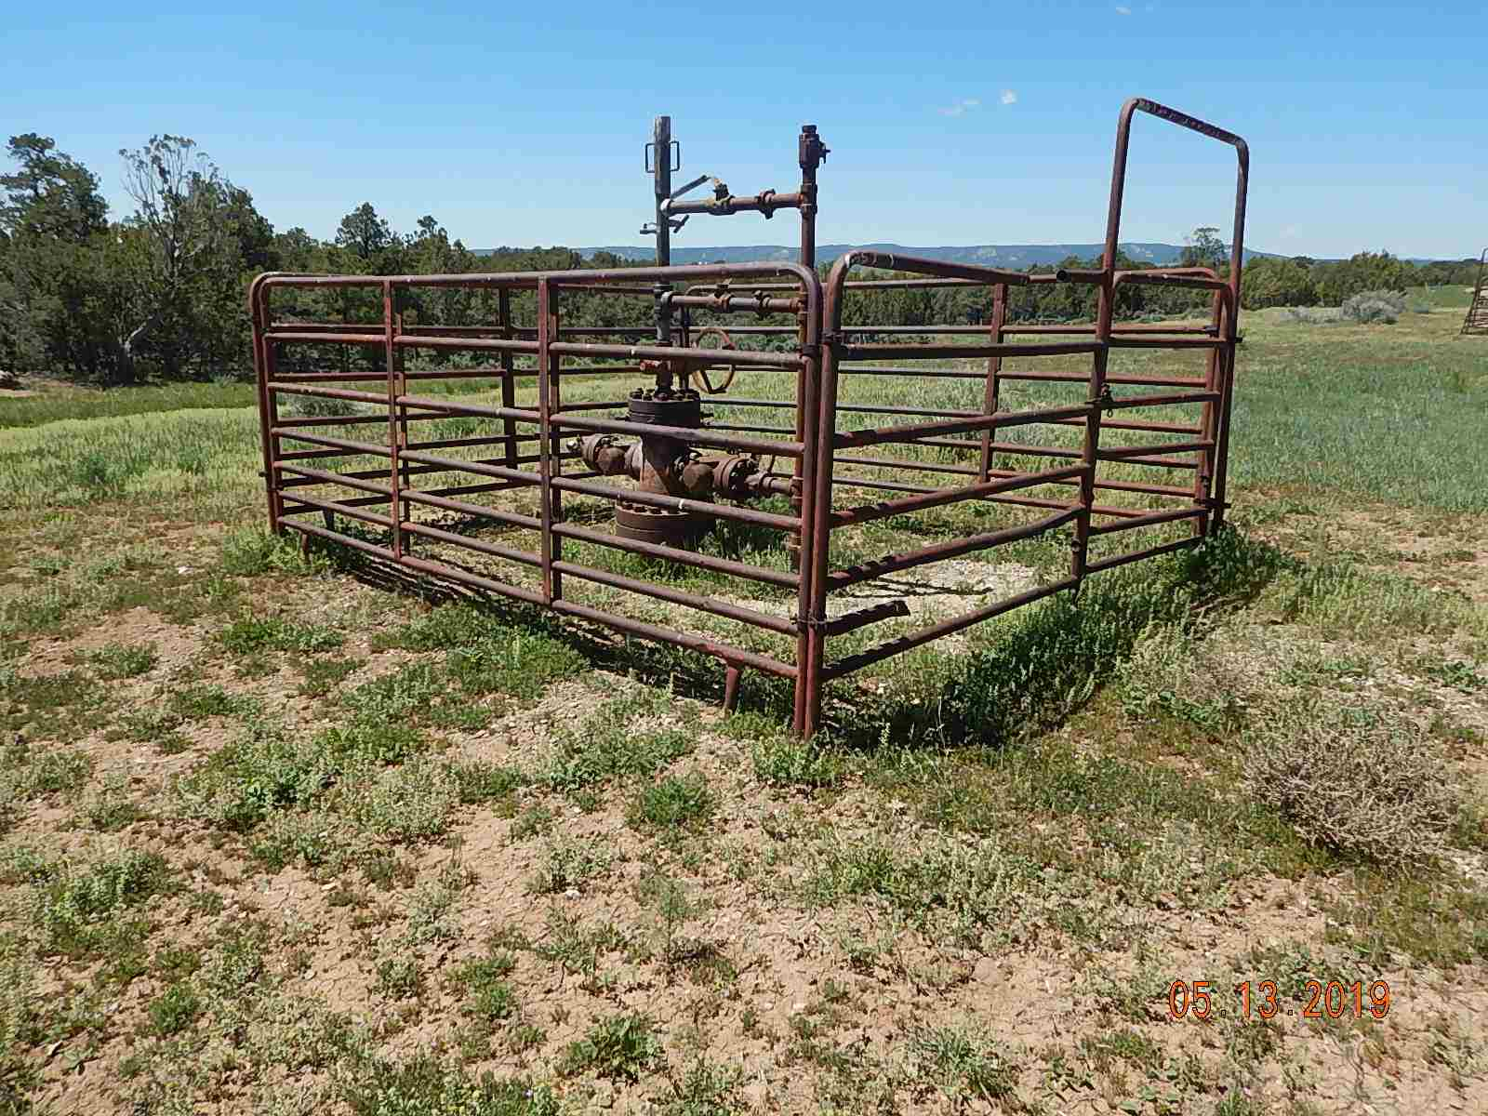
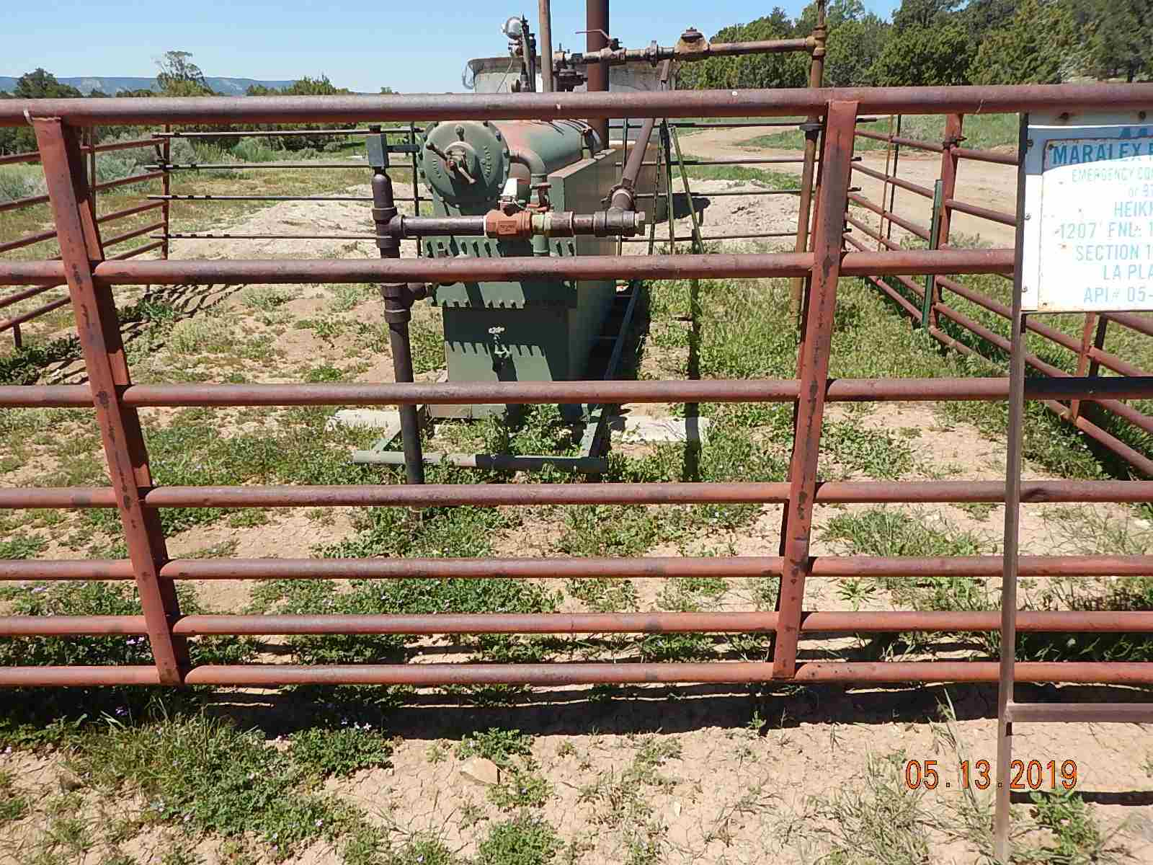
Inspection Photos
HEIKKINEN 1-10
API: 005-067-06609
Weeds around equipment.
Weeds around equipment.

Slide 2
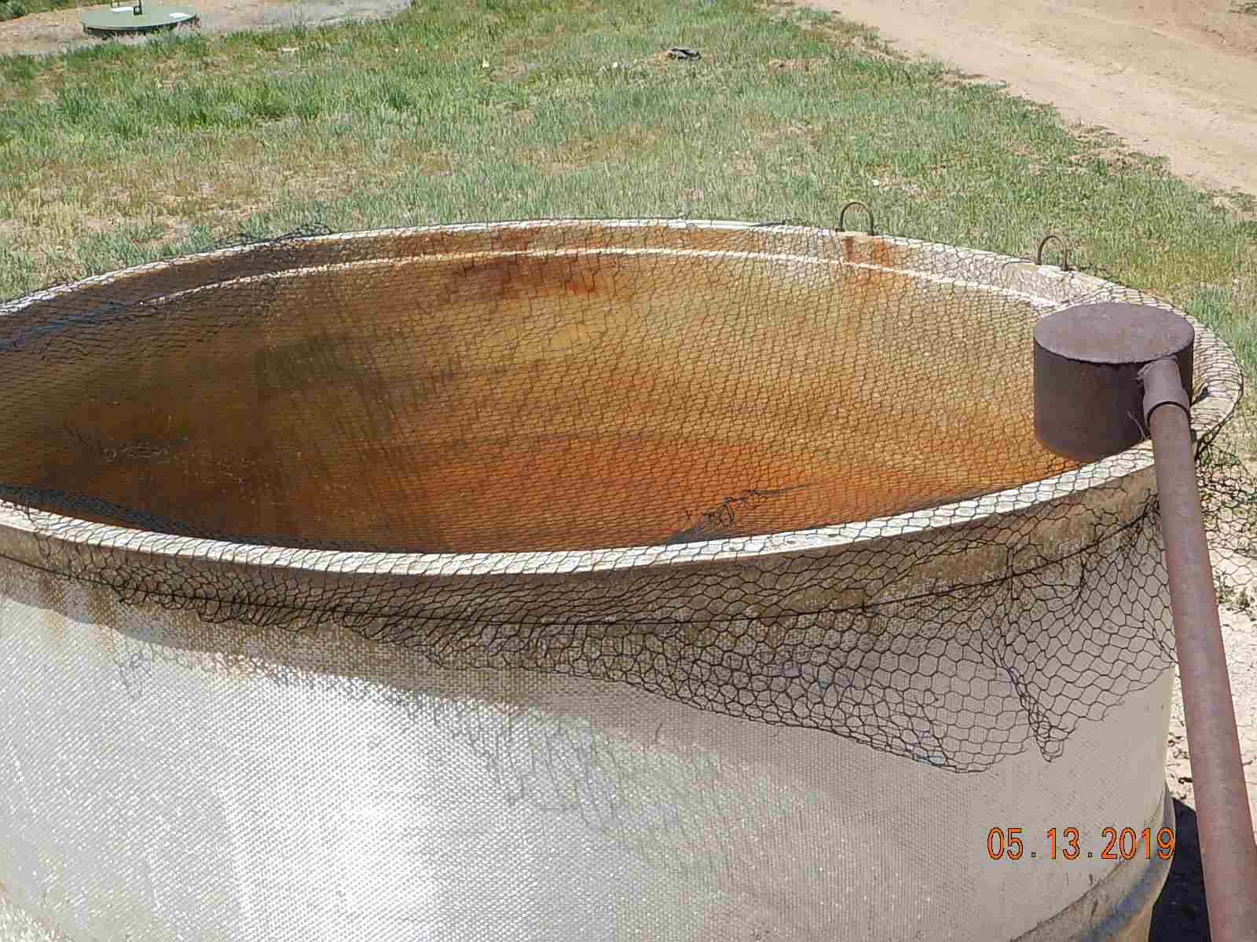
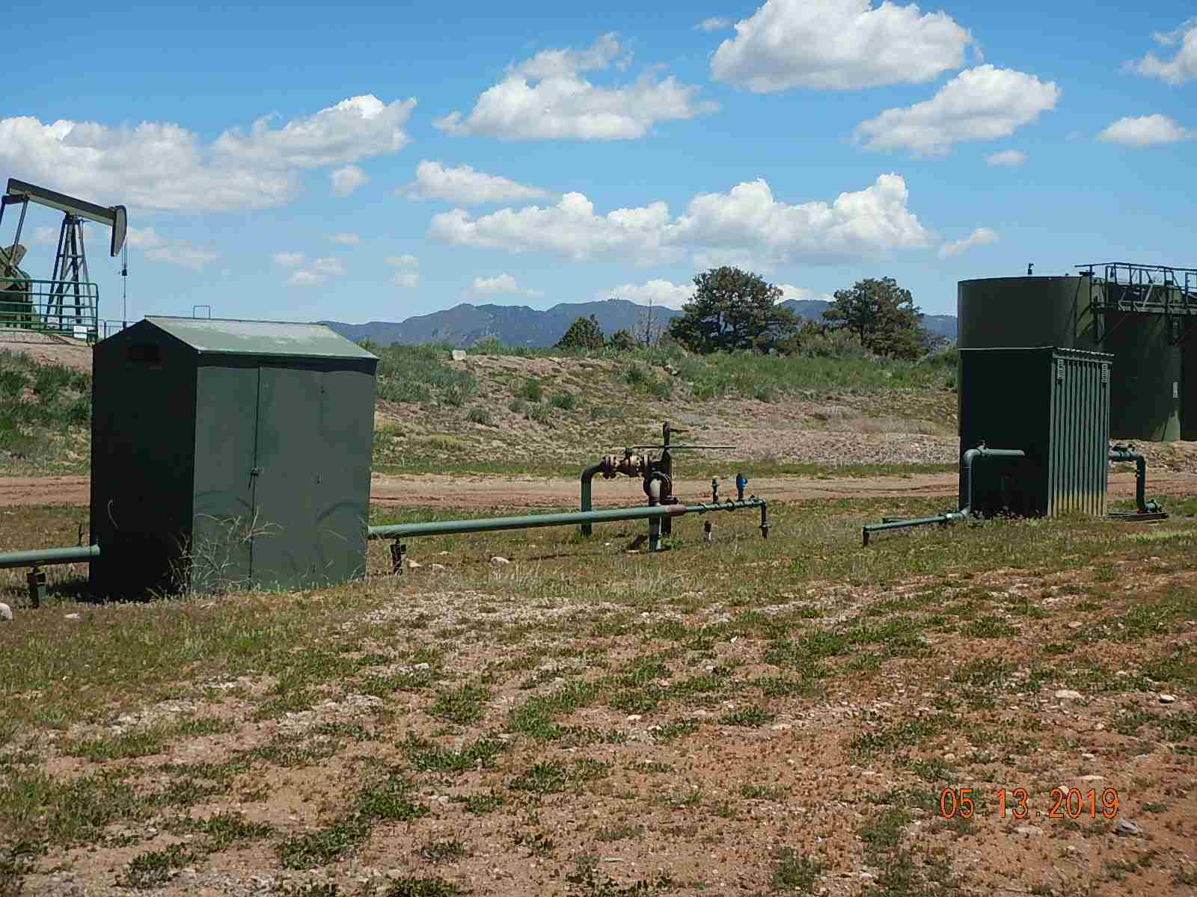
Inspection Photos
HEIKKINEN 1-10
API: 005-067-06609
Holes in wildlife protection netting.
Weeds around equipment.

Slide 3
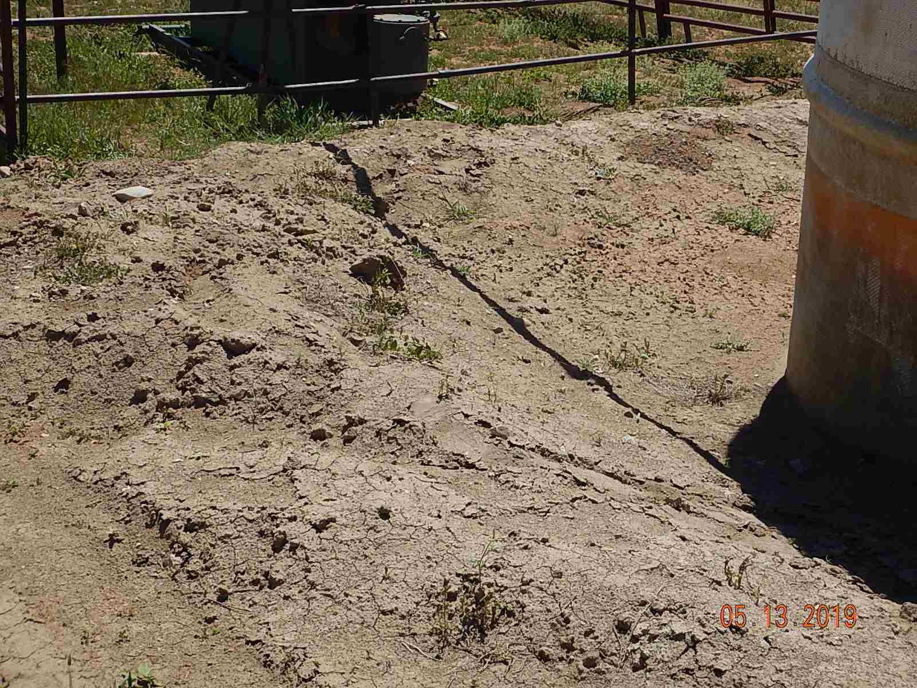
Inspection Photos
HEIKKINEN 1-10
API: 005-067-06609
Tire tracks through secondary containment and containment inadequate.

