Slide 1
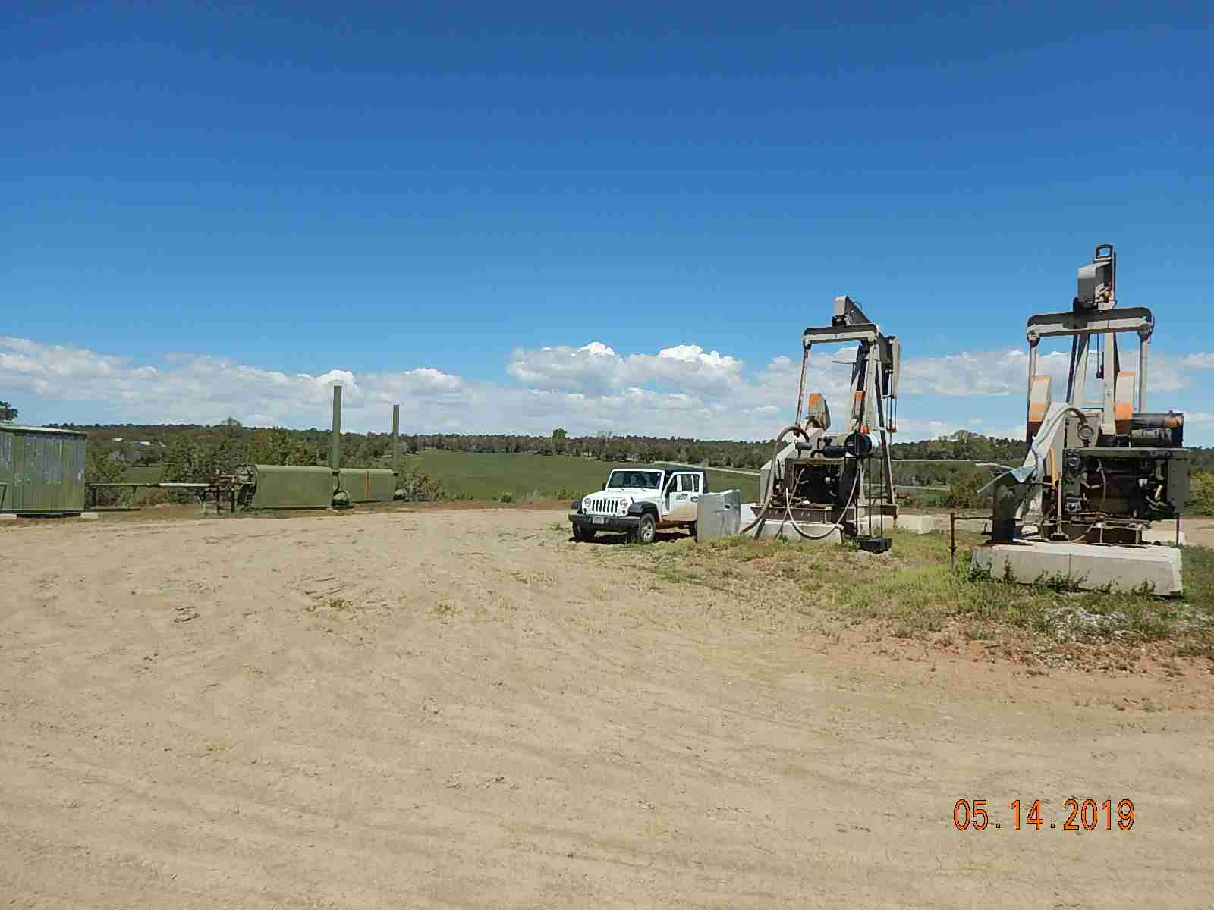
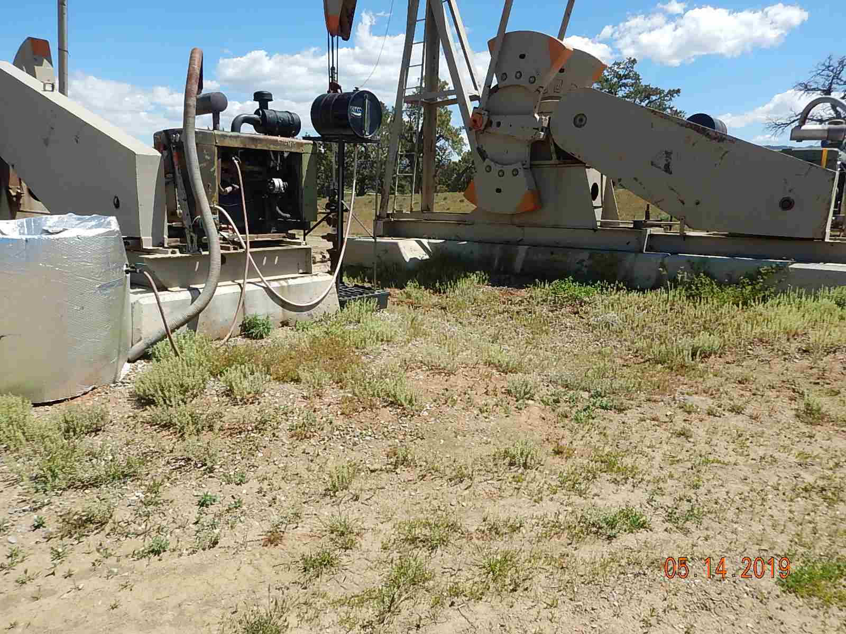
Inspection Photos
ARTFGANCE 33-7-14 1
API: 05-067-096056
Weeds around equipment.
Weeds around equipment

Slide 2
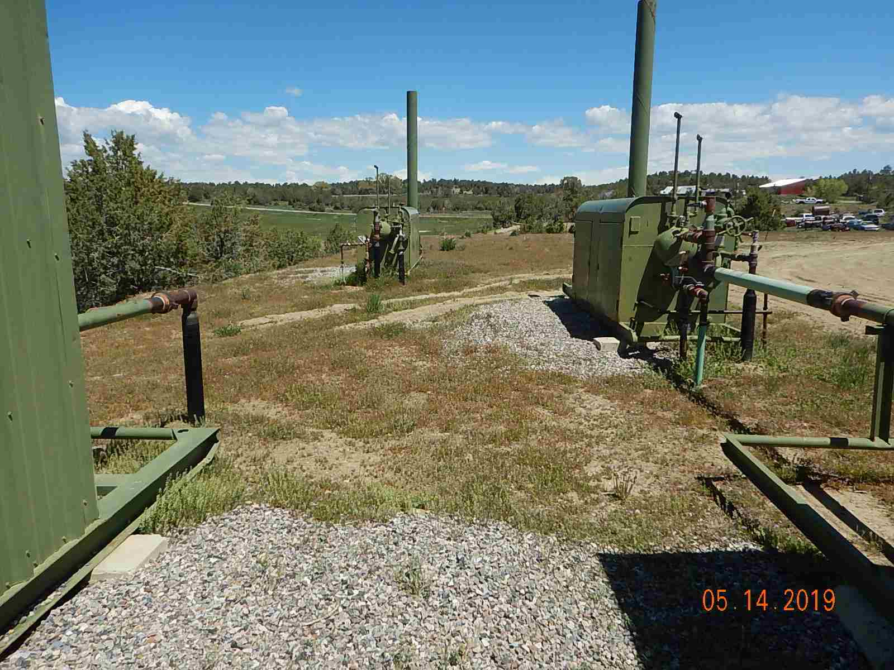
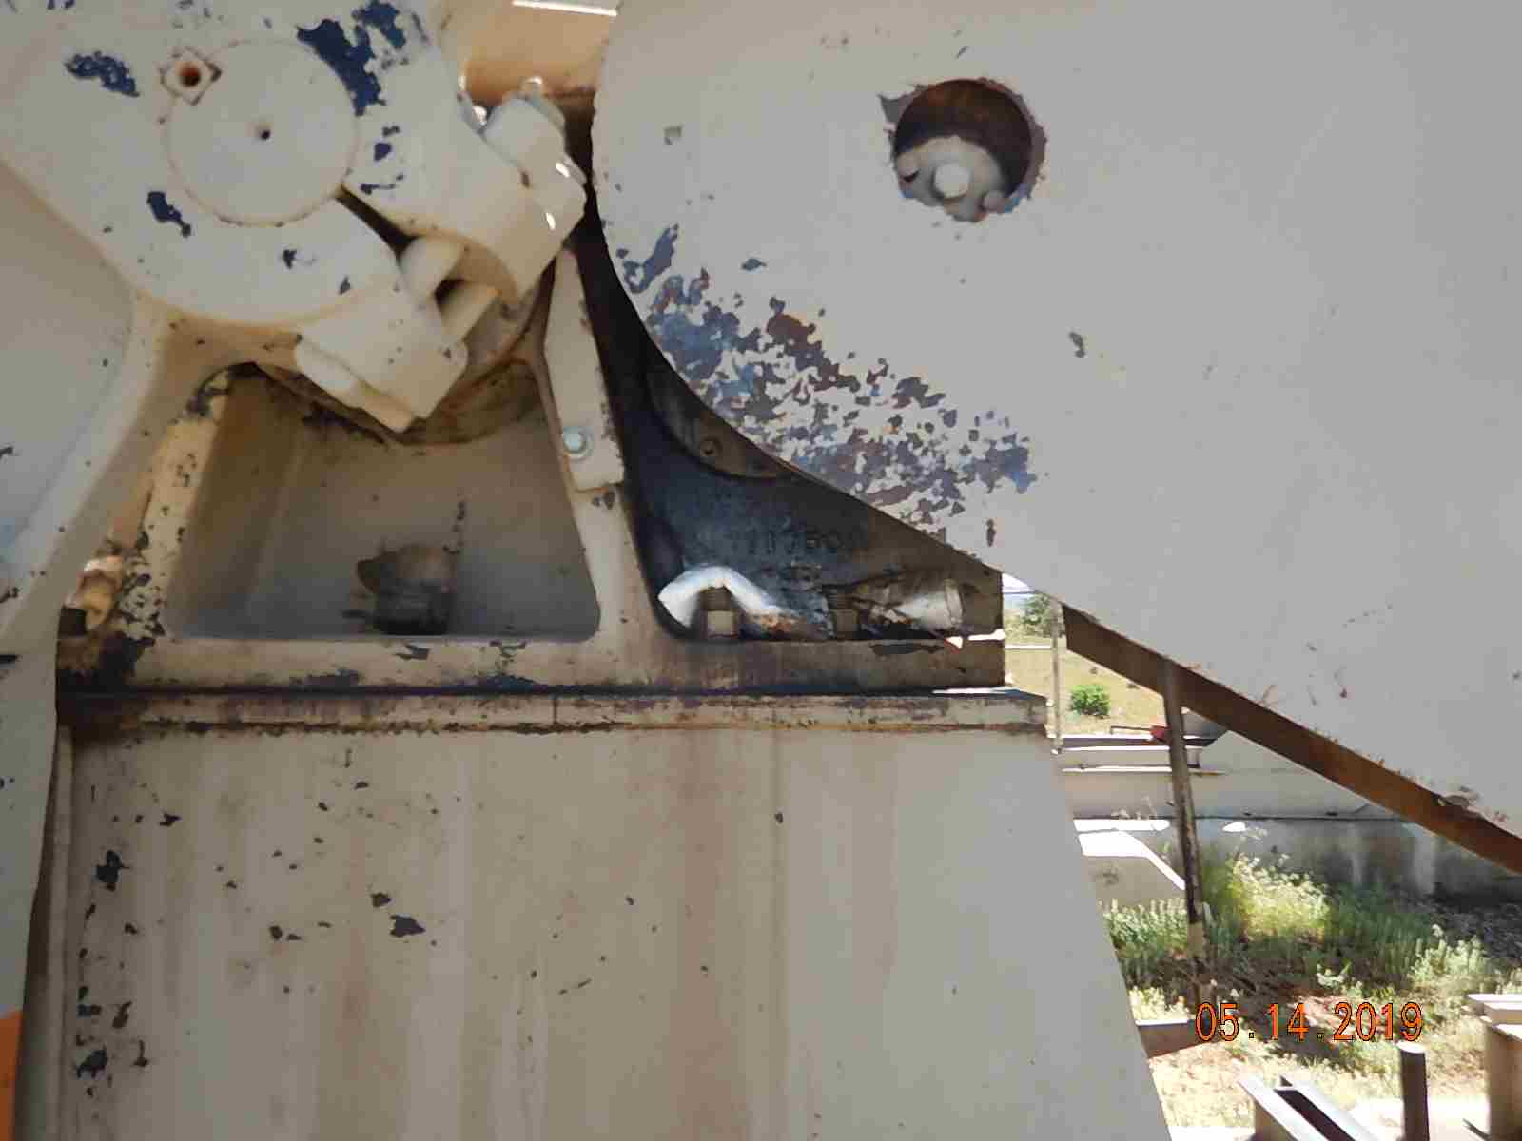
Inspection Photos
ARTFGANCE 33-7-14 1
API: 05-067-096056
Weeds around equipment
Leaking gearbox seal.

Slide 3
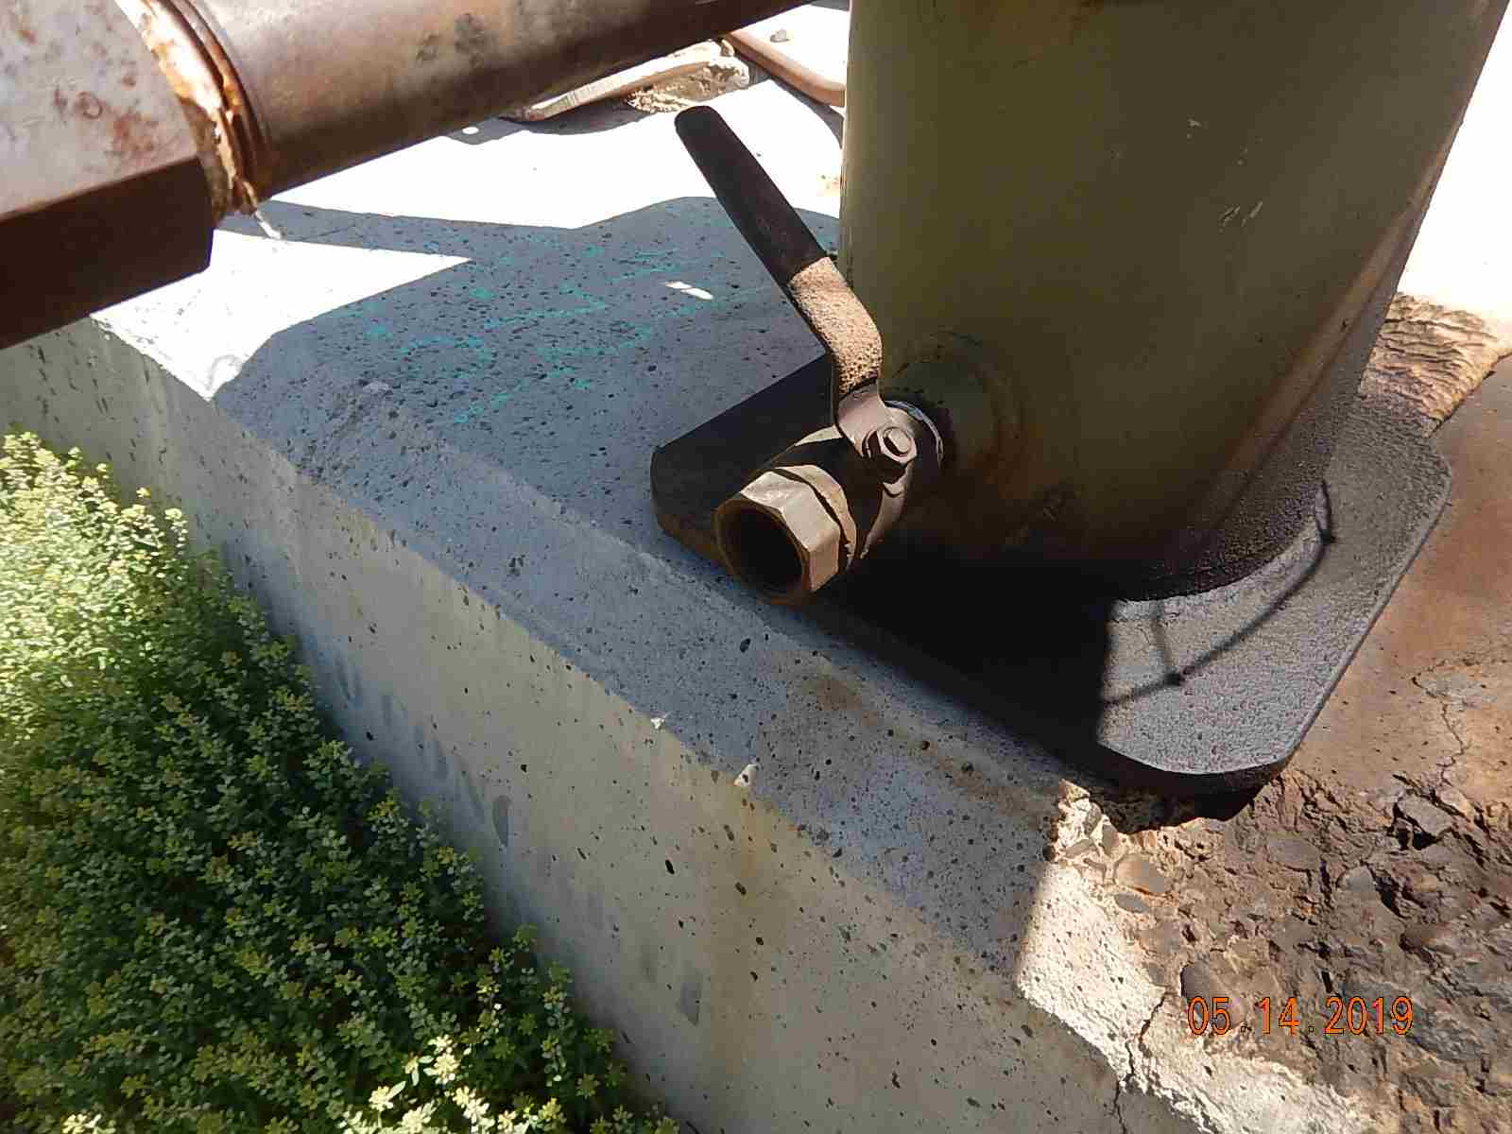
Inspection Photos
ARTFGANCE 33-7-14 1
API: 05-067-096056
Leaking valve on knockout pot.

