Slide 1
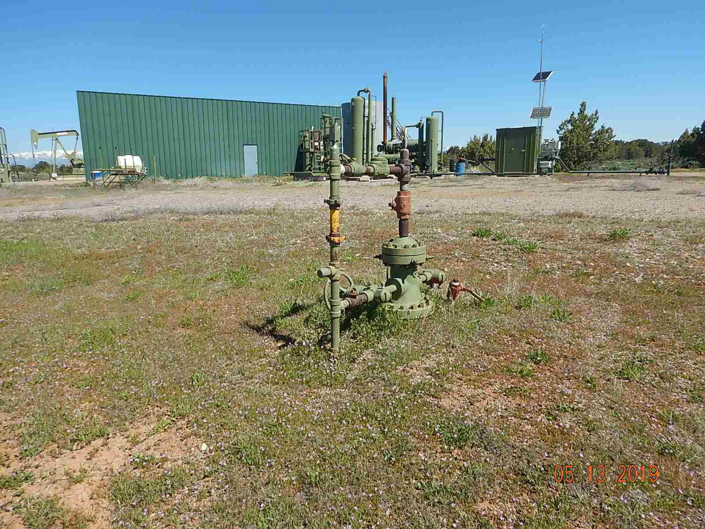
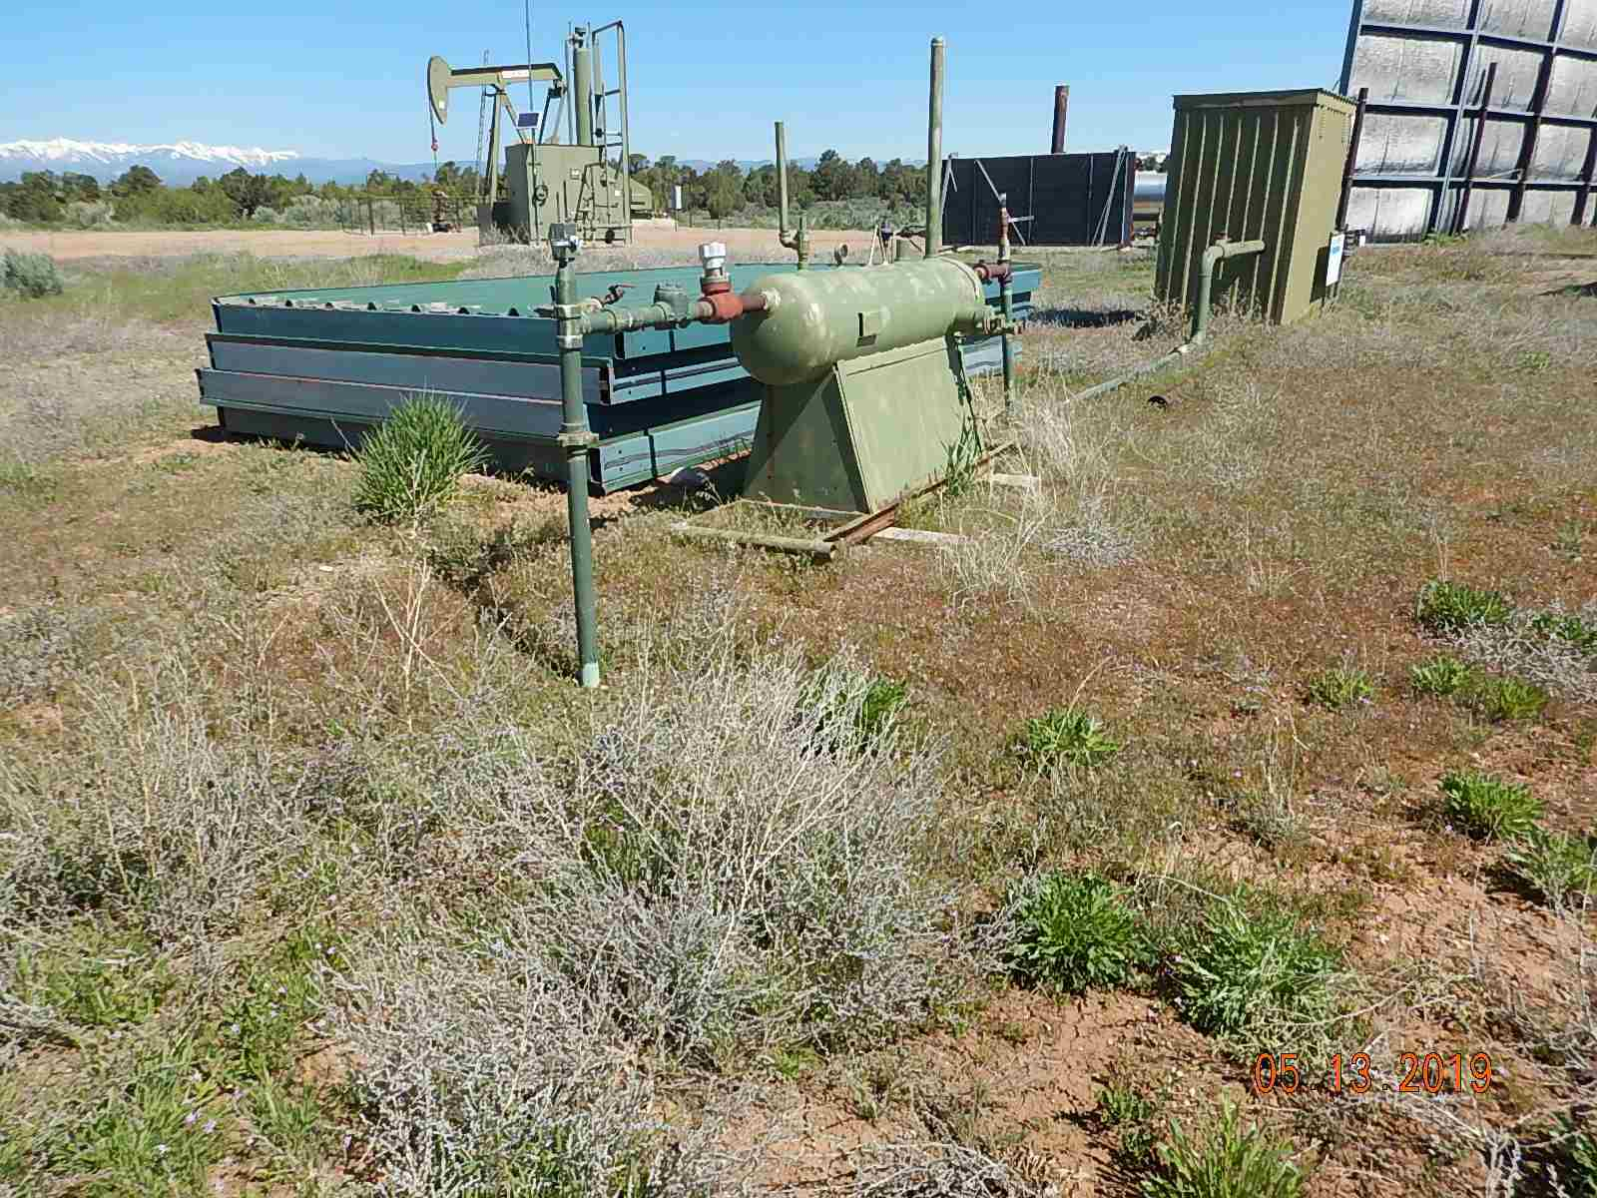
Inspection Photos
Shelhammer 1
API: 05-067-06537
Weeds around equipment
Weeds around equipment and unused equipment sound panels.

Slide 2
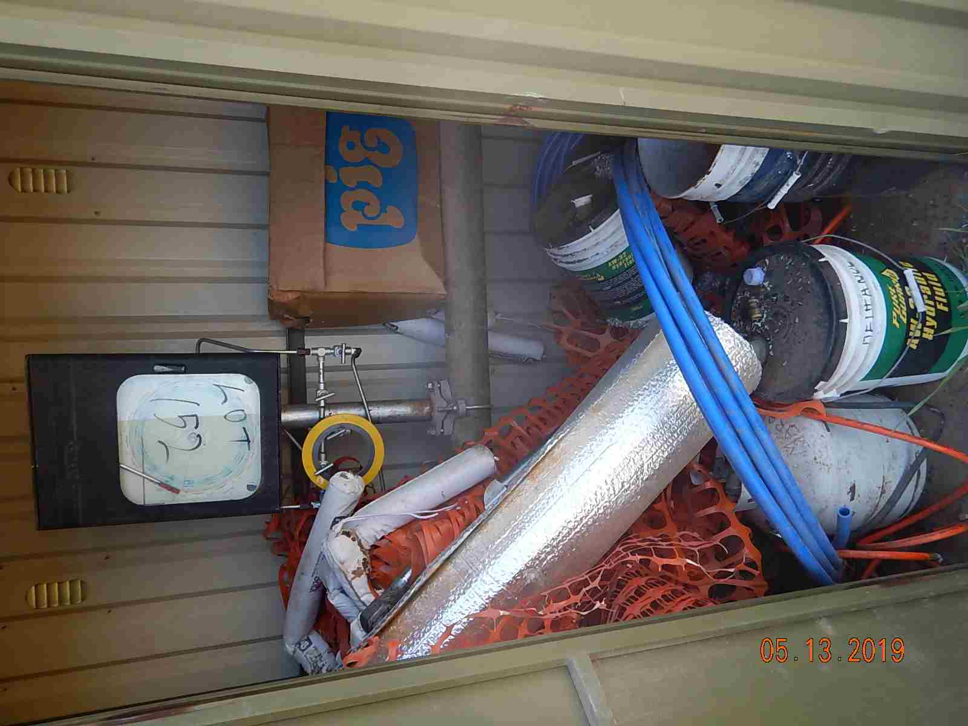
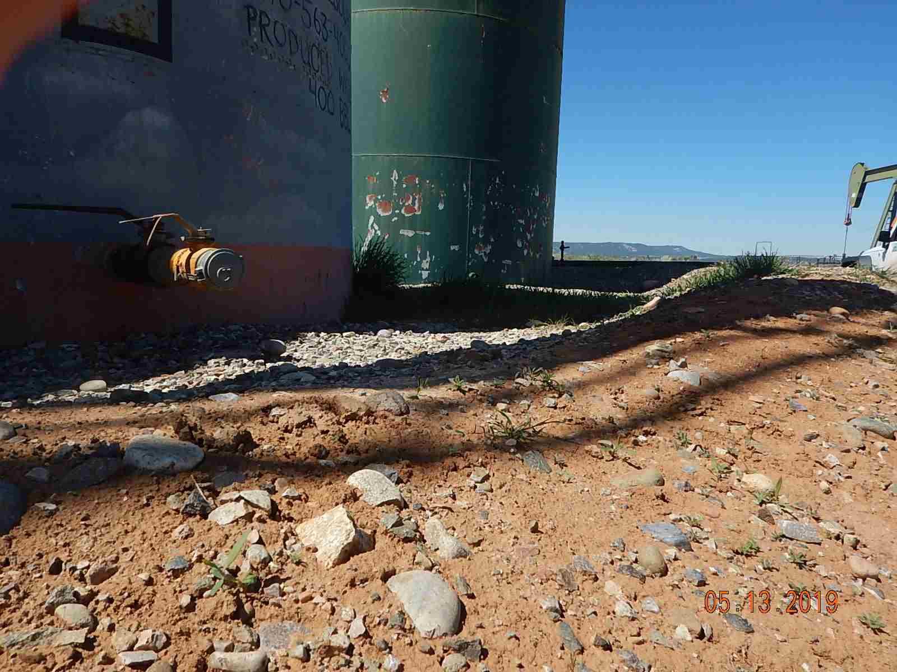
Inspection Photos
Shelhammer 1
API: 05-067-06537
Trash in meter house.
Secondary Containment berms inadequate capacity.

Slide 3
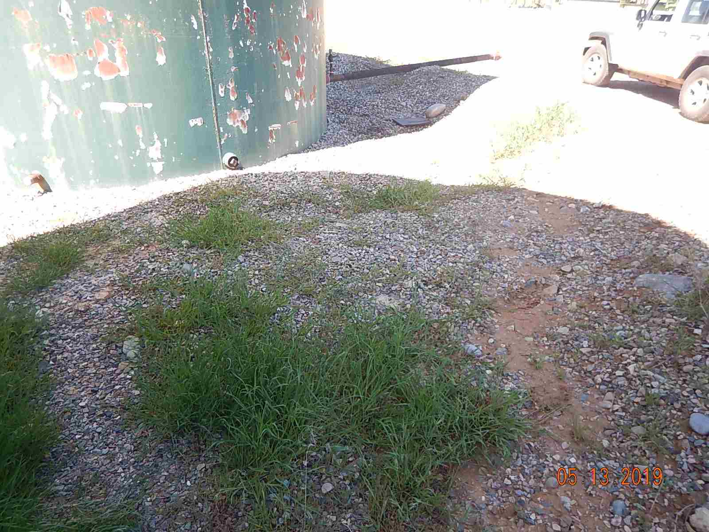
Inspection Photos
Shelhammer 1
API: 05-067-06537
Weeds in secondary containment.

