Slide 1
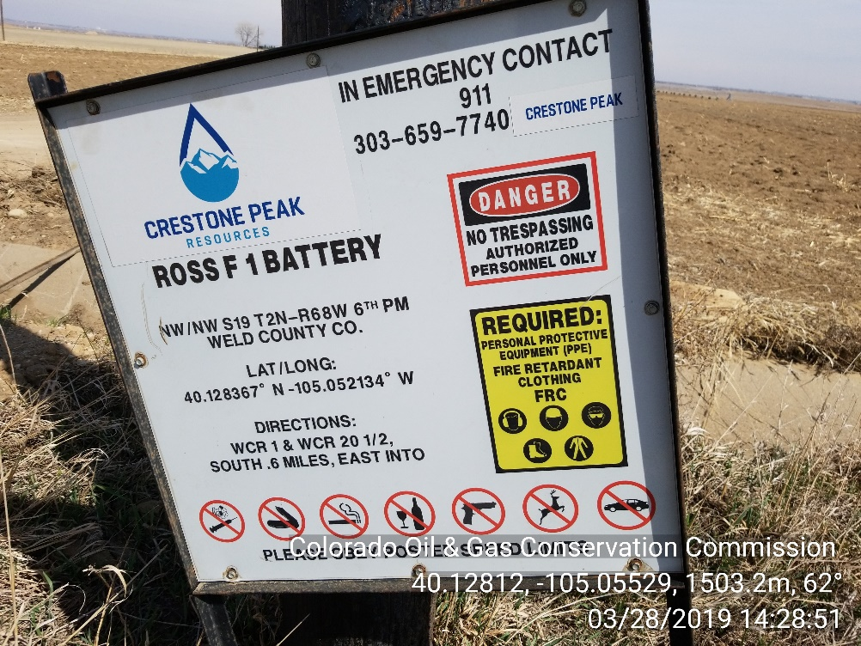
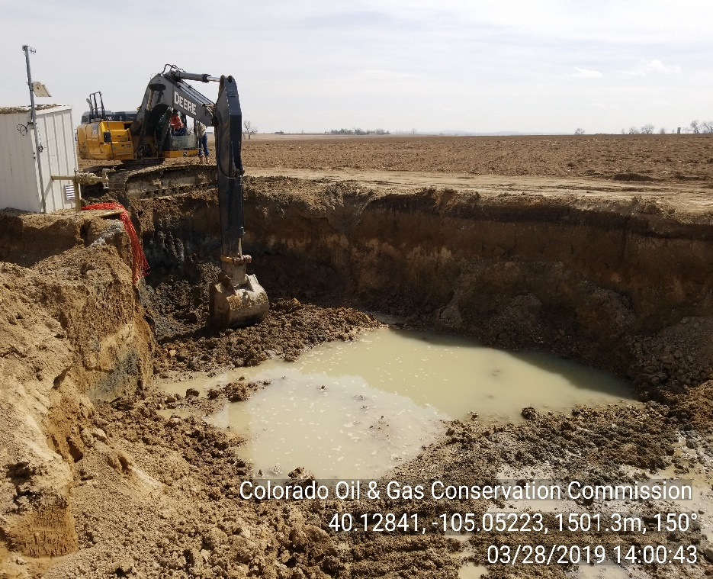

Inspection Photos
Location Name: Ross F Unit 1
Location Number: 322909
Location Sign
Excavation, smear zone visible, ground water infiltrating

Slide 2
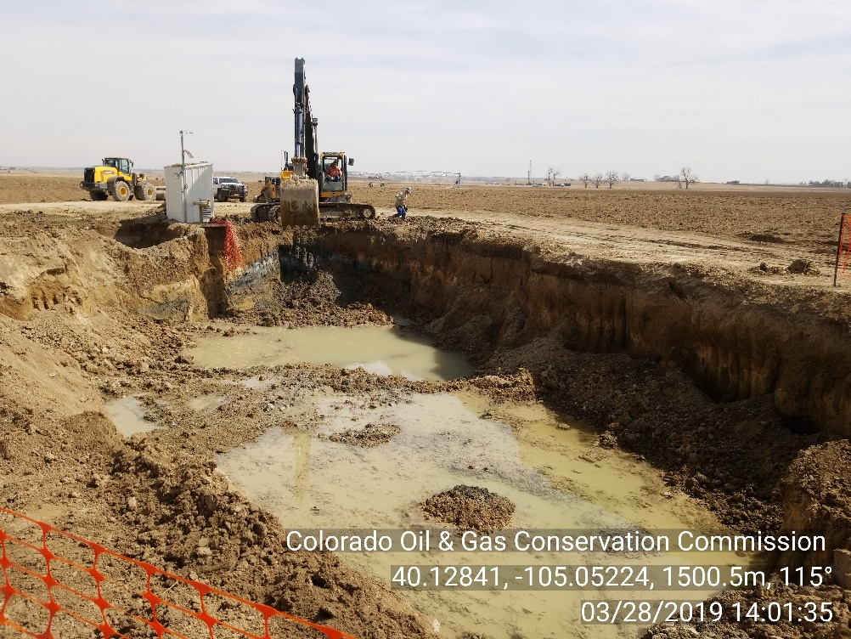
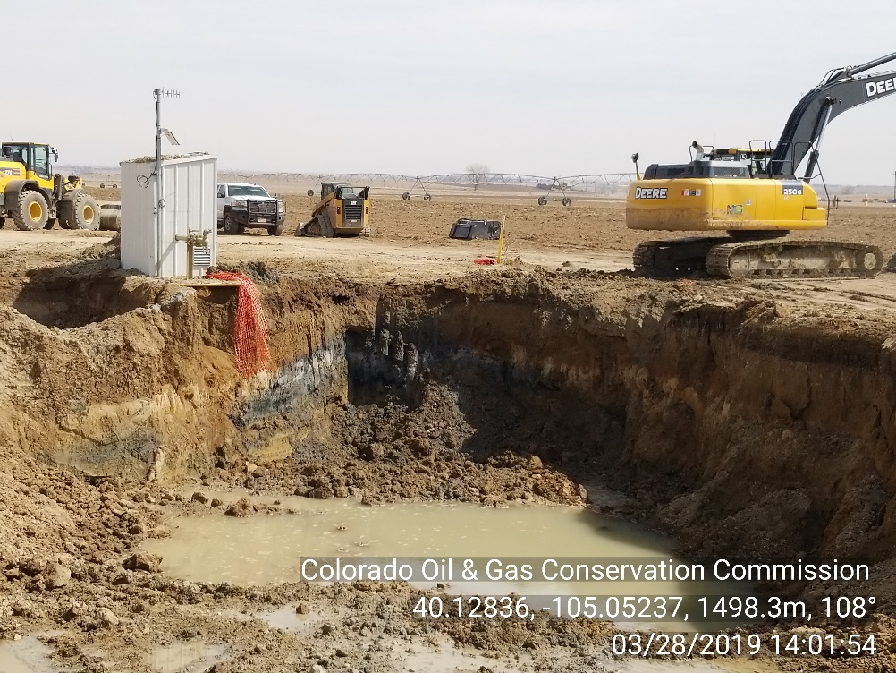
Inspection Photos
Location Name: Ross F Unit 1
Location Number: 322909
Excavation, smear zone visible
Excavation, smear zone visible

Slide 3
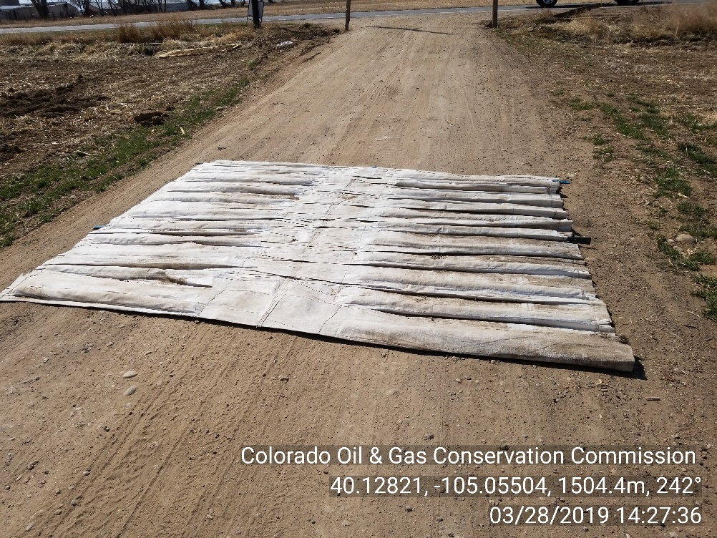
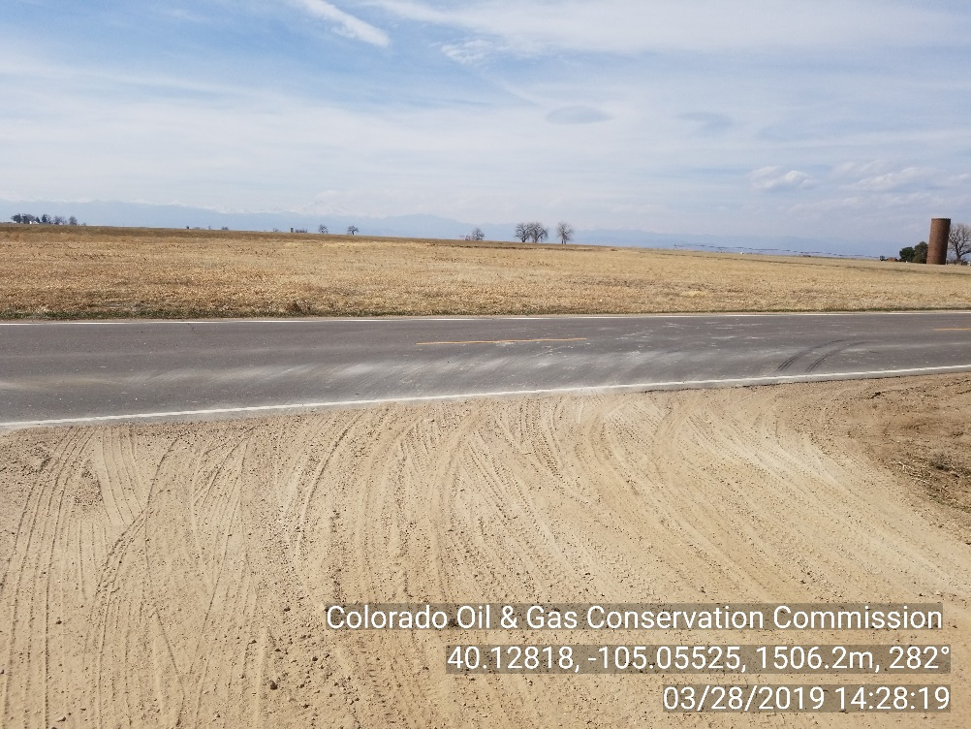
Inspection Photos
Location Name: Ross F Unit 1
Location Number: 322909
Temporary construction mat at entrance
Looking west at Aggregate Road

