Slide 1
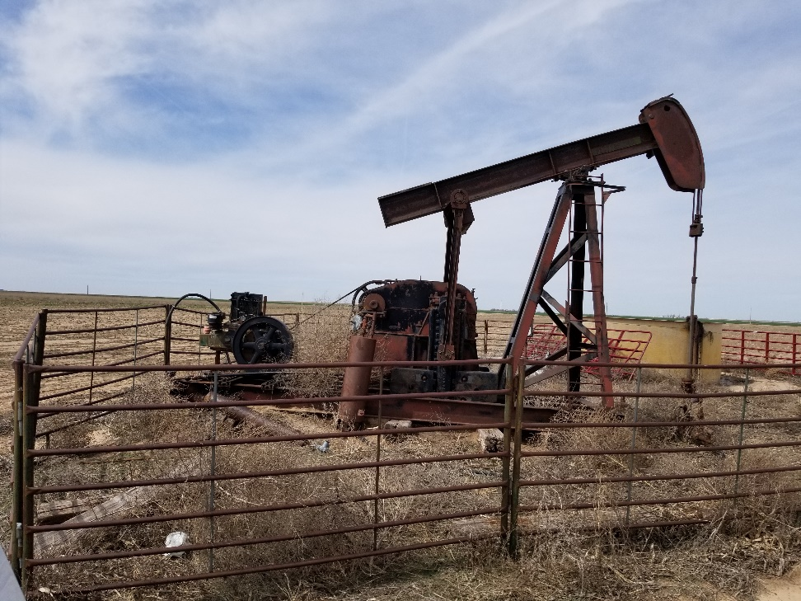
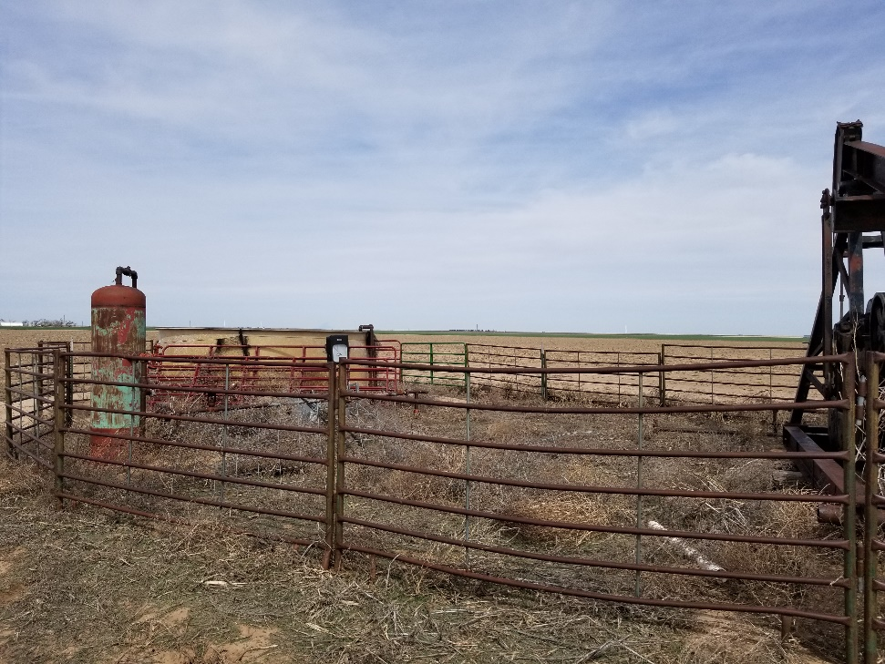
Inspection Photos
Location Name: Hetrick 1-29
API: 05-009-06368
1. Weeds around unit and wellhead. Debris laying around base of unit.
2. Weeds across location between unit and meter run.

Slide 2
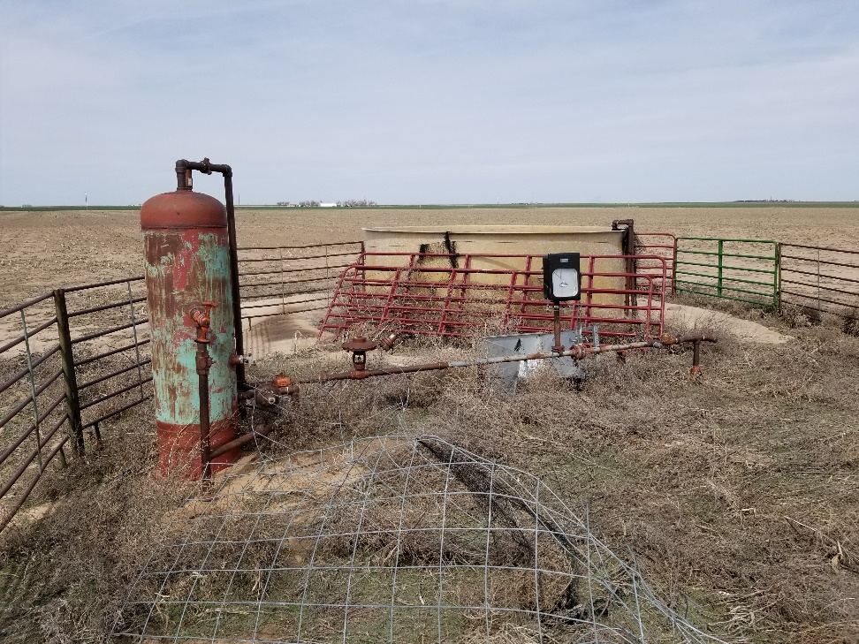
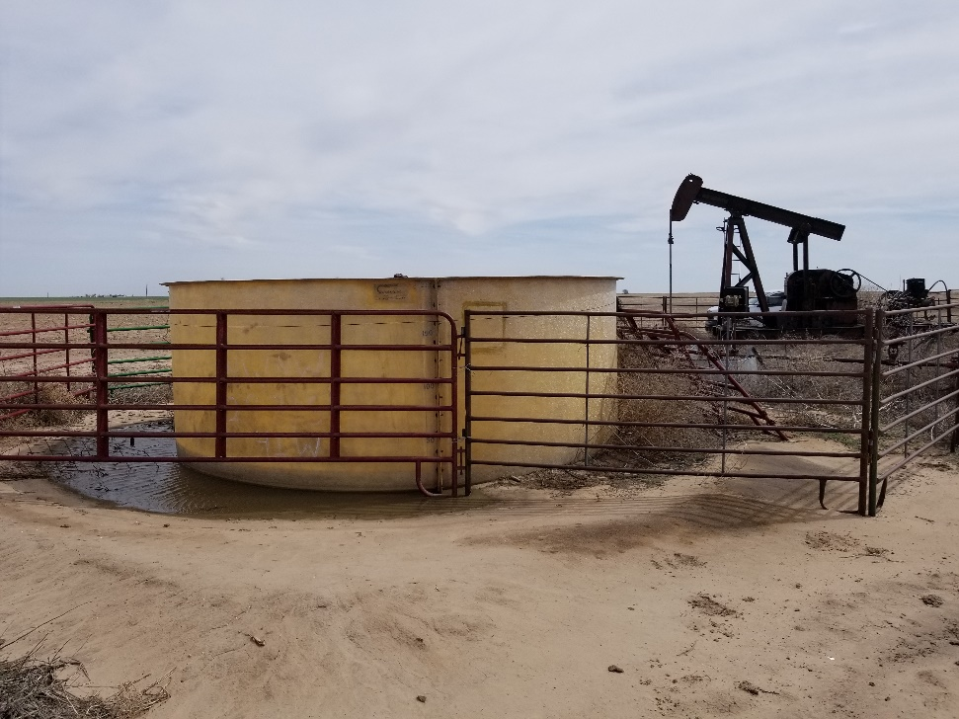
Inspection Photos
Location Name: Hetrick 1-29
API: 05-009-06368
3. Weeds across location between unit, meter run and VGS. Wire panels laying inside metal panels. Meter run housing is laying on the ground.
4. No berms around water tank. Tank is empty at time of inspection. No labeling on water tank

