Slide 1
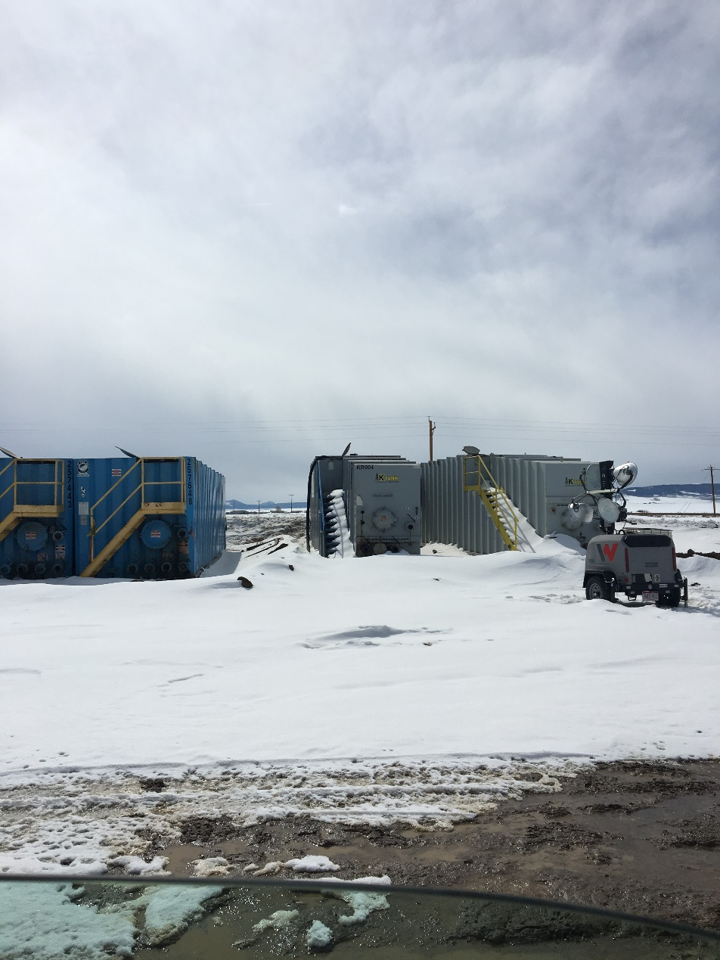
Inspection Photos
Location: Mutual 1-17H
Spill 462655
Inspection Date: 3/11/19
Photos taken by Kris Neidel
Photo 1-Tank storage, a vac hose is coming out of the side top of the tank. Vac hoses should be removed when not in use.

Slide 2
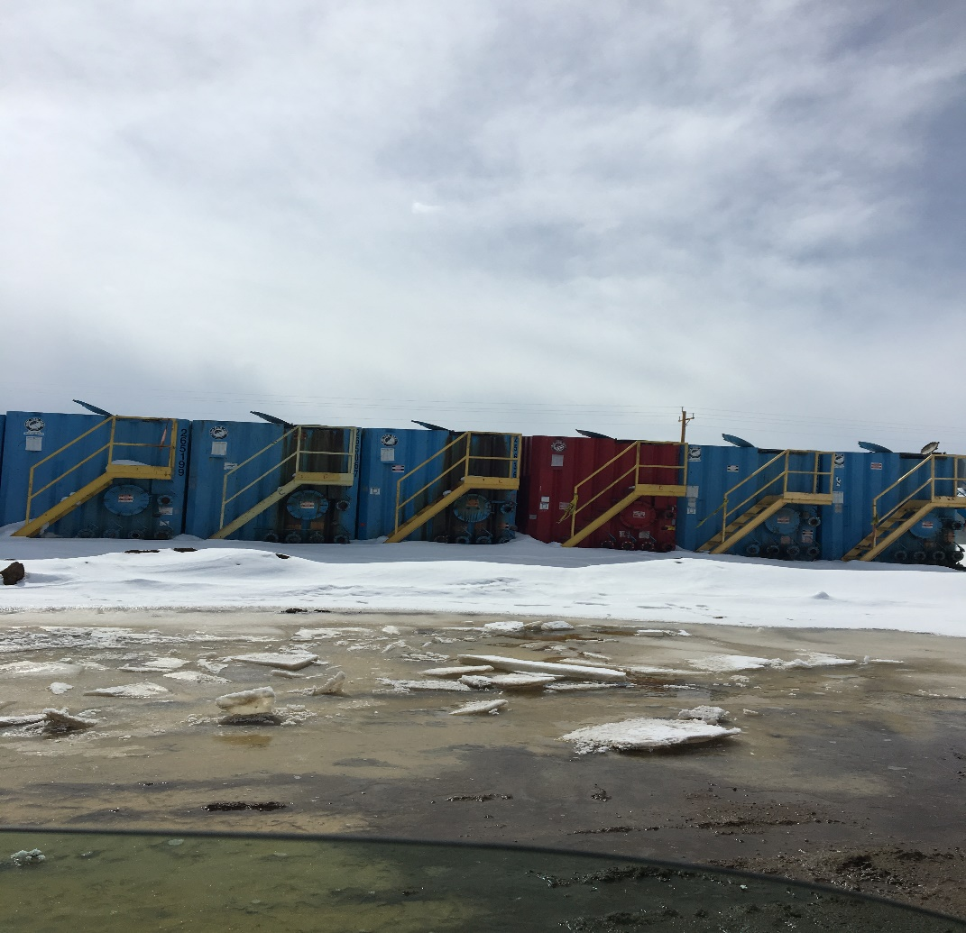
Inspection Photos
Location: Mutual 1-17H
Spill 462655
Inspection Date: 3/11/19
Photos taken by Kris Neidel
Photo 2-All hatches on top of tanks were open.

Slide 3
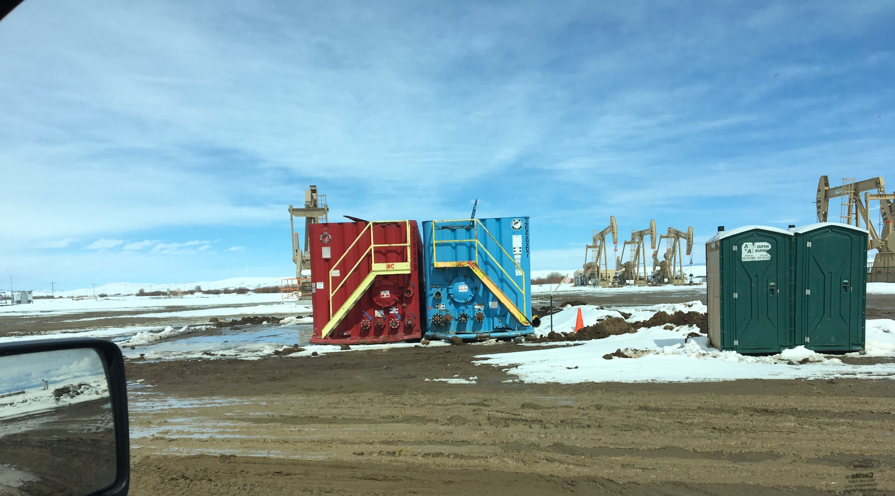
Inspection Photos
Location: Mutual 1-17H
Spill 462655
Inspection Date: 3/11/19
Photos taken by Kris Neidel
Photo 3-Two other frac tank to directly to the north of the large row.
.

Slide 4
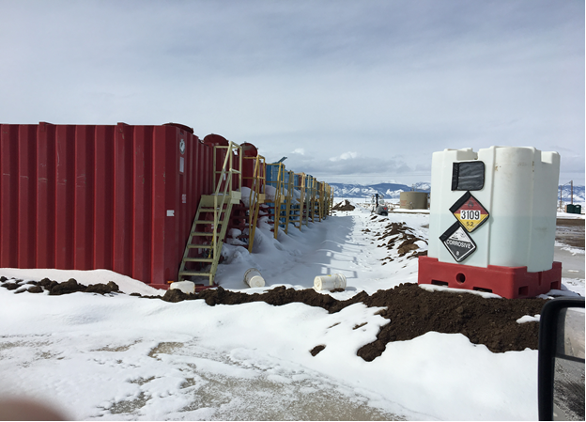
Inspection Photos
Location: Mutual 1-17H
Spill 462655
Inspection Date: 3/11/19
Photos taken by Kris Neidel
Photo 4-Mutual location. Frac tanks stored on location. All tanks were reported to be empty and not in use. Note buckets on ground, the buckets appeared empty. Per the placard on Chem tank, the stored chemical is Peroxide. What is the Peroxide being used for? The Operator should submit a Sundry on duration of the storage of the Frac tanks.
.

