Slide 1
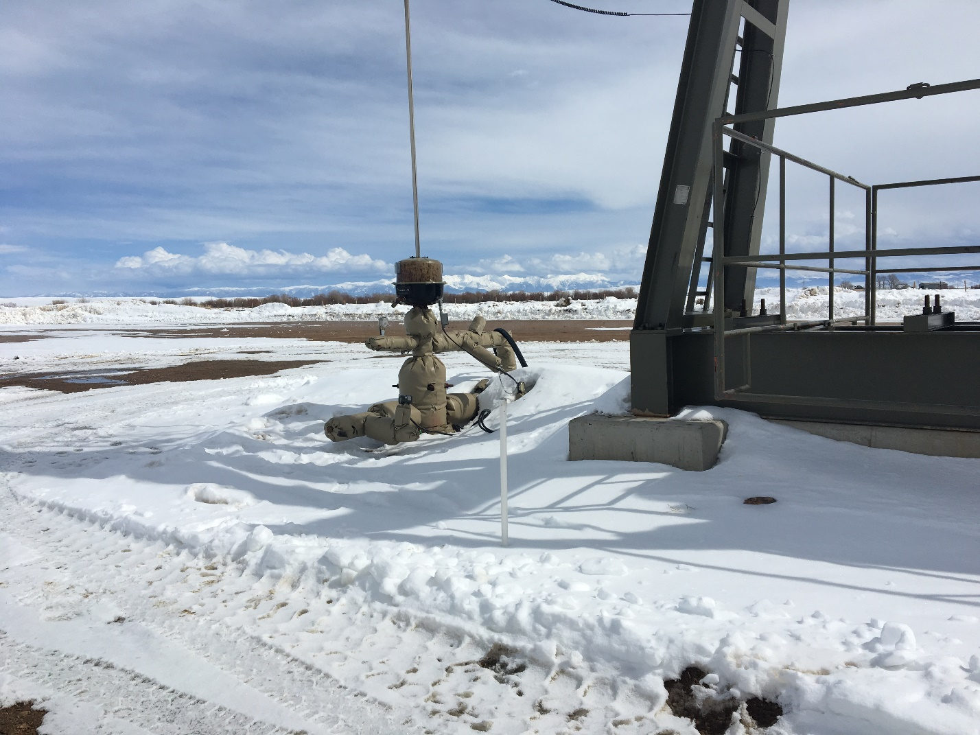
Inspection Photos
Location: Hebron 2-07H
Inspection Date: 3/11/19
Photos taken by Kris Neidel
Photo 1-SI well, note 1” PVC pipe is monitoring well.

