Slide 1
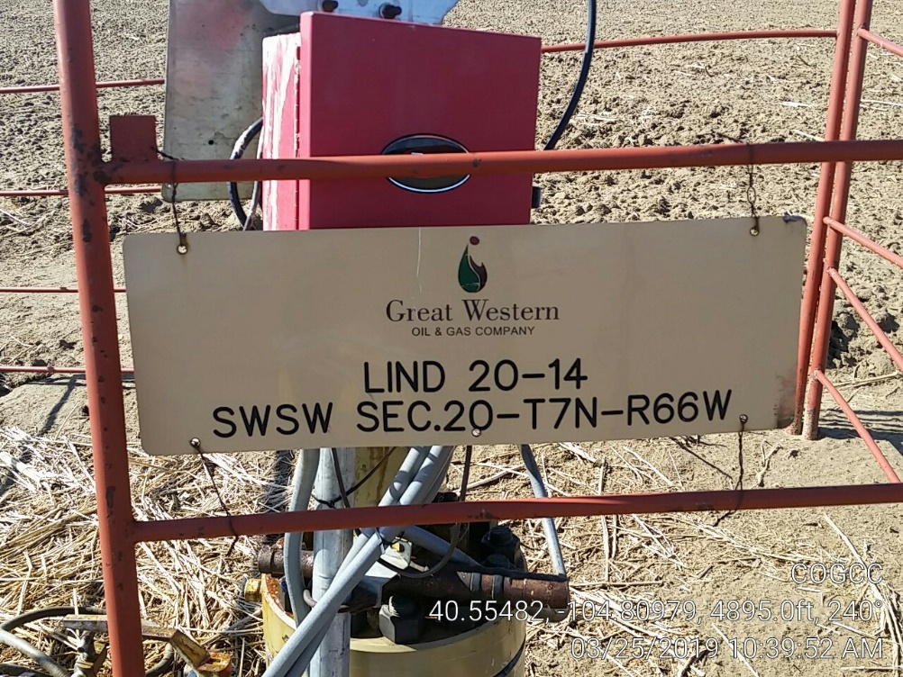
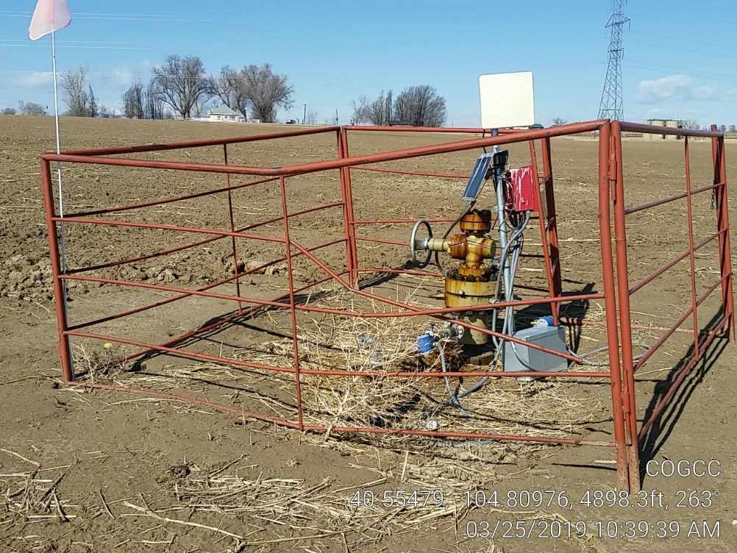
Inspection Photos
Location Name: Lind 20-14
Location ID: 302376
Photo 1 – Wellhead sign
Photo 2 – Wellhead

