Slide 1
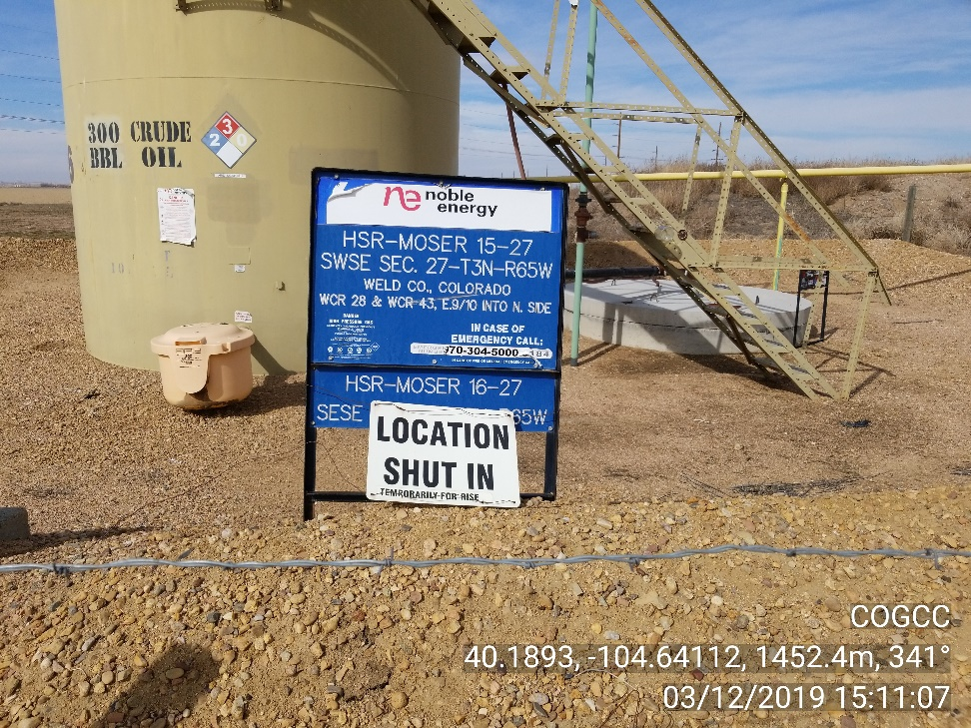
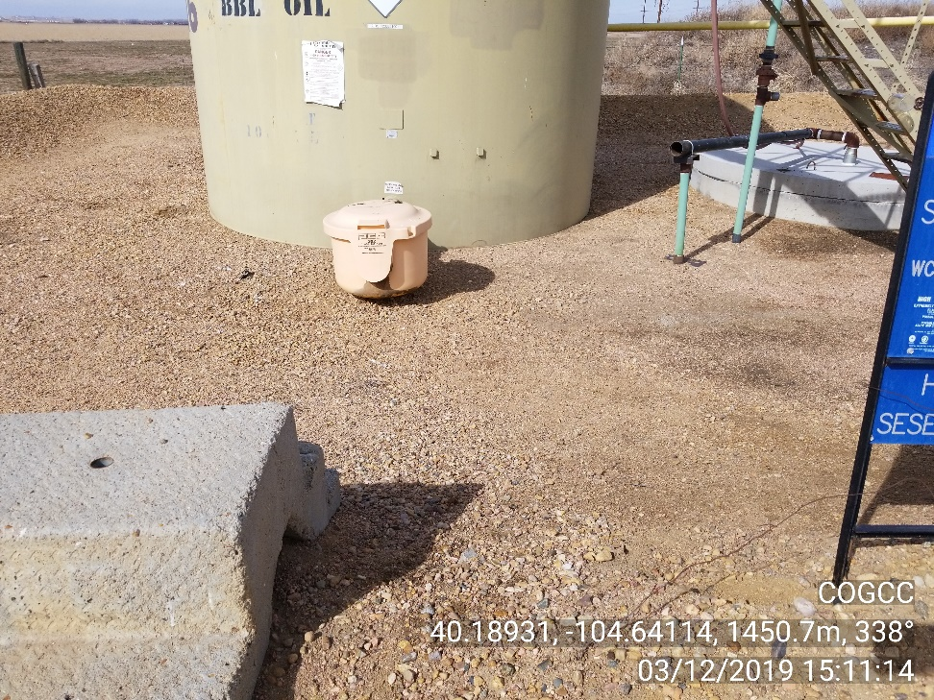
Inspection Photos
Location Name: MOSER, WESLEY E. G. U. B-63N65W
Location ID 406261
Photo 1 – Battery location sign
Photo 2 – Stained soil at load out has been cleaned

Slide 2
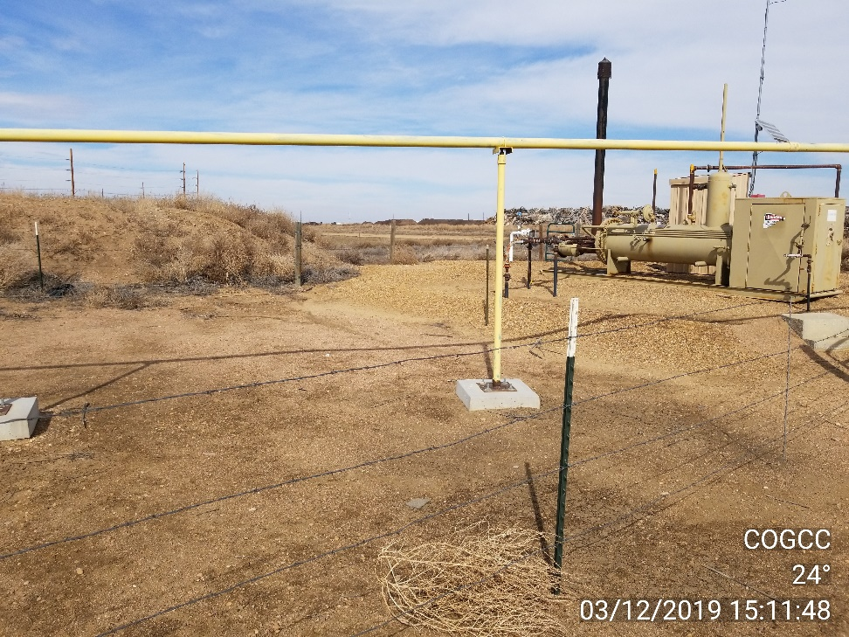
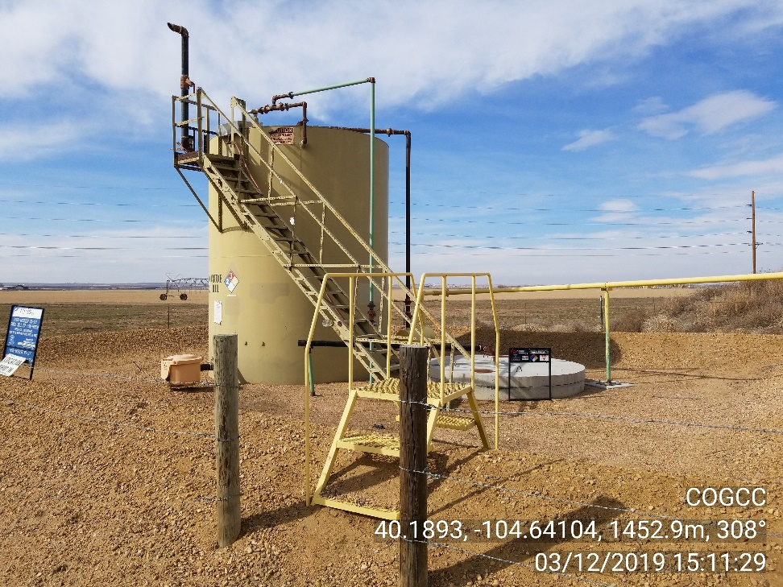
Inspection Photos
Location Name: MOSER, WESLEY E. G. U. B-63N65W
Location ID 406261
Photo 3 – Unused equipment removed
Photo 4 – Site photo

