Slide 1
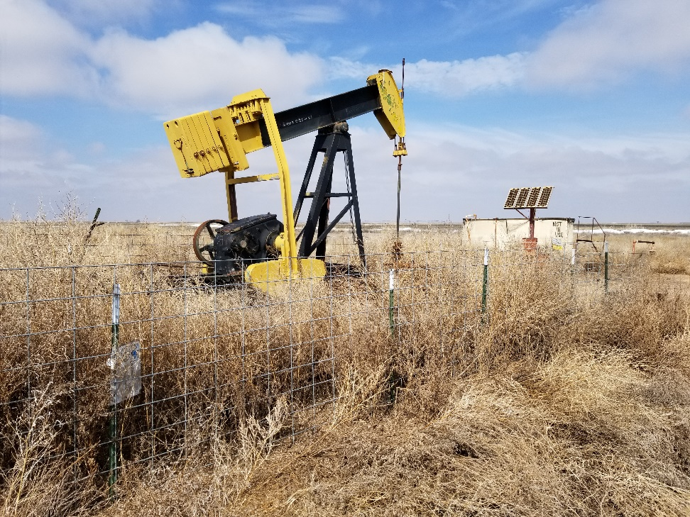
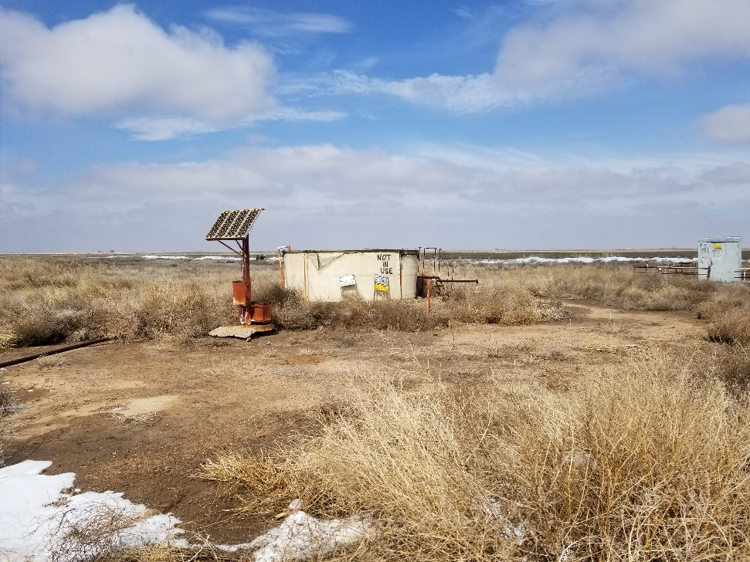
Inspection Photos
Location Name: Hume 1
API: 05-009-06118
1. Weeds in fence around wellhead and unit
2. Weeds across location. No berms around water tank. Tank was empty at time of inspection.

Slide 2
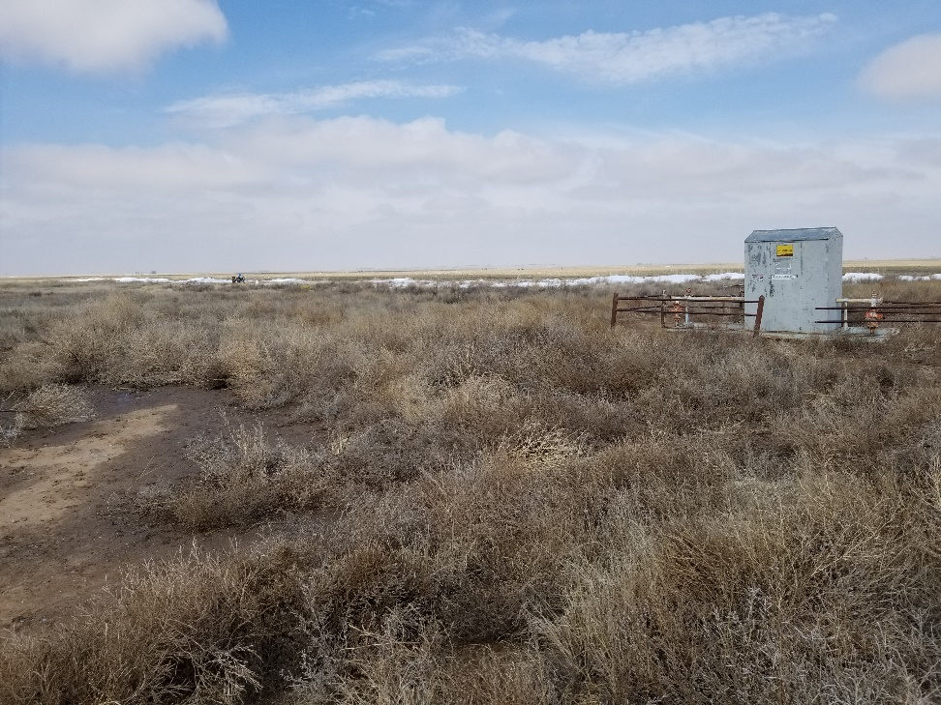
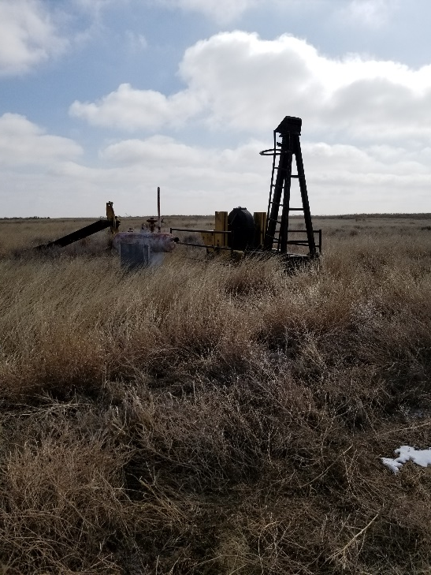
Inspection Photos
Location Name: Hume 1
API: 05-009-06118
3. Weeds around meter shed
4. Unused equipment on east side of location

