Slide 1
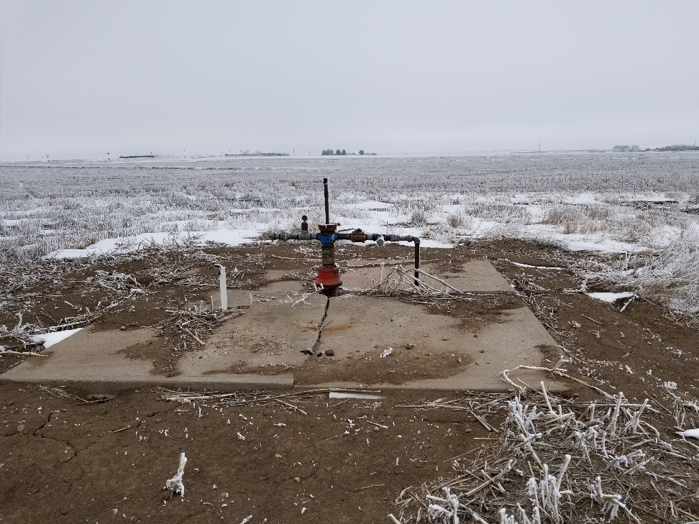
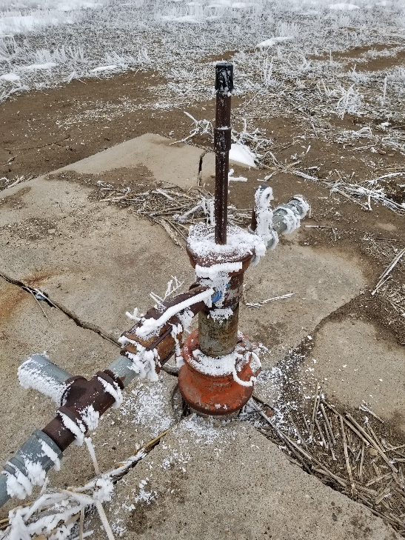
Inspection Photo
Location Name: Melvin Gross
API: 05-063-06088
1. Wellhead
2. Casing valve

