Slide 1
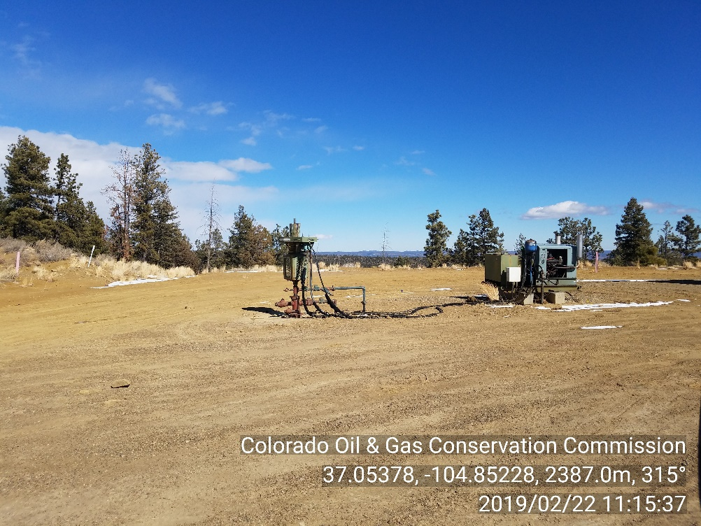
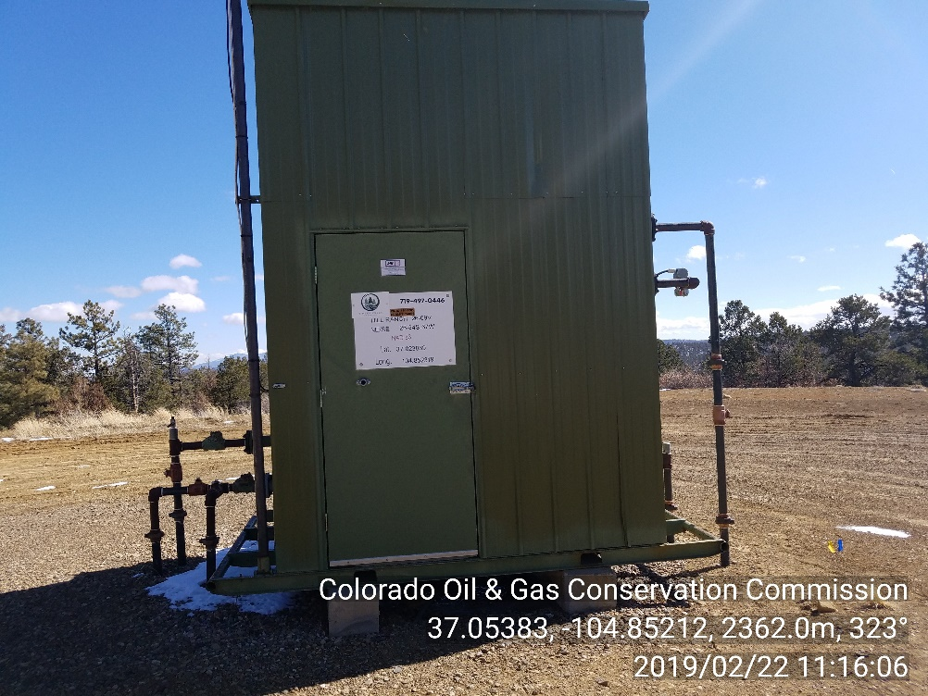
Inspection Photos
Location Name: HILL RANCH 26-09V
API #: 05-071-07359
Insp. Doc. # 695100
PHOTO 1: WELLHEAD
PHOTO 2: WELL SIGN/METER HOUSE

