Slide 1
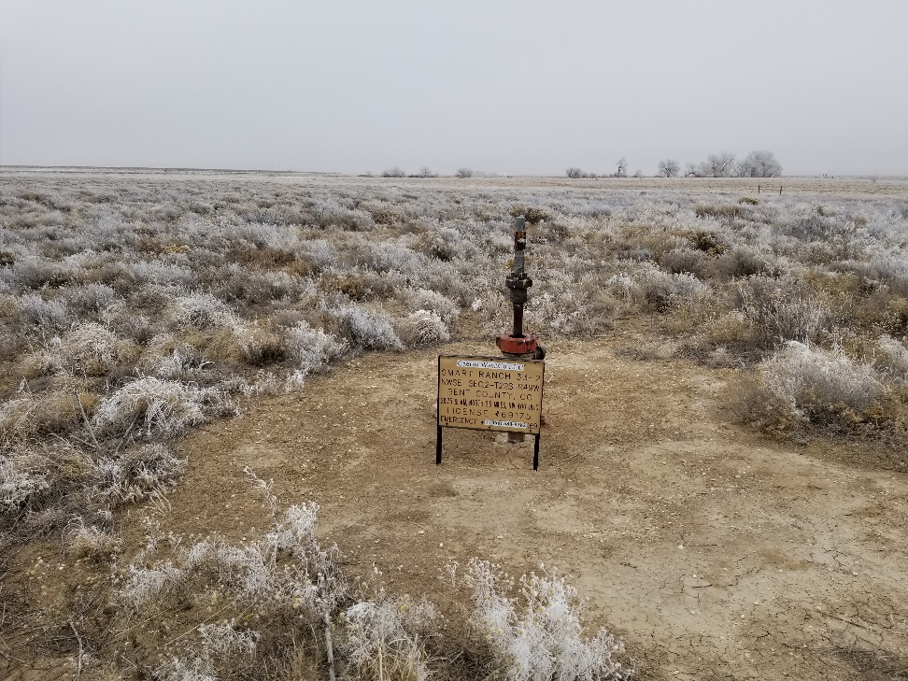
Inspection Photo
Location Name: Smartt Ranch 33-2
API: 05-011-06194
1. Wellhead with (2)- 2” valves for isolation

