Slide 1
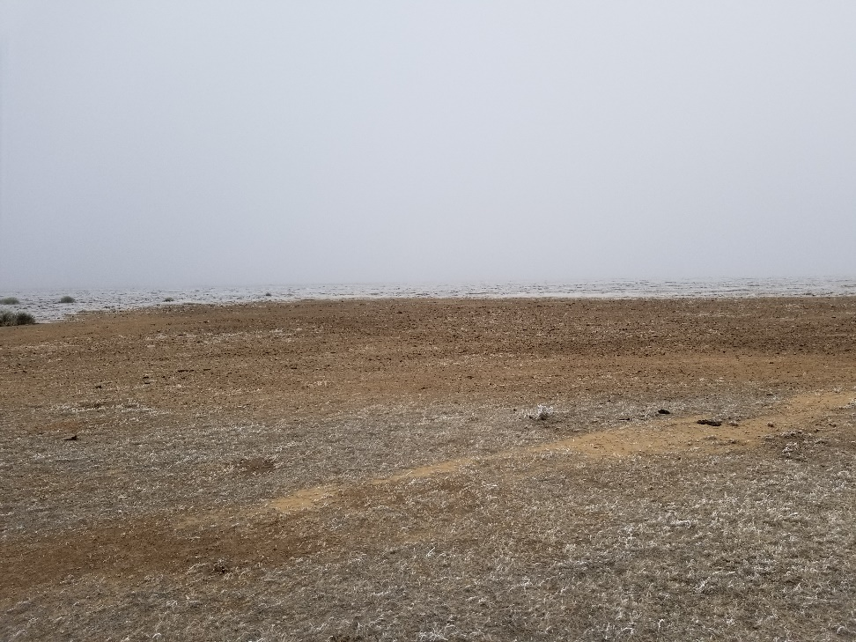
Inspection Photo
Location Name: State 918-S 1
API: 05-011-06018
1. Location is clean and ready for final reclamation

