Slide 1
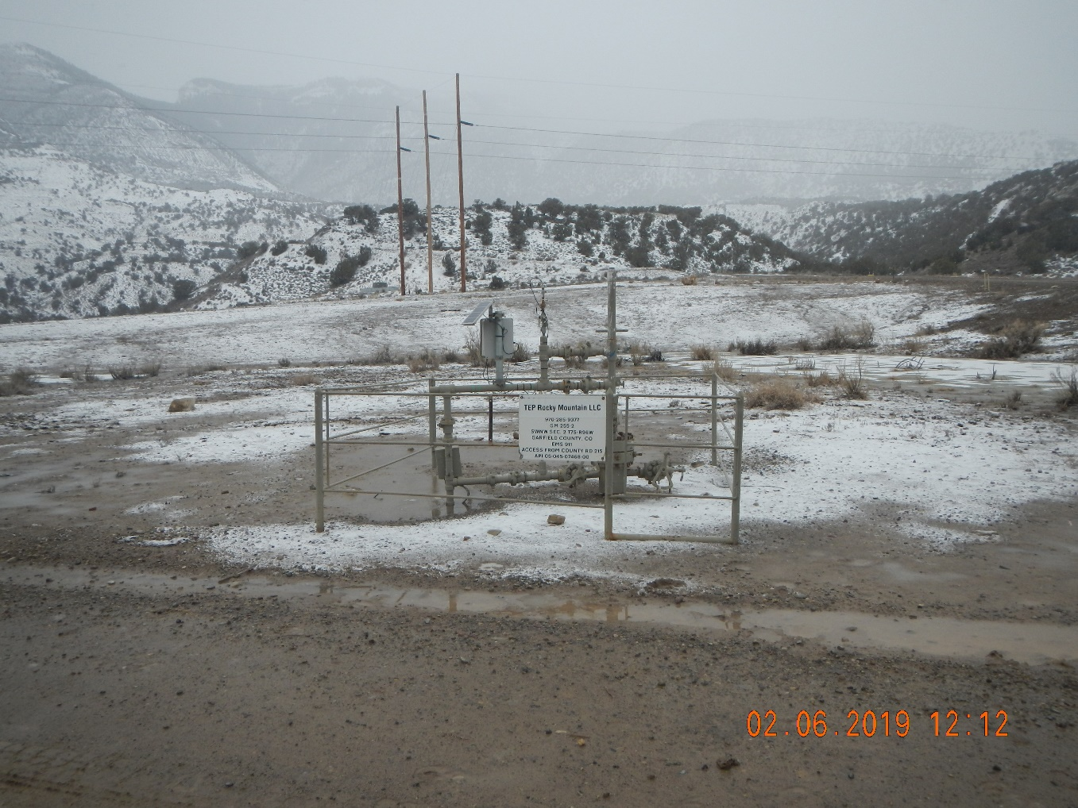
GM 252-2
Api # 05-045-07468
Inspection # 689702556

