Slide 1
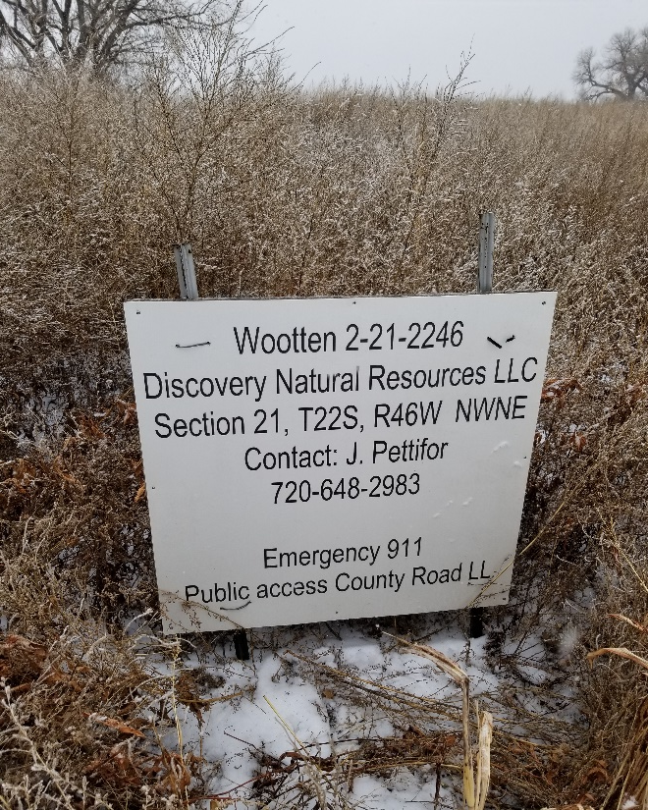
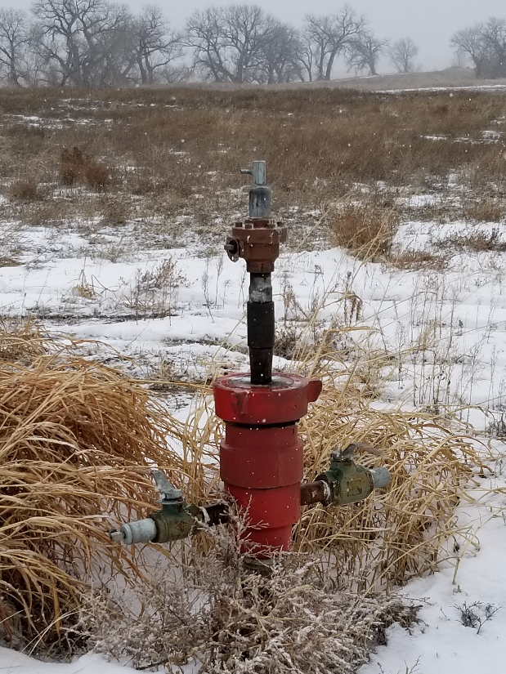
Inspection Photos
Location Name: Wooten 2-21-2246
API: 05-099-06913
1. Update lease sign to current operator
2. Wellhead isolated with ball valve

