Slide 1
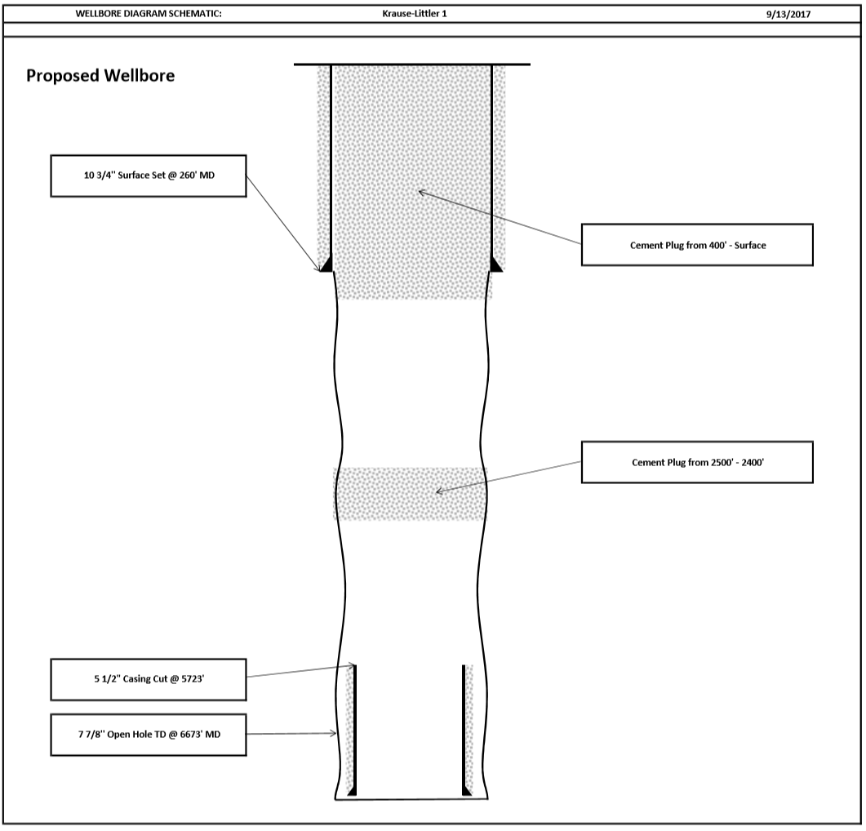
Cement plug from 410’ – surface
245 sacks, 15.8#, neat cmt
Cement plug from 2,507’ – 2,165’
120 sacks, 15.8#, neat cmt

