Slide 1
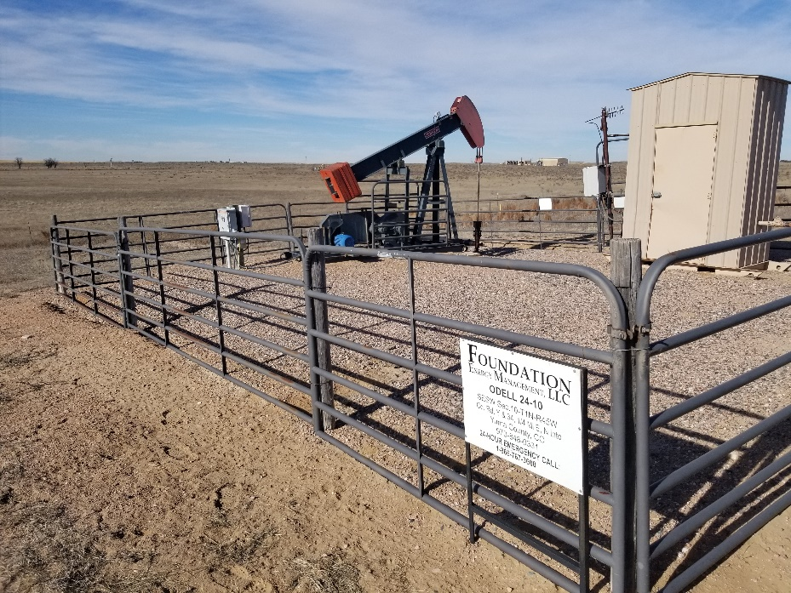
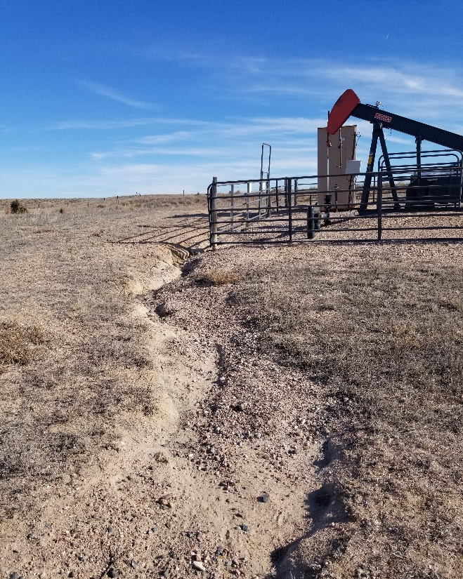
Inspection Photos
Location Name: Odell 24-10
API: 05-125-07827
1. Location photo
2. Erosion off of location to the northwest

