Slide 1
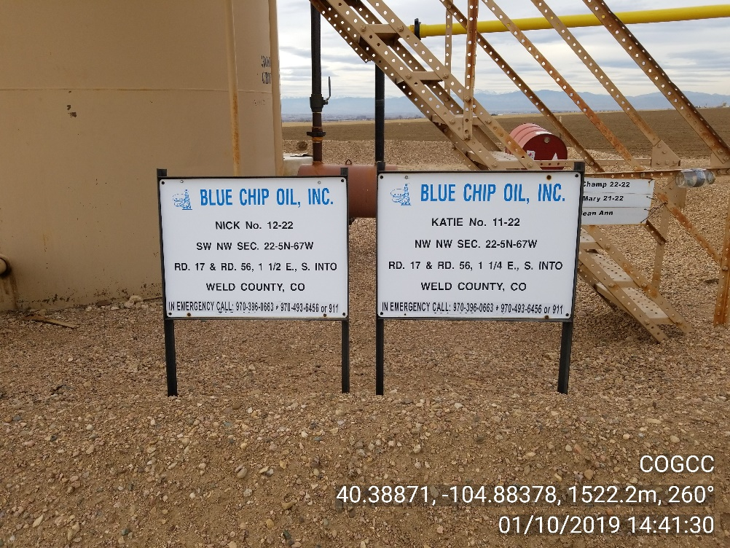
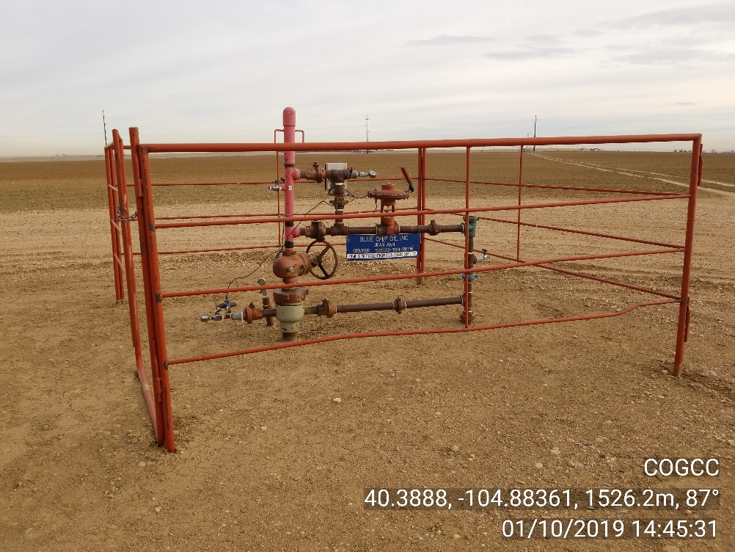
Inspection Photos
Location Name: Jean Ann 25-22 - Shared Tank Battery w/ Nick 12-22, Katie 11-22
Location ID API 123-22929
Photo 1 – Battery Location Sign
Photo 2 – Jean Ann well site

Slide 2
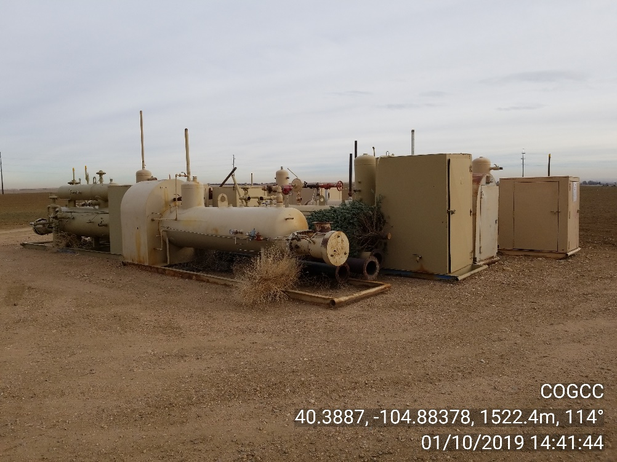
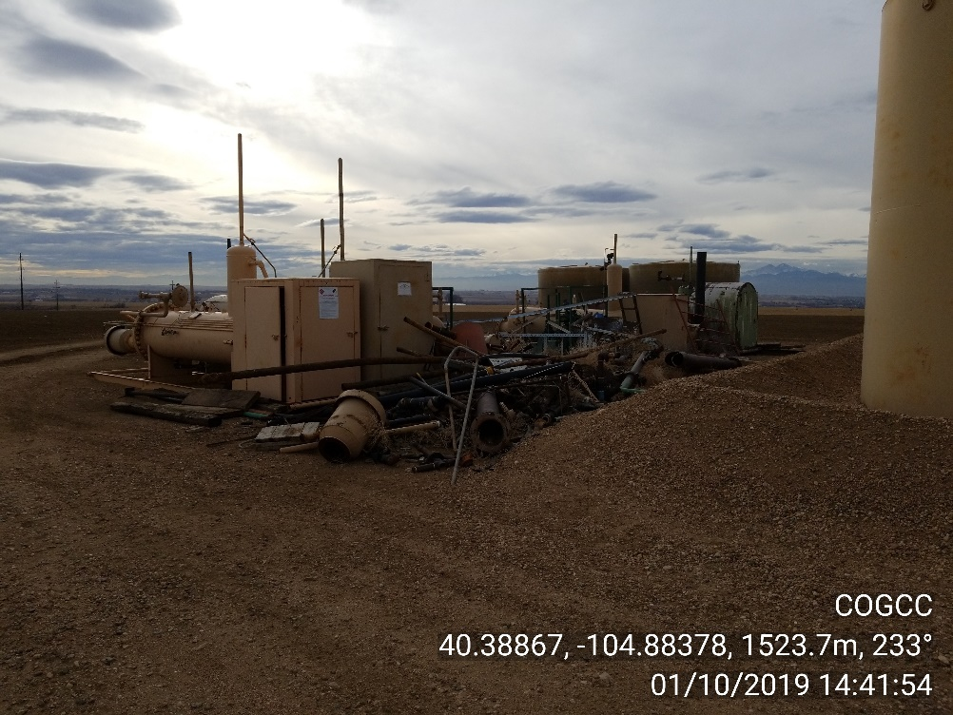
Inspection Photos
Location Name: Jean Ann 25-22 - Shared Tank Battery w/ Nick 12-22, Katie 11-22
Location ID API 123-22929
Photo 3 – Equipment stored on site
Photo 4 – Equipment stored on site

Slide 3
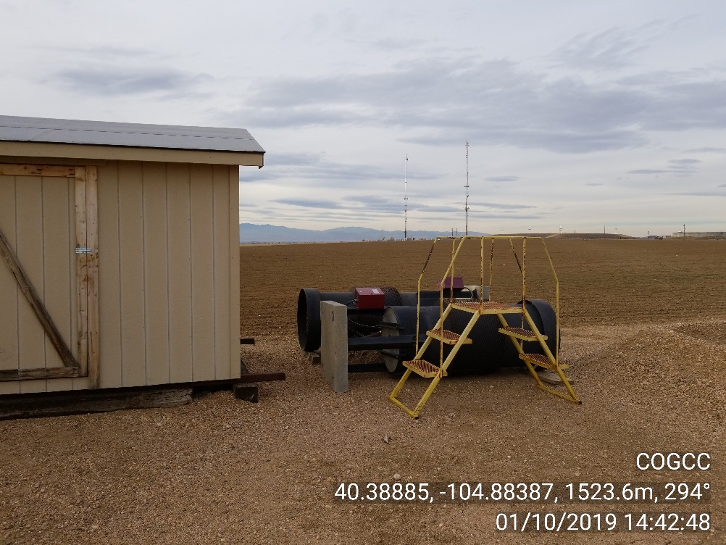
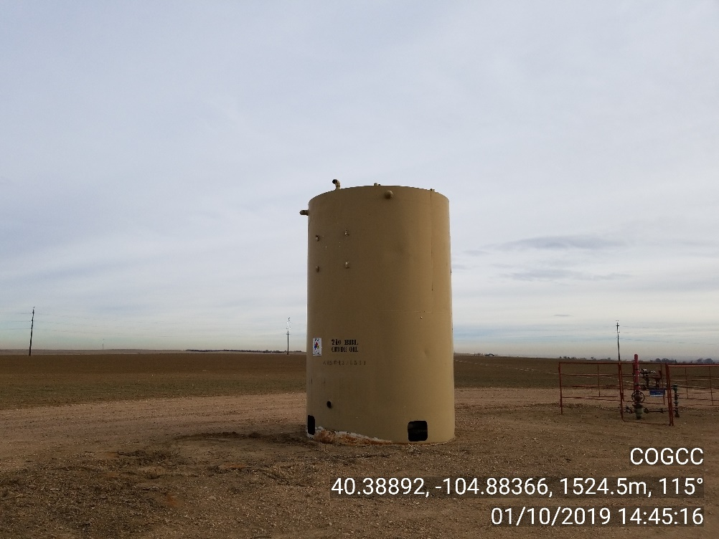
Inspection Photos
Location Name: Jean Ann 25-22 - Shared Tank Battery w/ Nick 12-22, Katie 11-22
Location ID API 123-22929
Photo 5 – Equipment stored on site
Photo 6 – Equipment stored on site

Slide 4
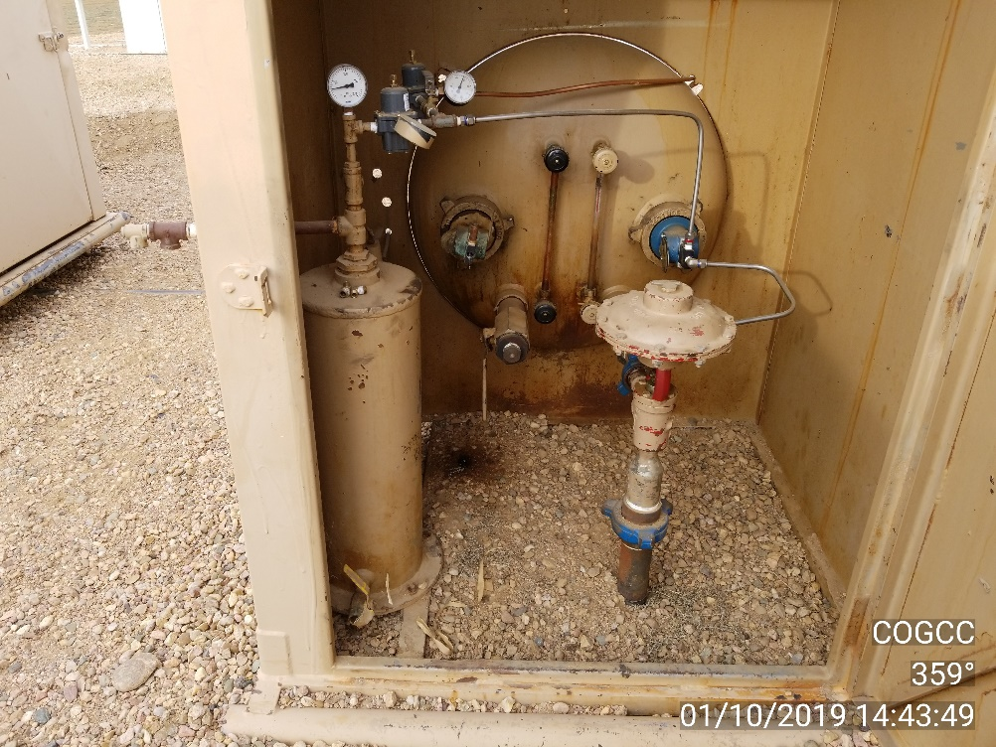
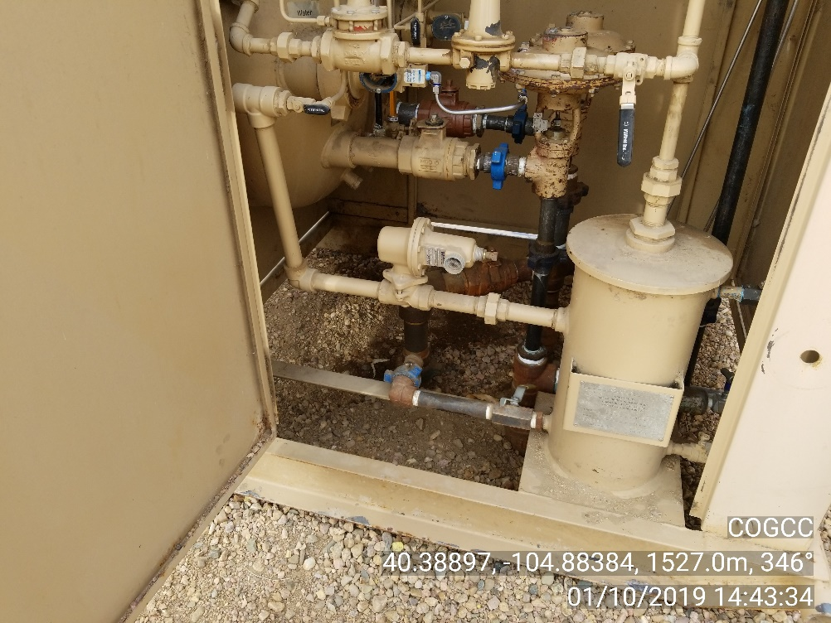
Inspection Photos
Location Name: Jean Ann 25-22 - Shared Tank Battery w/ Nick 12-22, Katie 11-22
Location ID API 123-22929
Photo 7 – Localized stained soil
Photo 8 – Localized stained soil

Slide 5
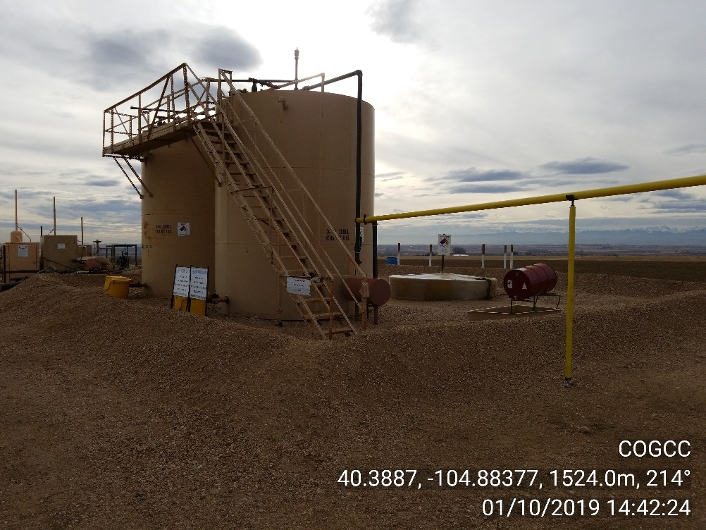
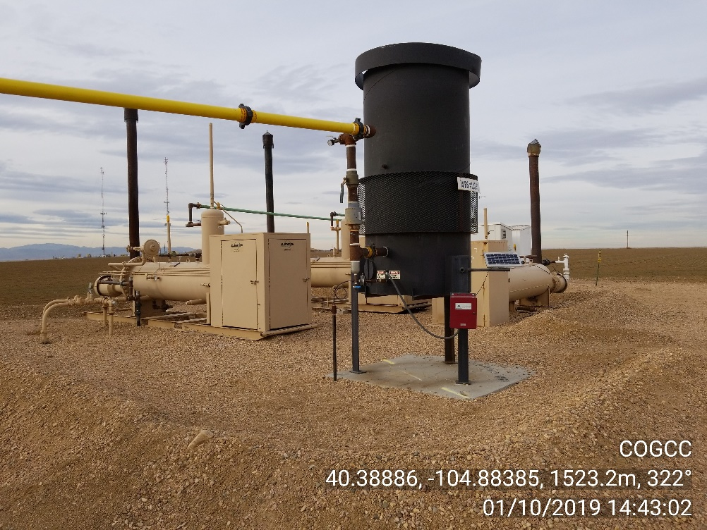
Inspection Photos
Location Name: Jean Ann 25-22 - Shared Tank Battery w/ Nick 12-22, Katie 11-22
Location ID API 123-22929
Photo 9 – Site photo
Photo 10 – Site photo

