Slide 1
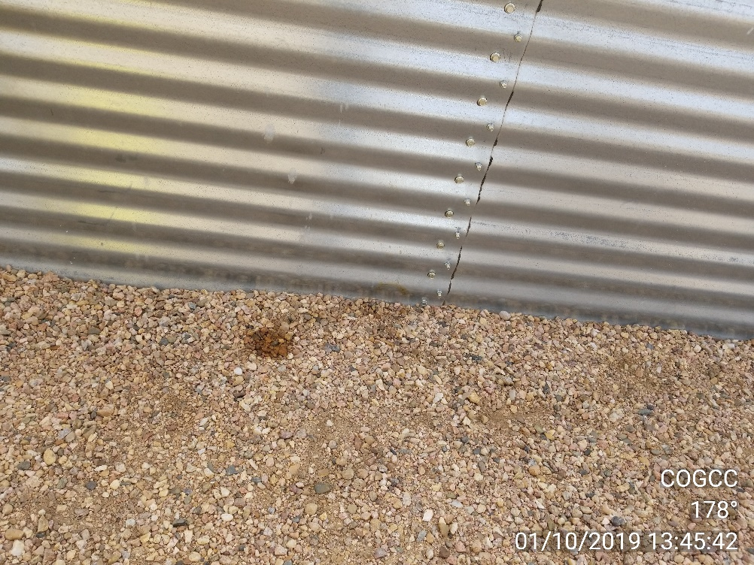
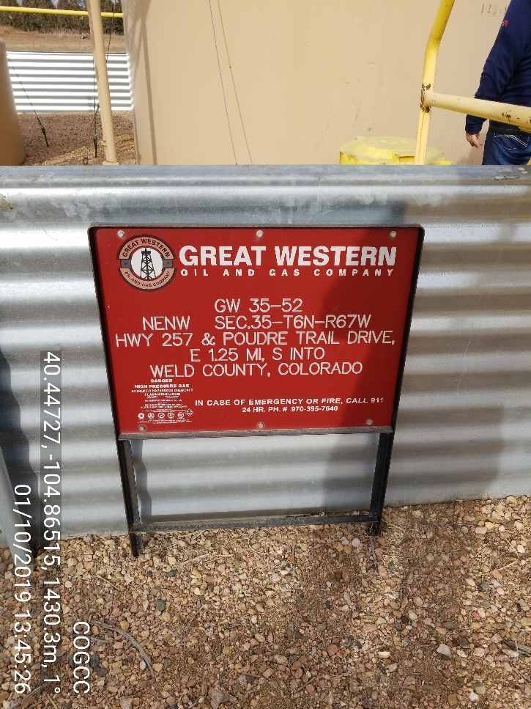
Inspection Photos
Location Name: Great Western # 35-52
Location ID API 123-30748/ Facility ID 446333
Photo 2 – Localized stained soil
Photo 1 – Battery Location Sign

Slide 2
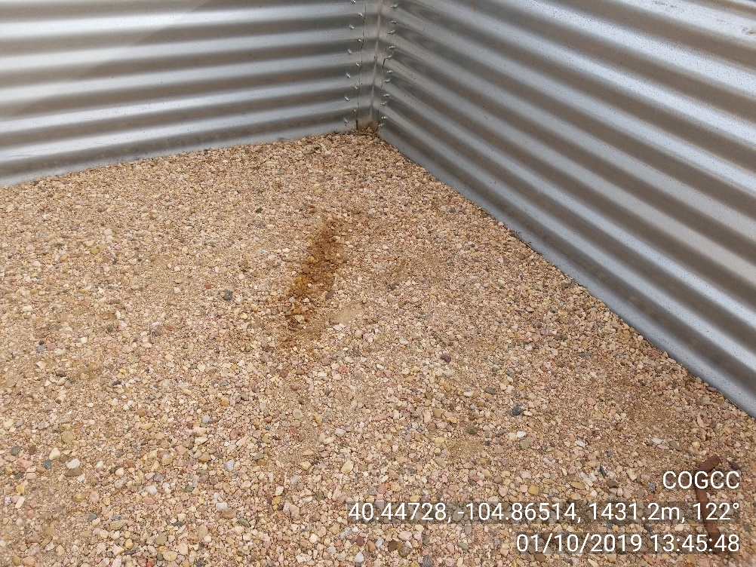
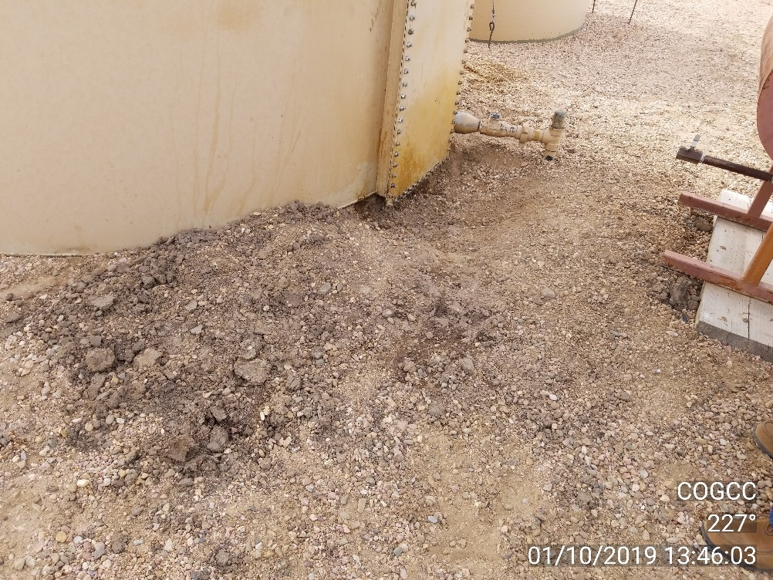
Inspection Photos
Location Name: Great Western # 35-52
Location ID API 123-30748/ Facility ID 446333
Photo 3 – Localized stained soil
Photo 4 – Localized stained soil

Slide 3
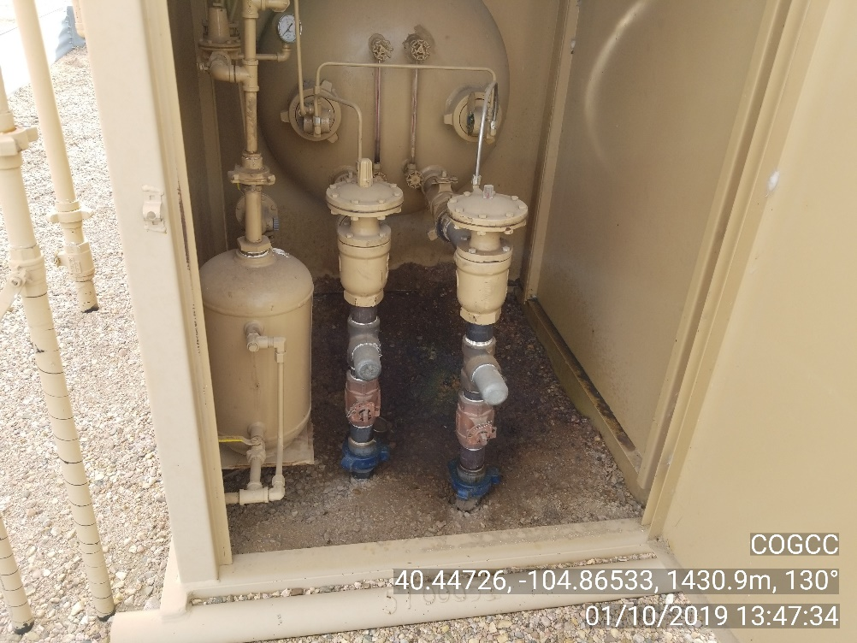
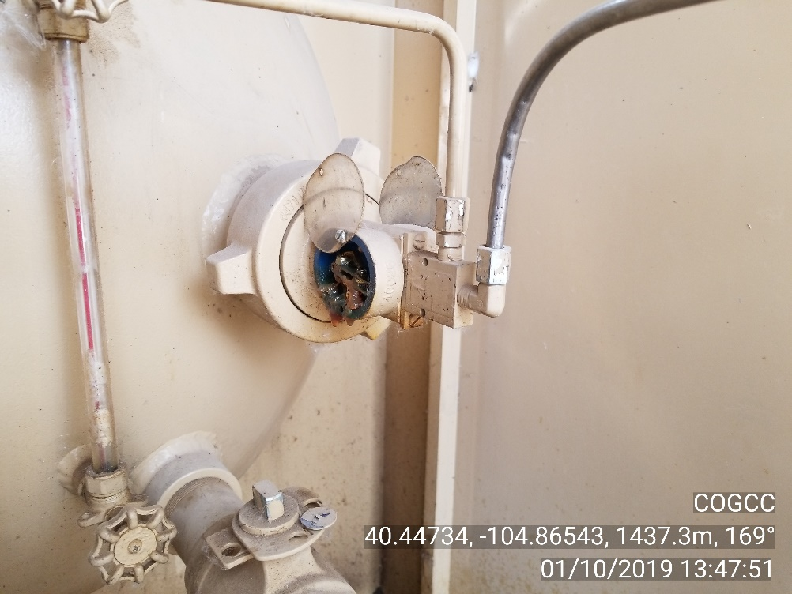
Inspection Photos
Location Name: Great Western # 35-52
Location ID API 123-30748/ Facility ID 446333
Photo 5 – Localized stained soil in separator
Photo 6 – Active drip – source of stained soil in seperator

Slide 4
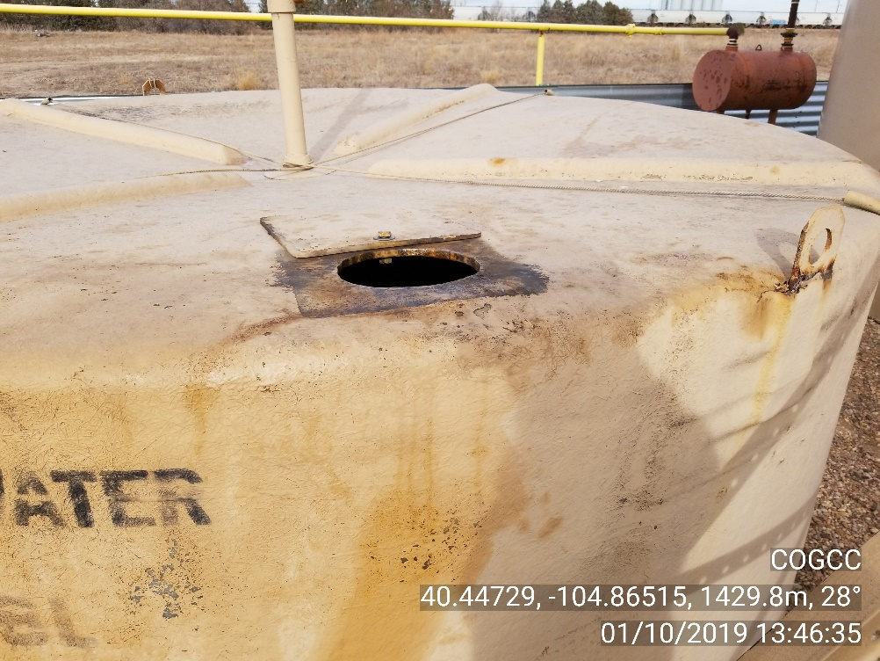
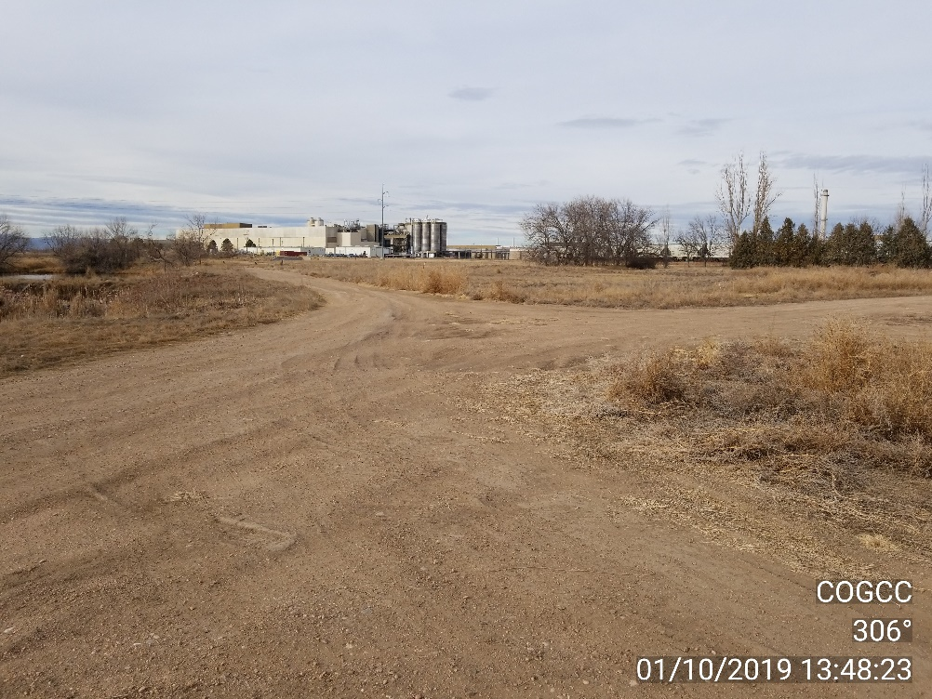
Inspection Photos
Location Name: Great Western # 35-52
Location ID API 123-30748/ Facility ID 446333
Photo 7 – Cover open on produced water tank
Photo 8 – Rutted access road

Slide 5
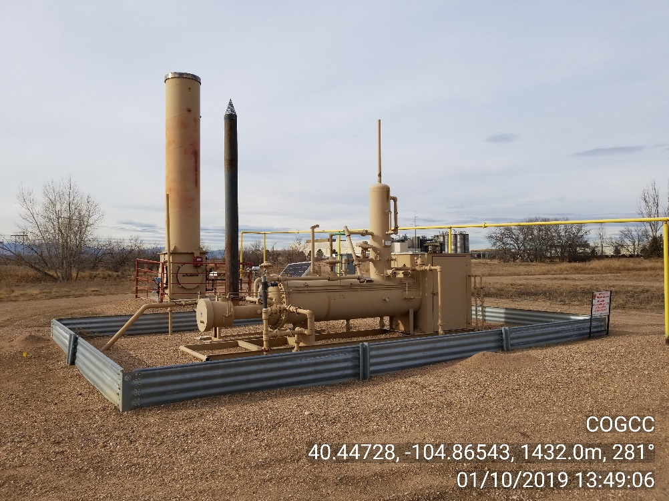
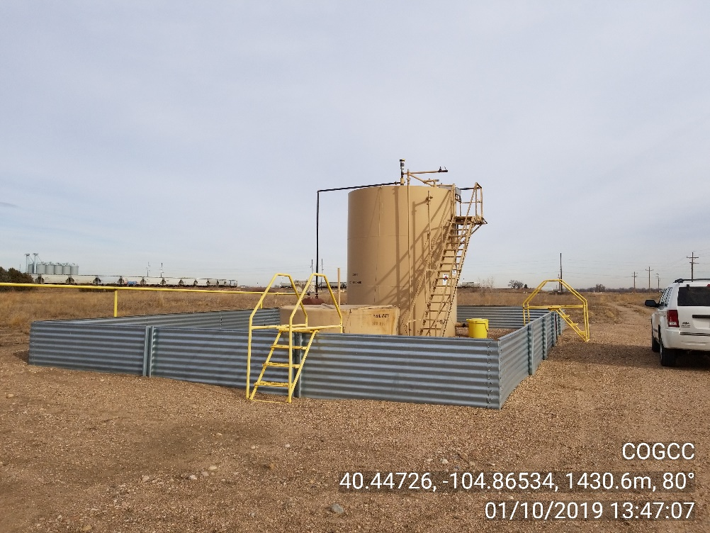
Inspection Photos
Location Name: Great Western # 35-52
Location ID API 123-30748/ Facility ID 446333
Photo 9 – Site photo
Photo 10 – Site photo

Slide 6
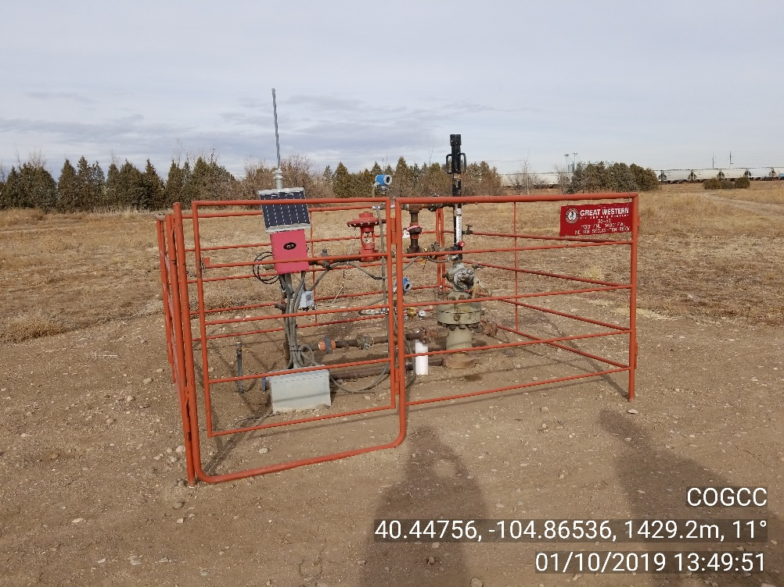
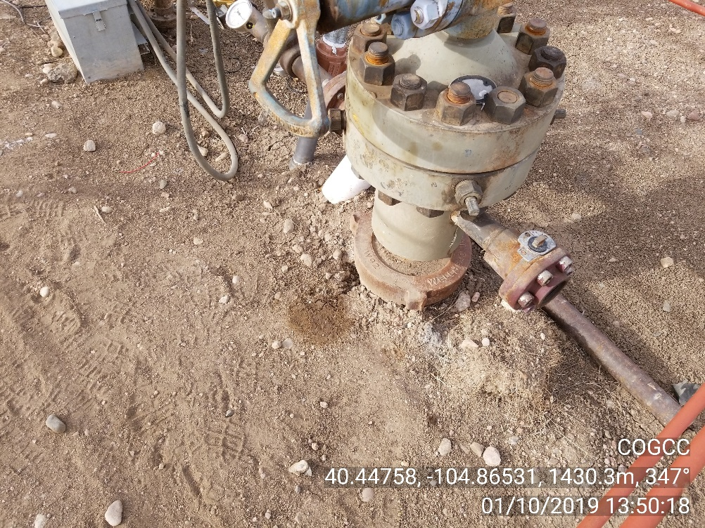
Inspection Photos
Location Name: Great Western # 35-52
Location ID API 123-30748/ Facility ID 446333
Photo 11 – Wellhead photo
Photo 12 – Localized stained soil at wellhead

