Slide 1
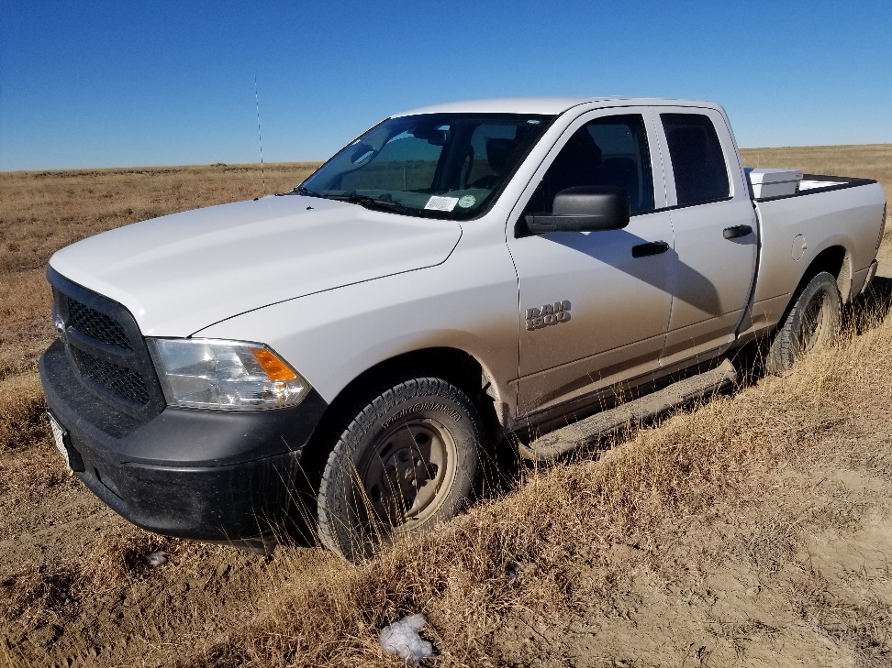
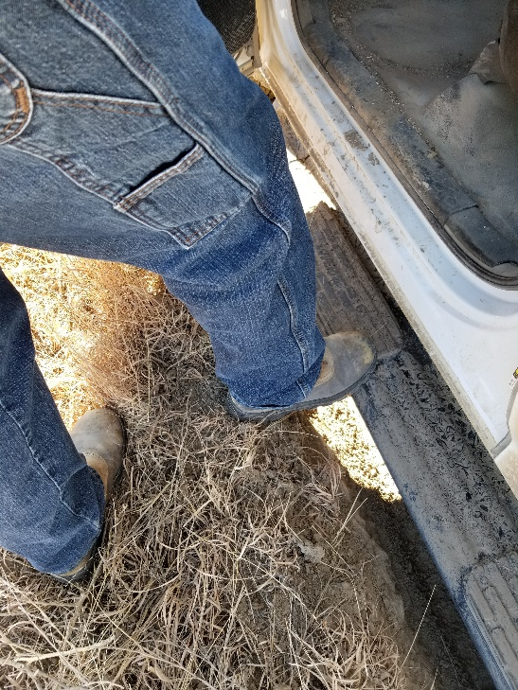
Inspection Photos
Location Name: Castlewood 1-8
API: 05-061-06759
Access has deep tracks. Repair and maintain access

