Slide 1
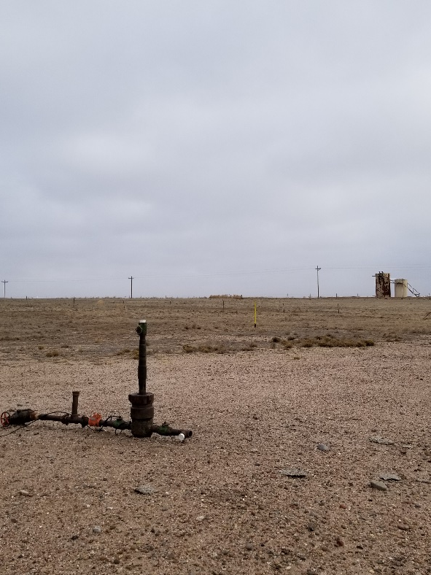
Inspection Photo
Location Name: Speaker-State 43-36 1
API: 05-017-06238
Wellhead

