Slide 1
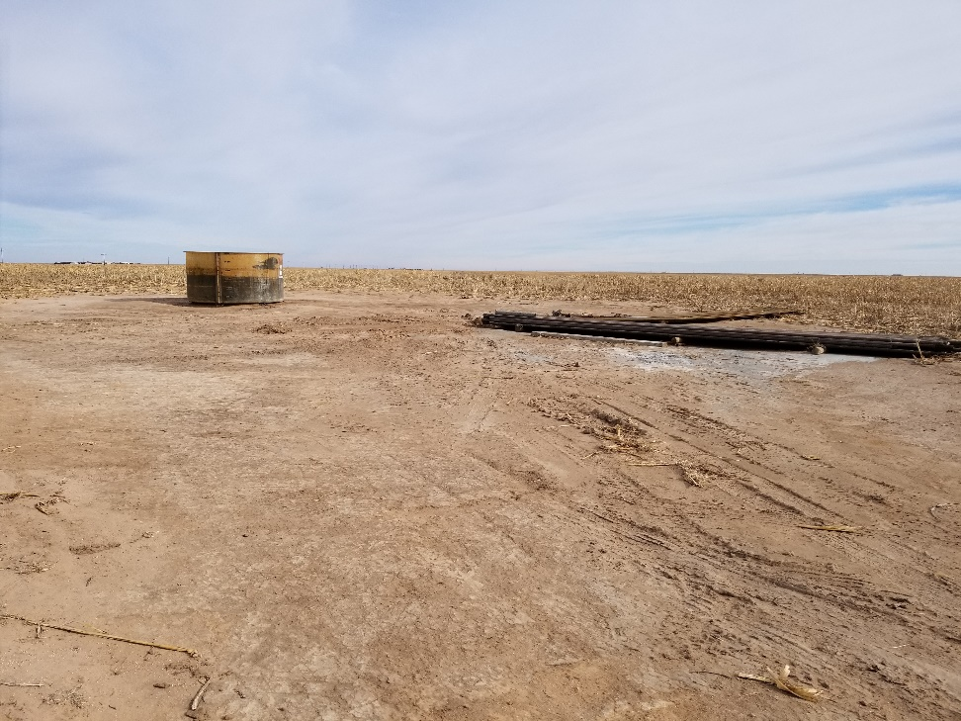
Inspection Photo
Location Name: Cogburn 1-1
API: 05-009-06551
1. Location photo. Unused equipment and water tank on location

