Slide 1
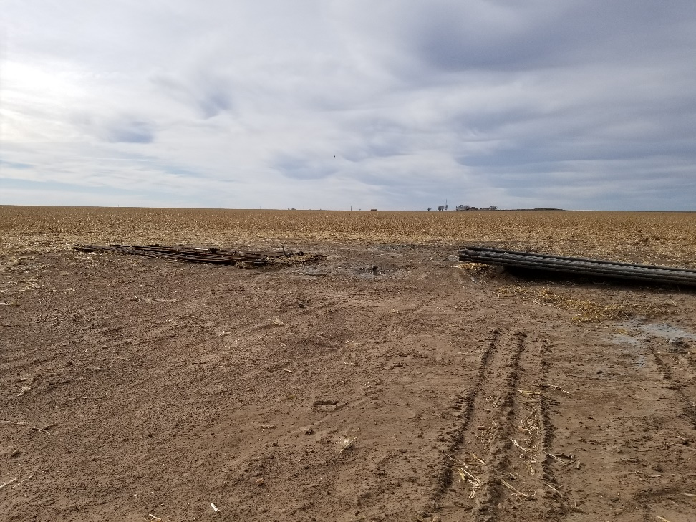
Inspection Photos
Location Name: Hume 1-29
API: 05-009-06555
1. Location photo. Unused equipment on location

