Slide 1
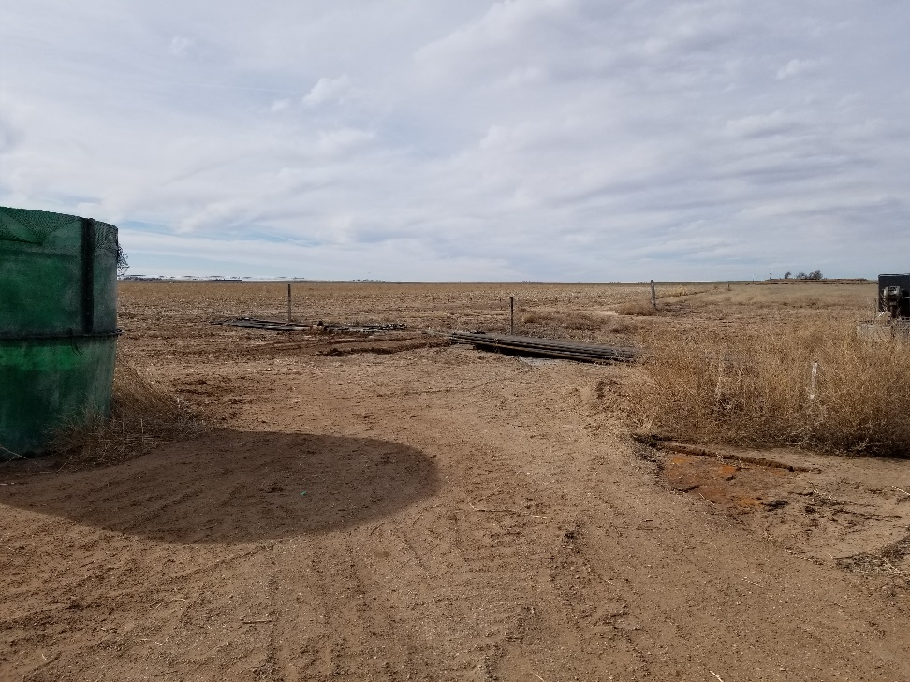
Inspection Photos
Location Name: Konkel 1-4
API: 05-009-06552
1. Location photo. Unused equipment and water tank on location

