Slide 1
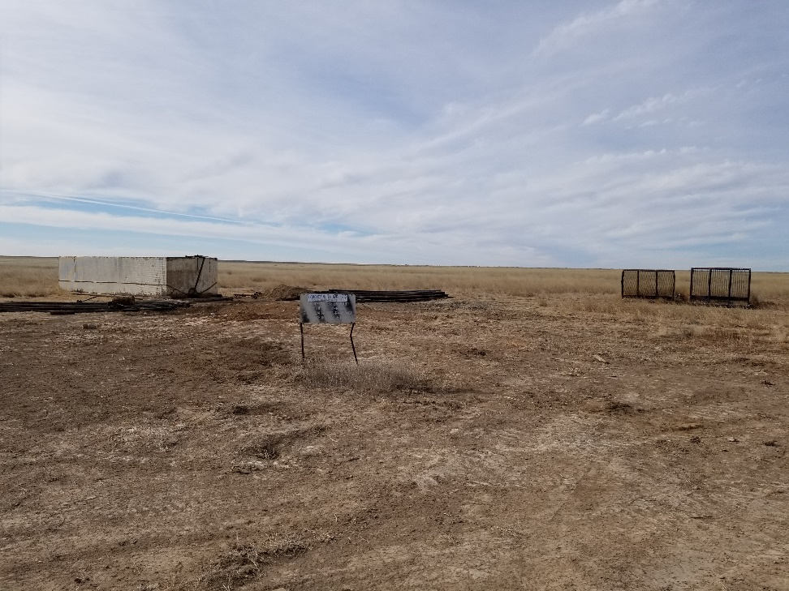
Inspection Photos
Location Name: Lippoldt 1-14
API: 05-009-06553
1. Location photo. Unused equipment and work tank on location

