Slide 1
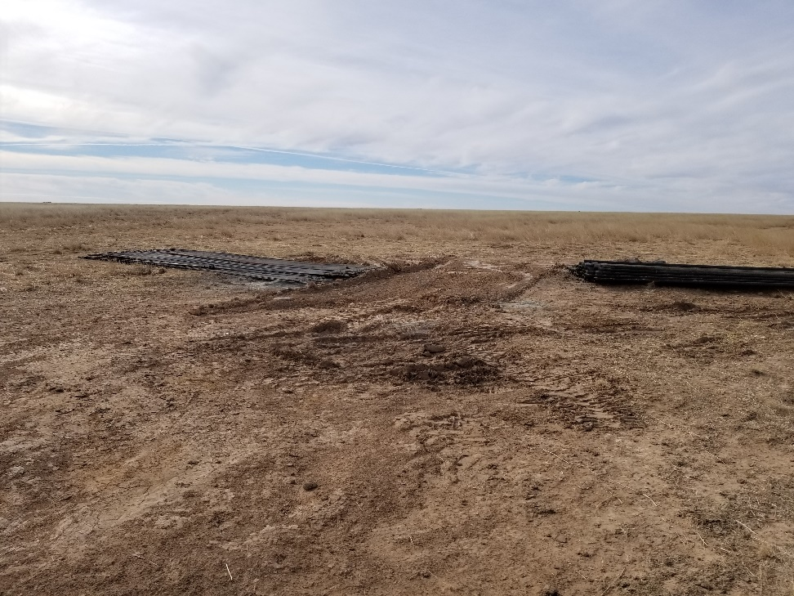
Inspection Photo
Location Name: Lippoldt 1-23
API: 05-009-06554
1. Location photo. Unused equipment still on location

