Slide 1
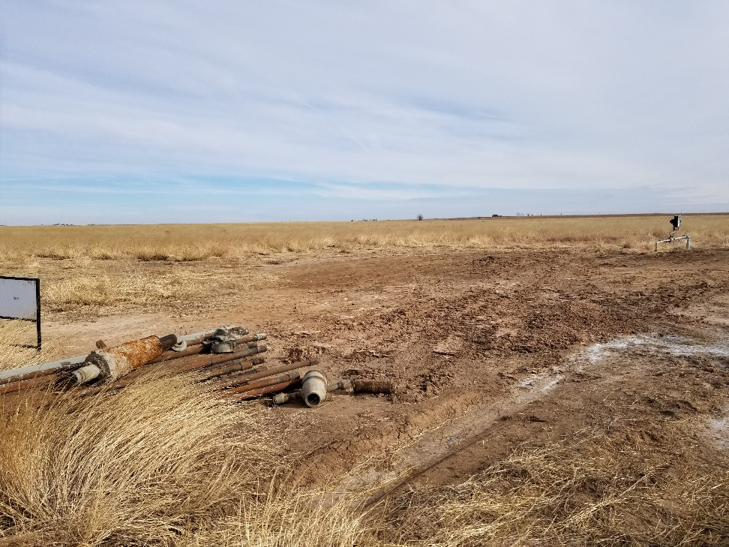
Inspection Photos
Location Name: Harper 1-20
API: 05-009-06573
Location photo. Well is plugged. Equipment still on location

