Slide 1
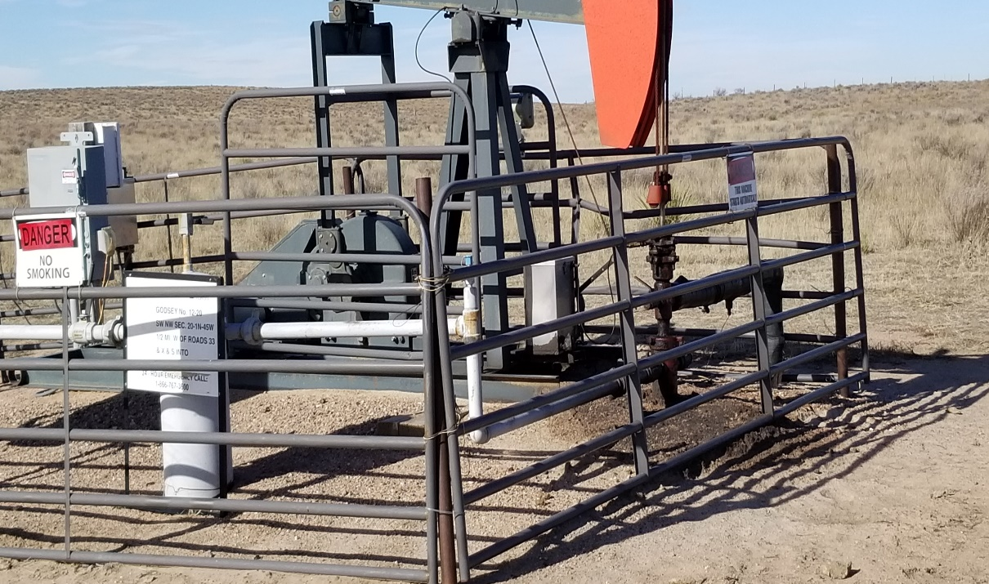
Inspection Photo
Location Name: Godsey 12-20
API: 05-125-09039
1. Stained soil

