Slide 1
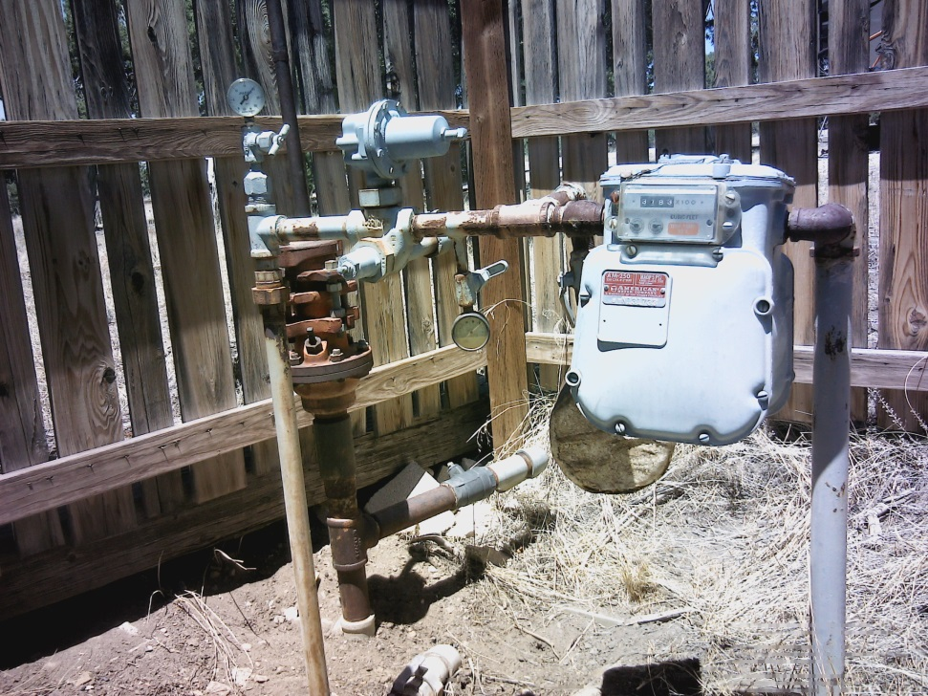
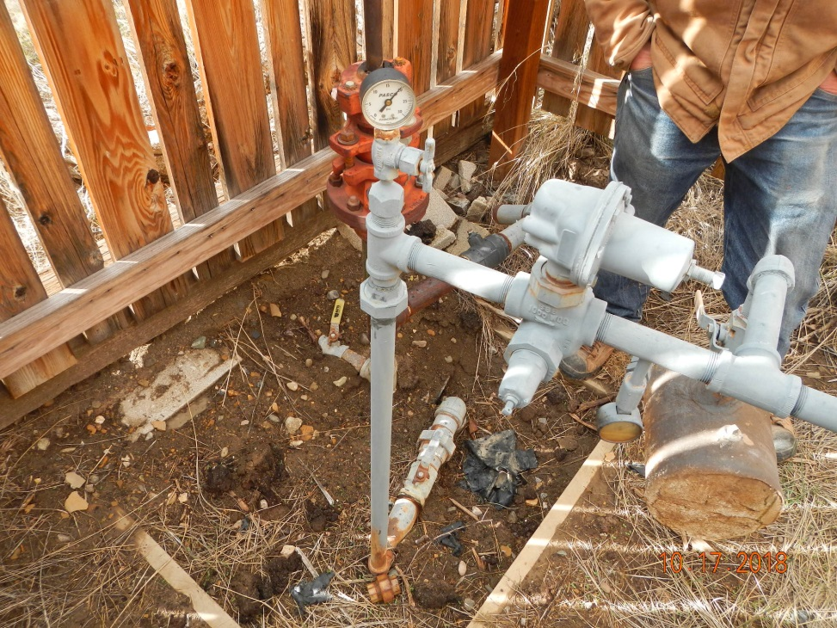

Inspection Photos
Location Name: Huber Culhane 1-32
API: 05-067-06581
Inspection Number: 685200526
Photo 1.
Photo 2.

Slide 2
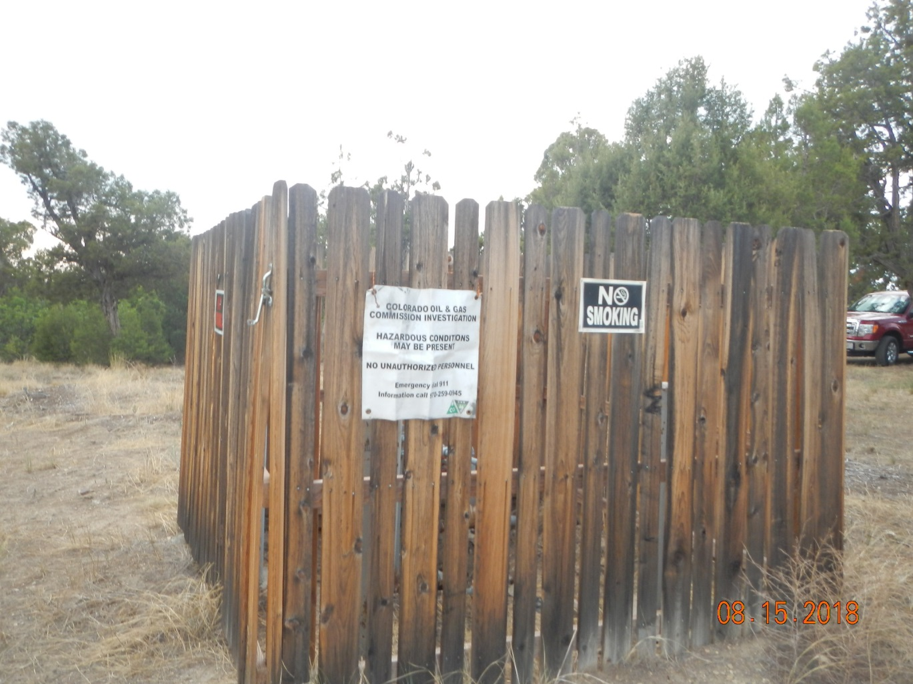
Inspection Photos
Location Name: Huber Culhane 1-32
API: 05-067-06581
Inspection Number: 685200526

