Slide 1
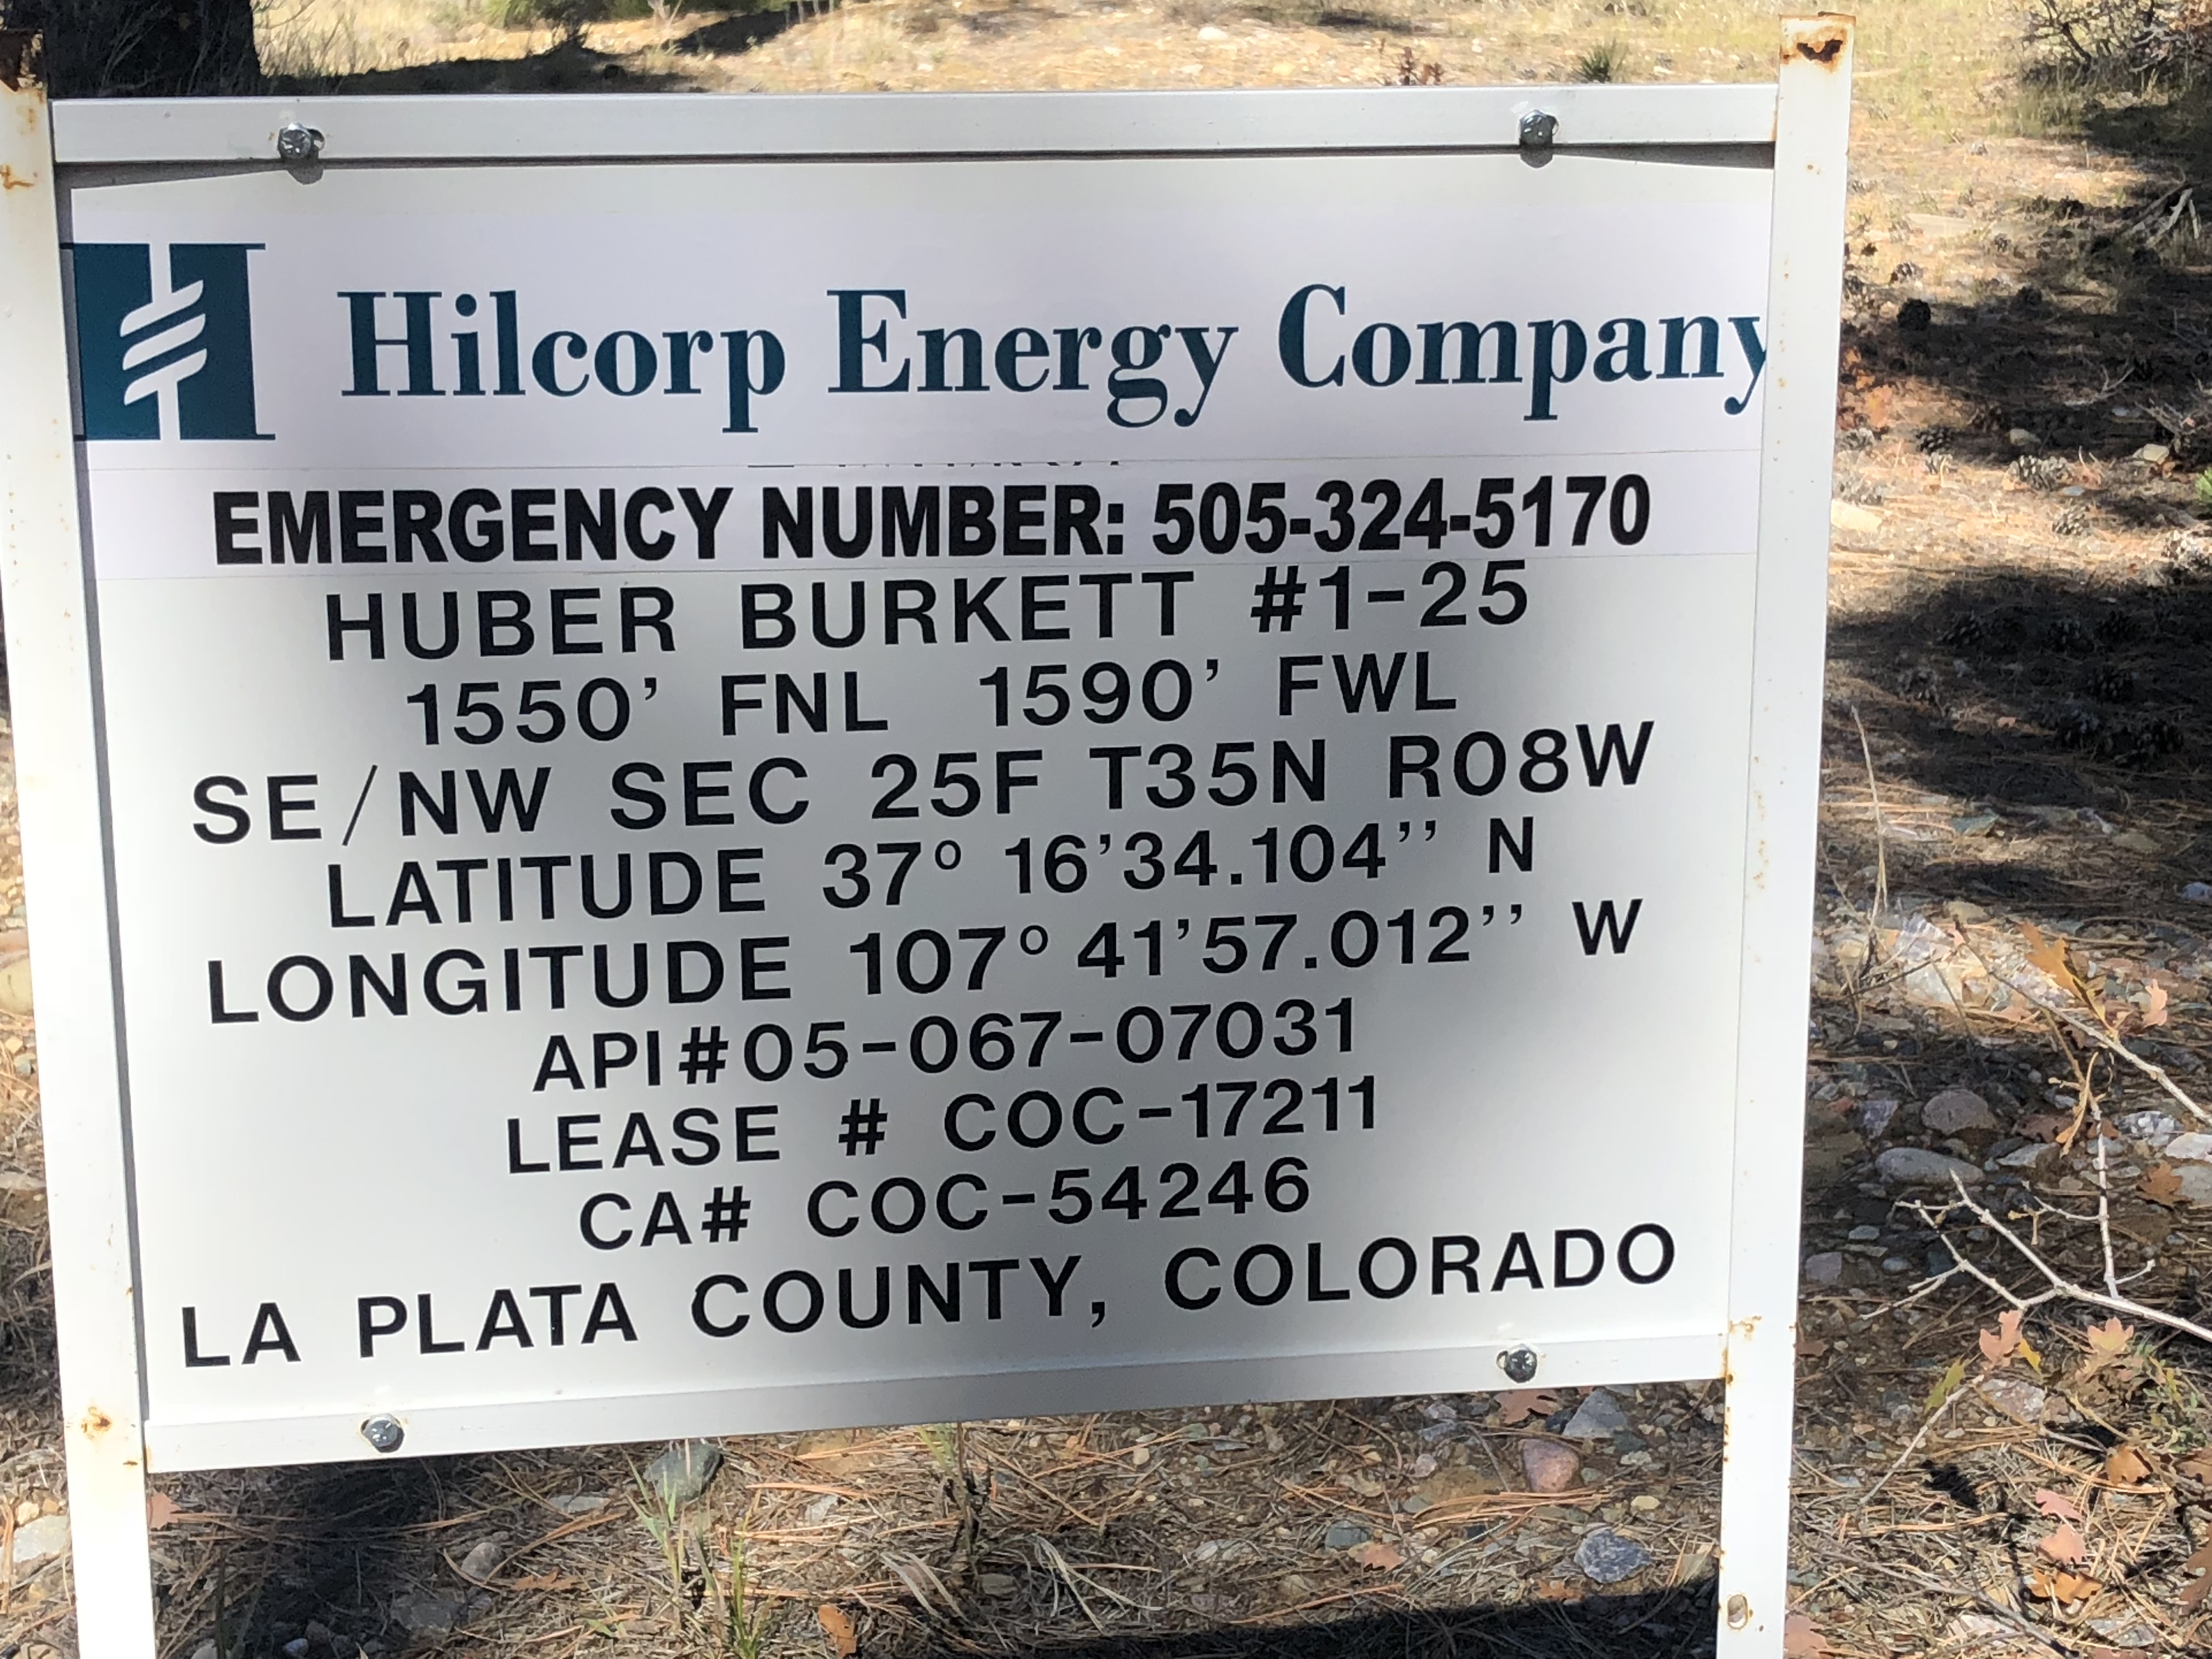
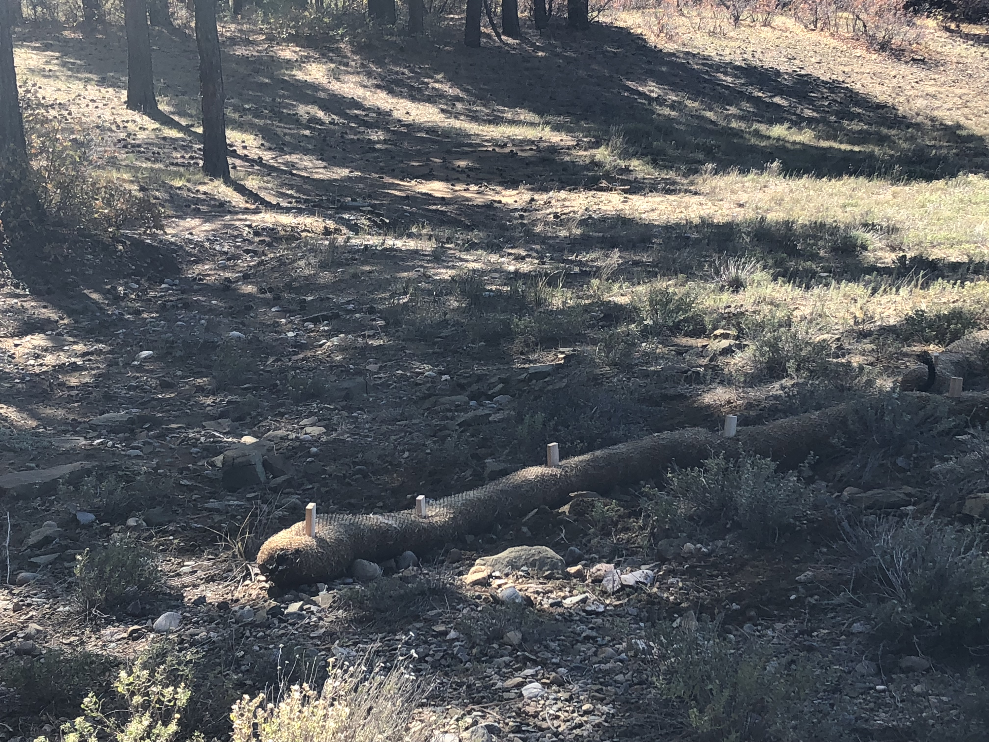
HUBER-BURKETT 1-25
Doc #680603166
BMP wattles installed on the western and southern affected areas of the well pad

Slide 2
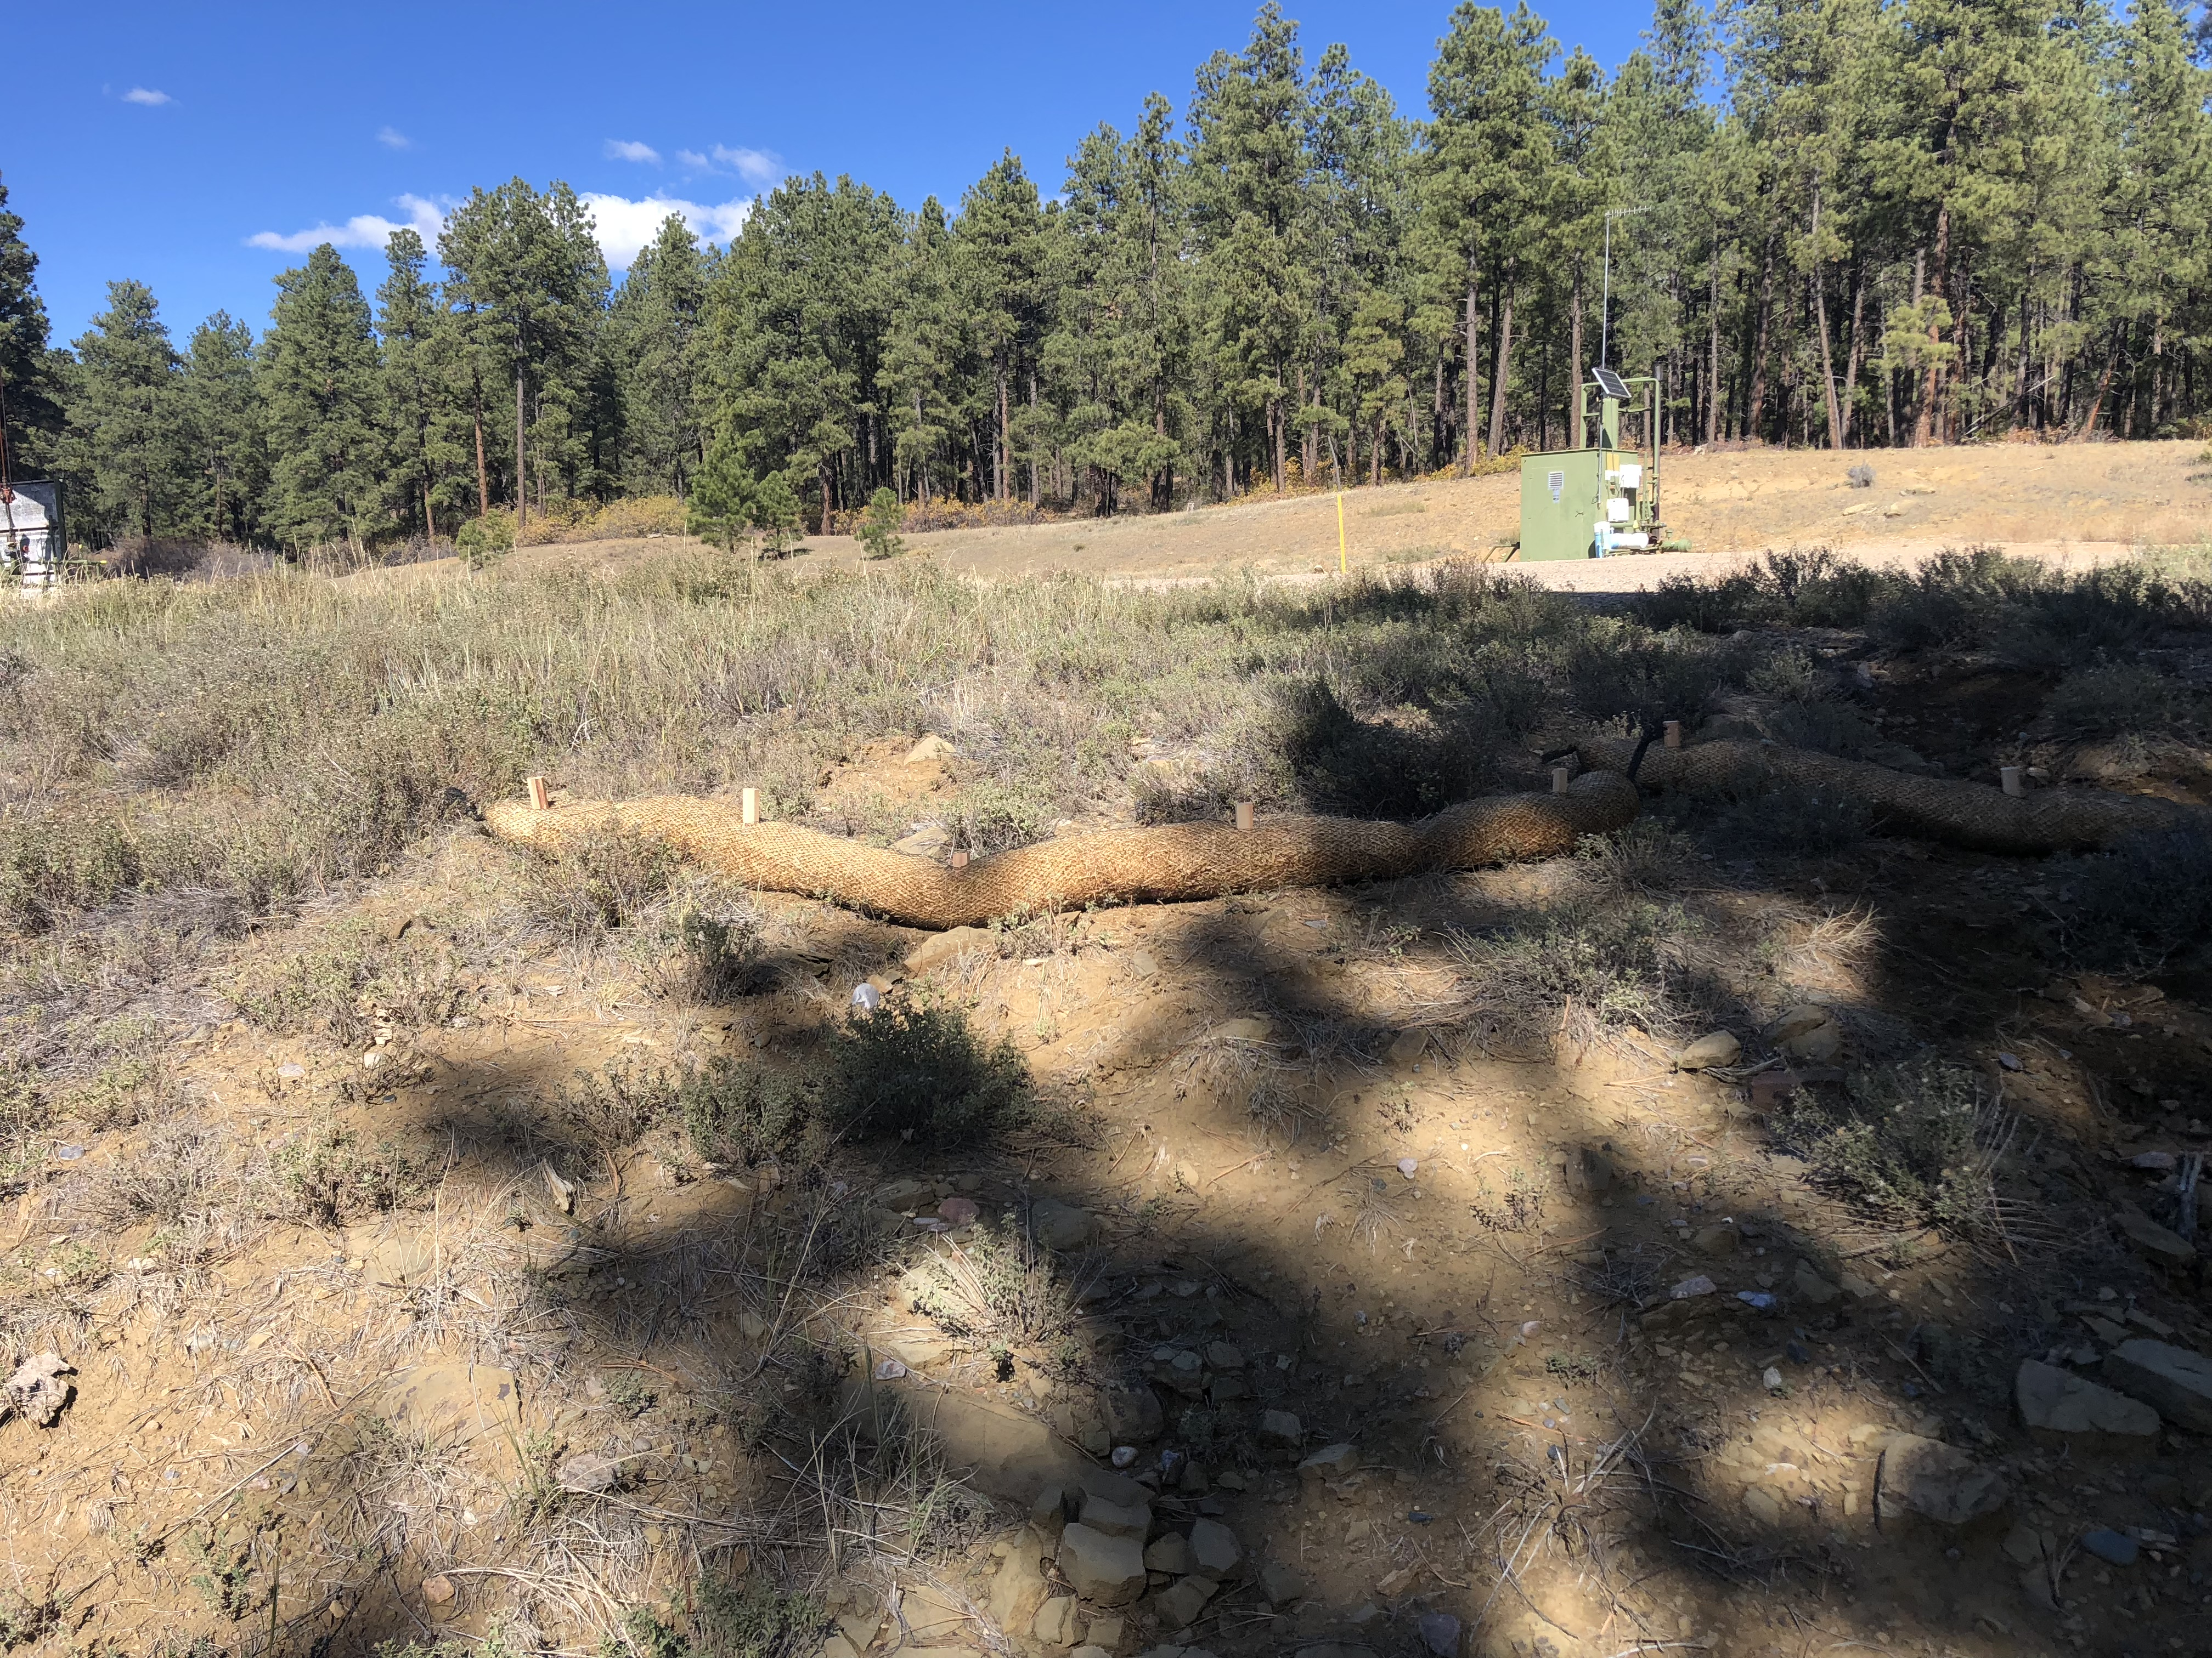
BMP wattles installed on the western and southern affected areas of the well pad

