Slide 1
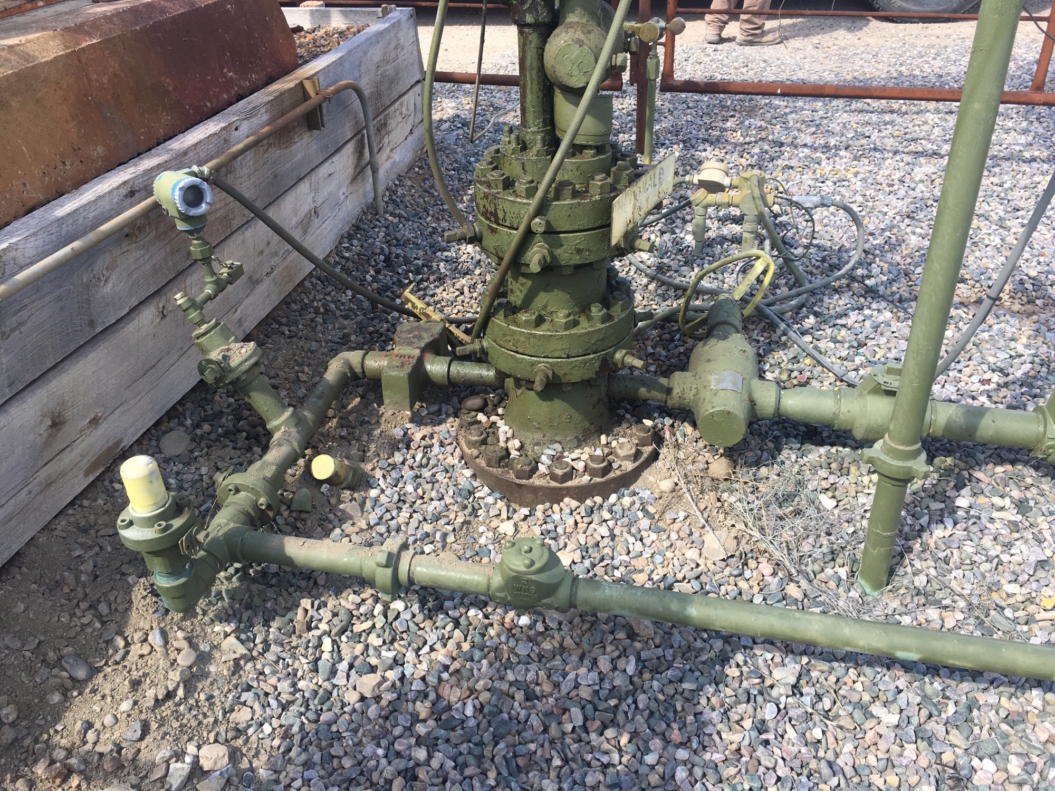
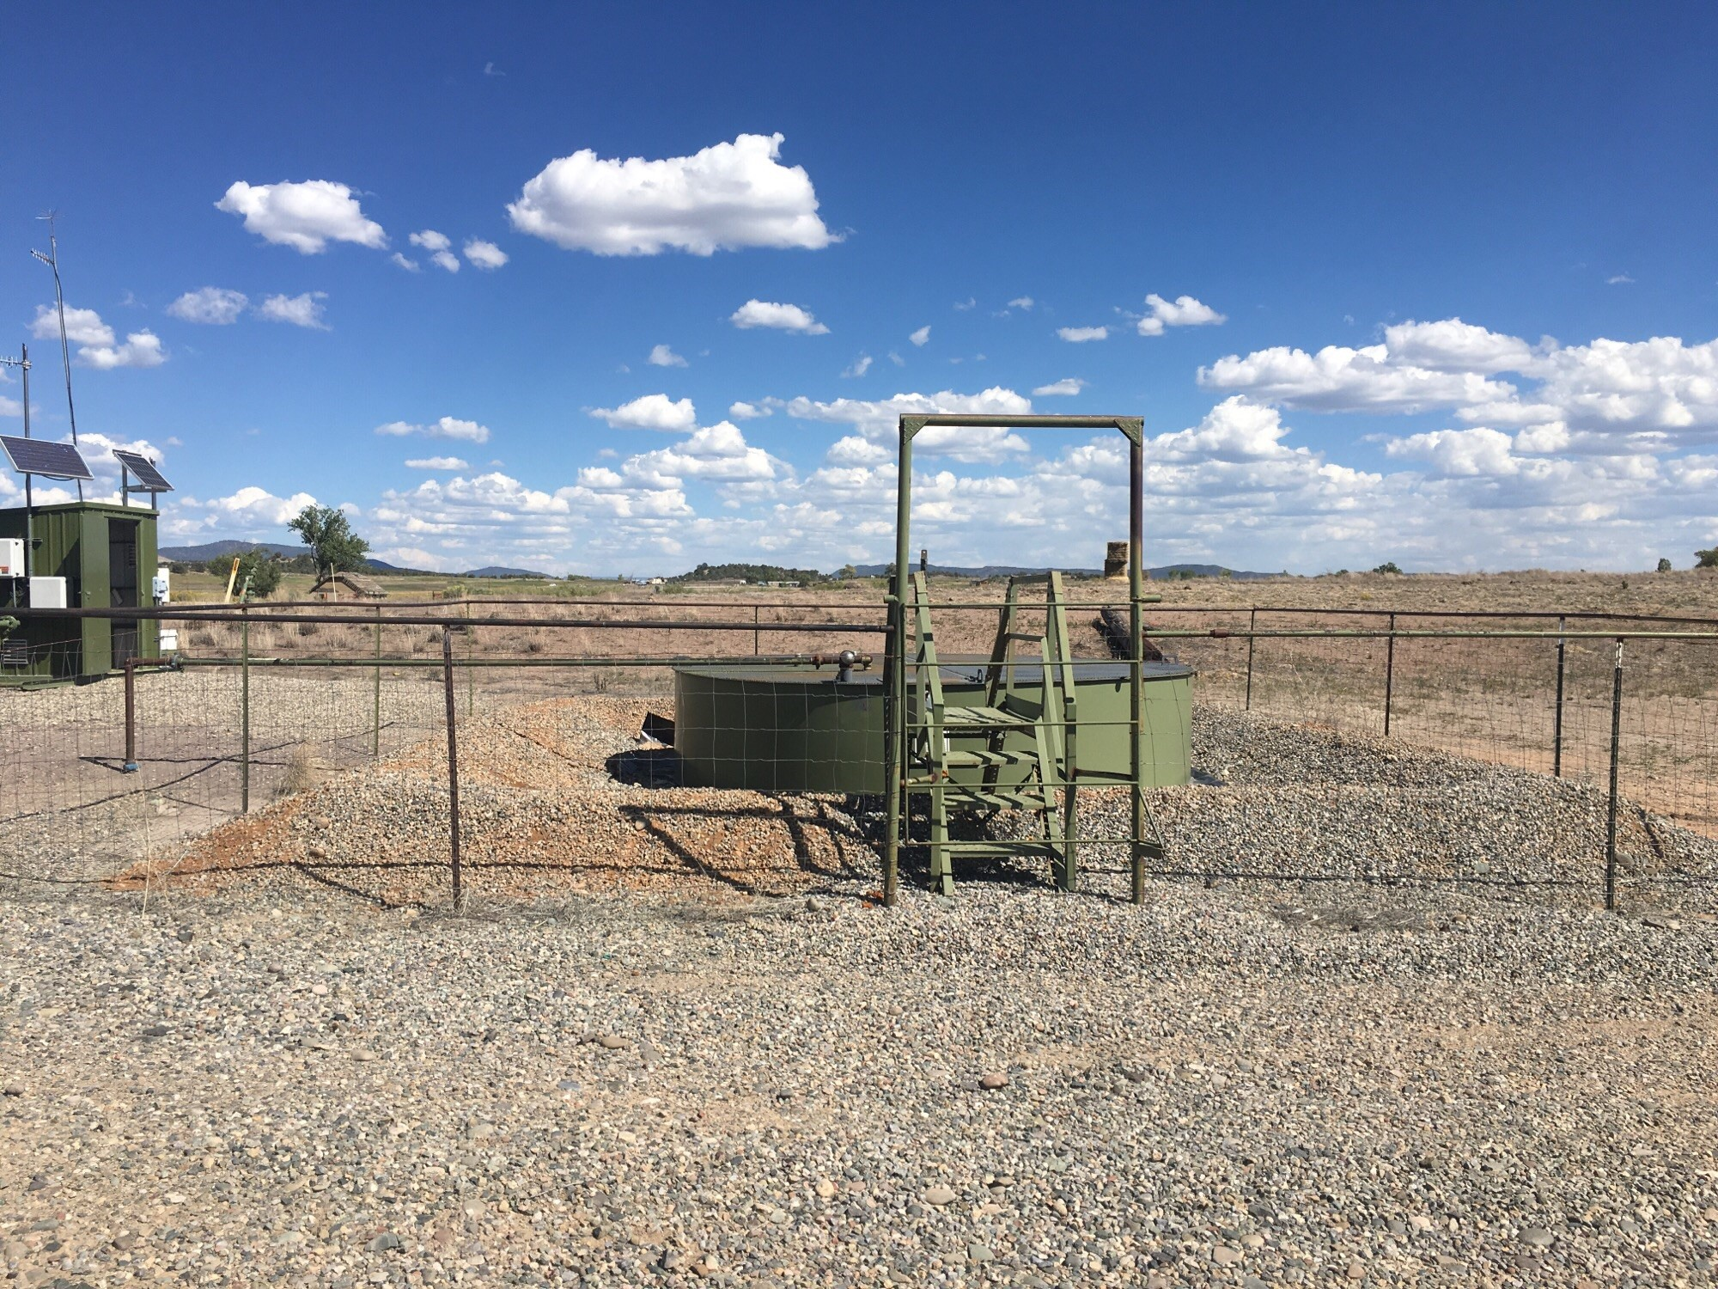
McDonald C 2 API # 005-067-09370
Impacted soil and gravel at wellhead has been
cleaned up and properly disposed.
Production tank berms have been addressed

Slide 2
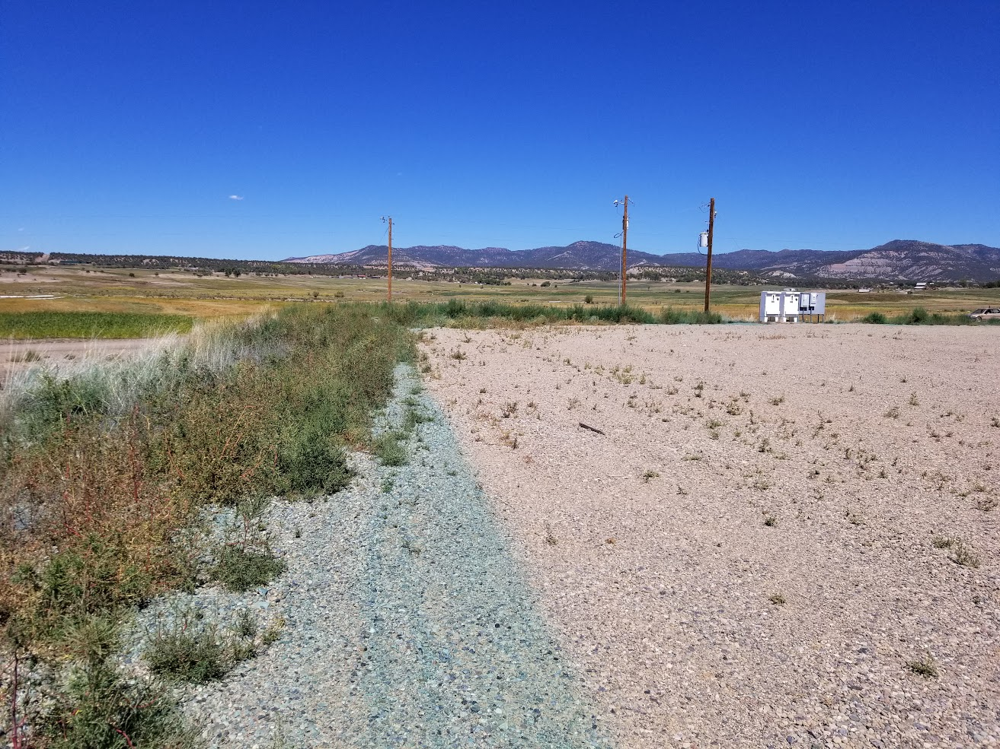
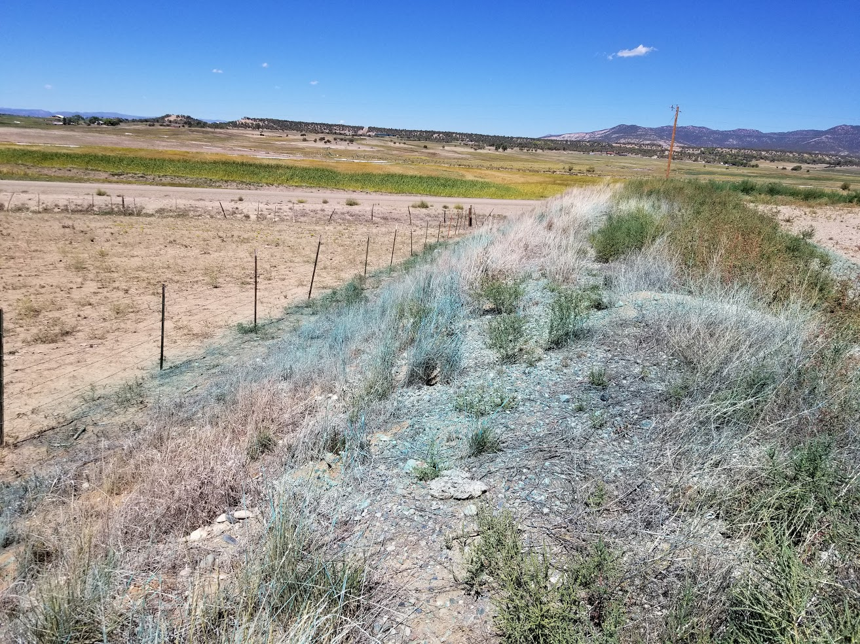
The Kochia has been sprayed and debris cleaned up

Slide 3
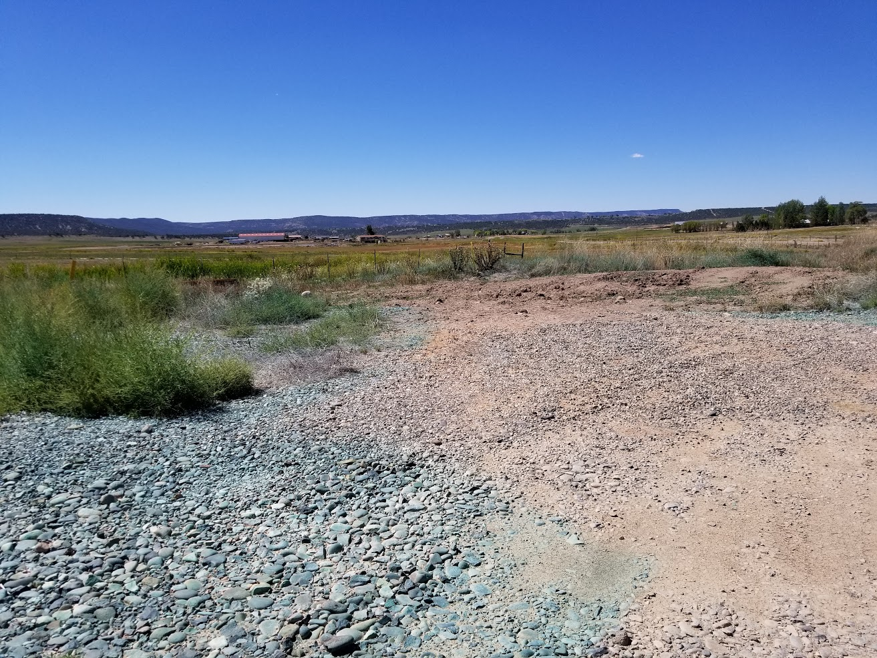
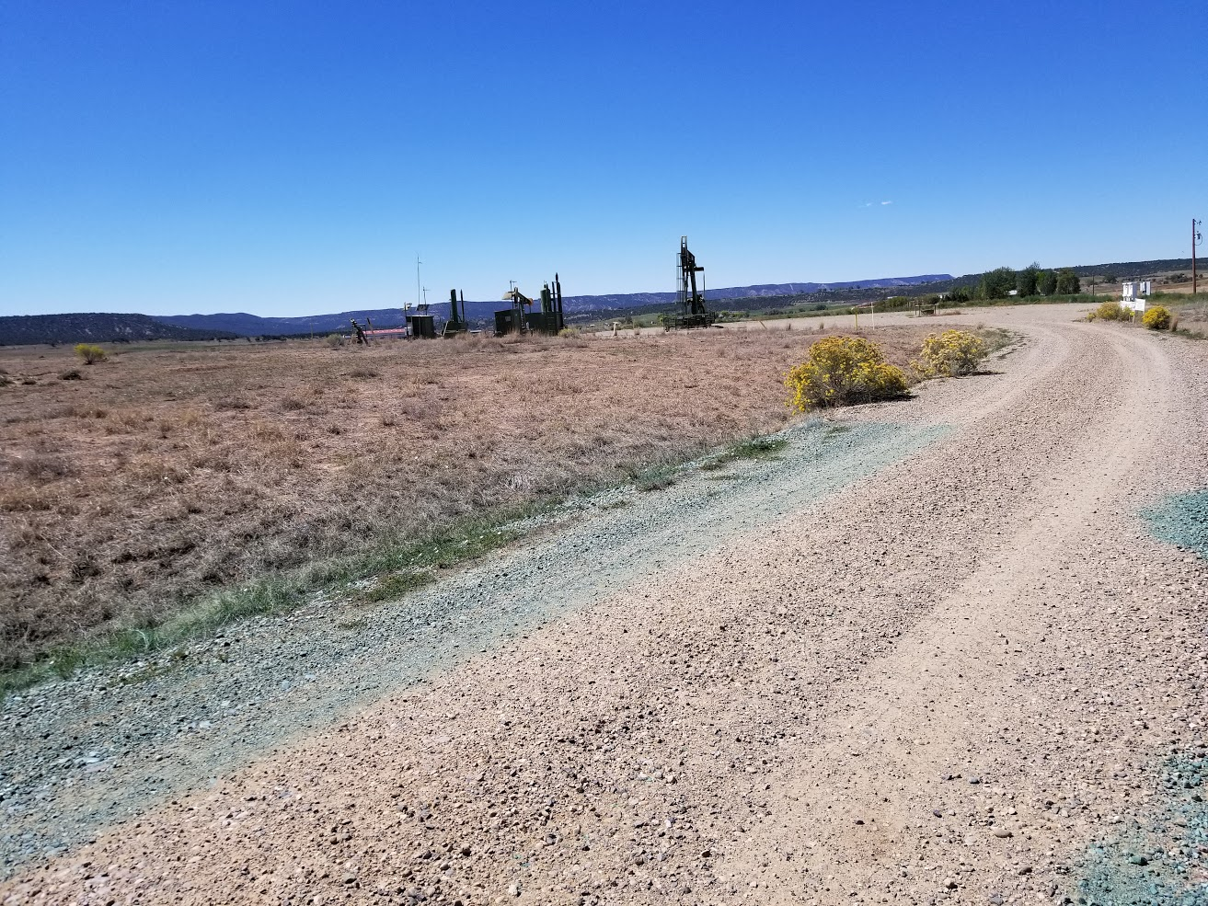
The Kochia has been sprayed and debris cleaned up

Slide 4
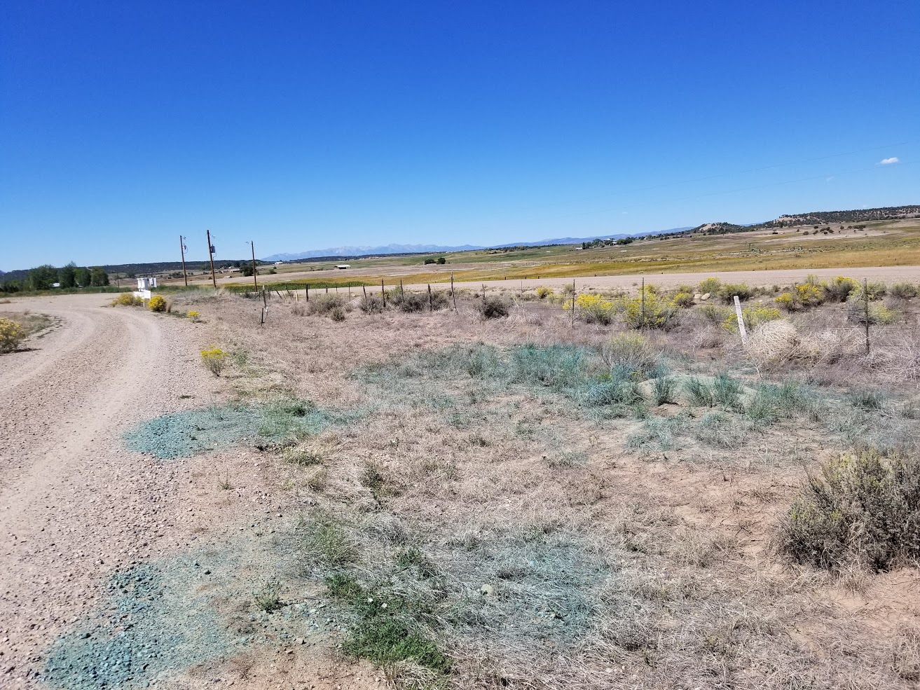
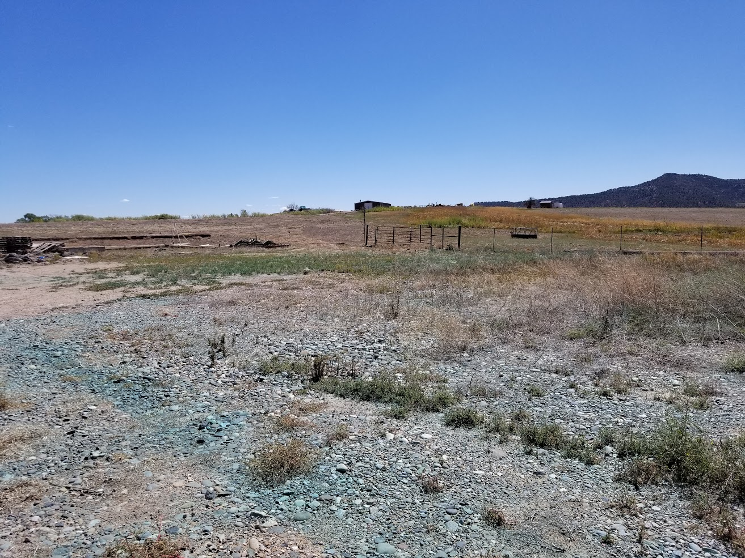
The Kochia has been sprayed and debris cleaned up

