Slide 1
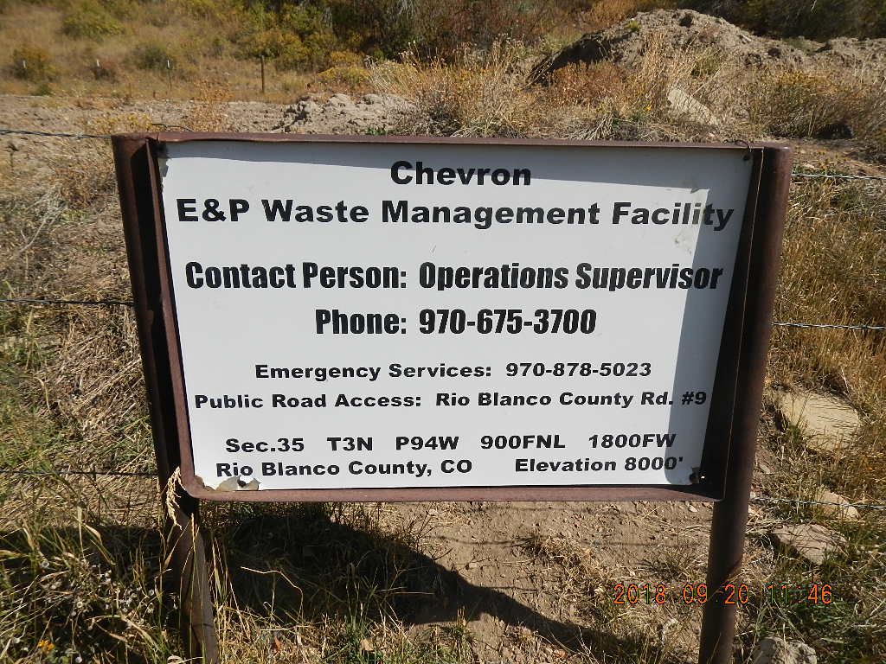
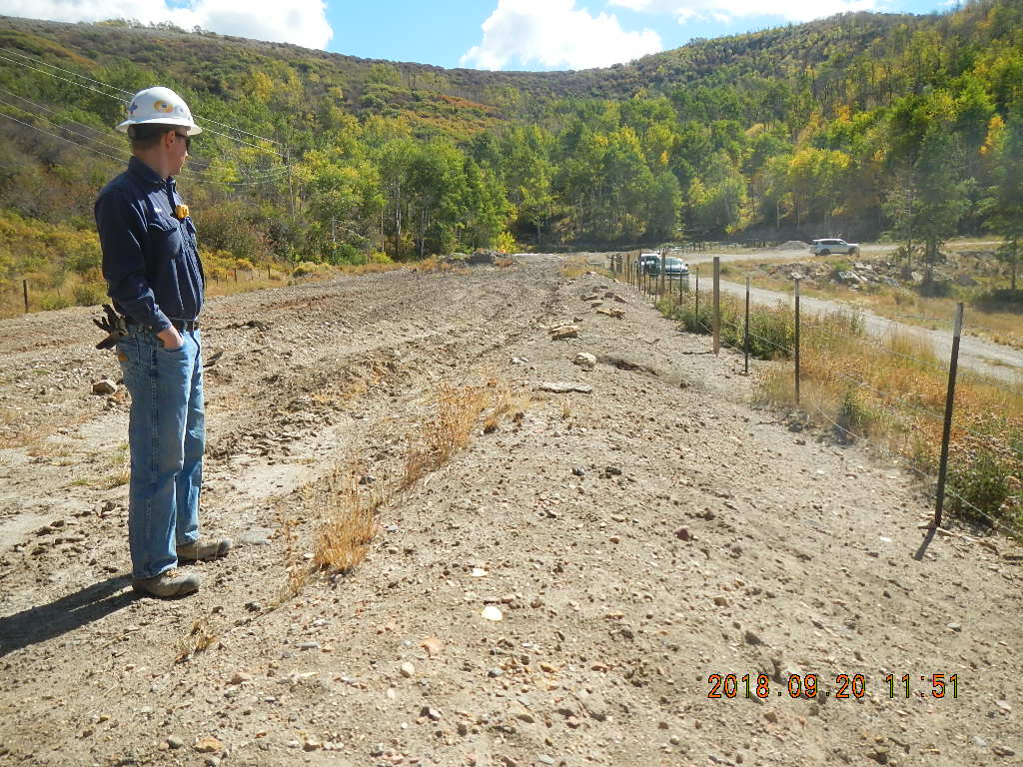
Inspection Photos
Location Name: Chevron Wilson Creek
CE&P Facility ID 149002
Location 149002
Berm worn down

Slide 2
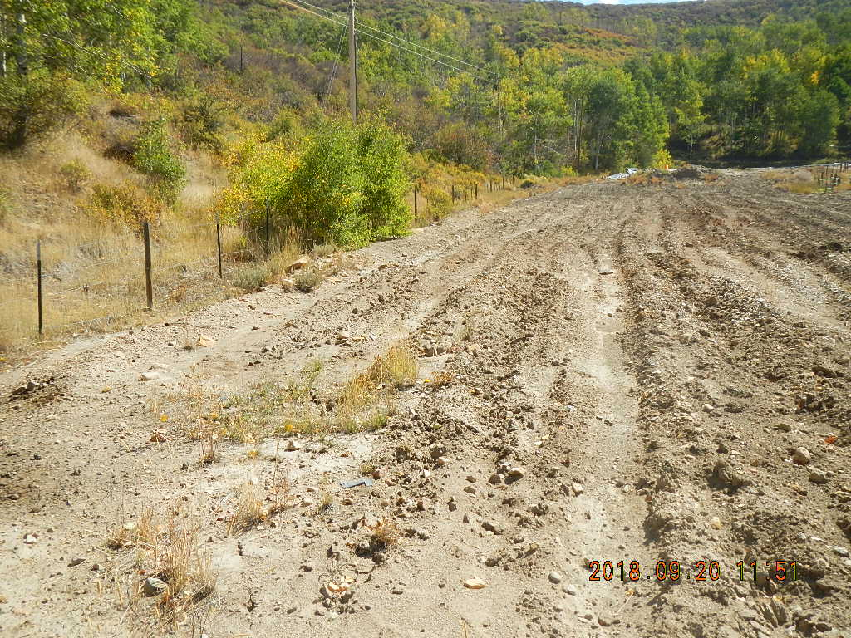
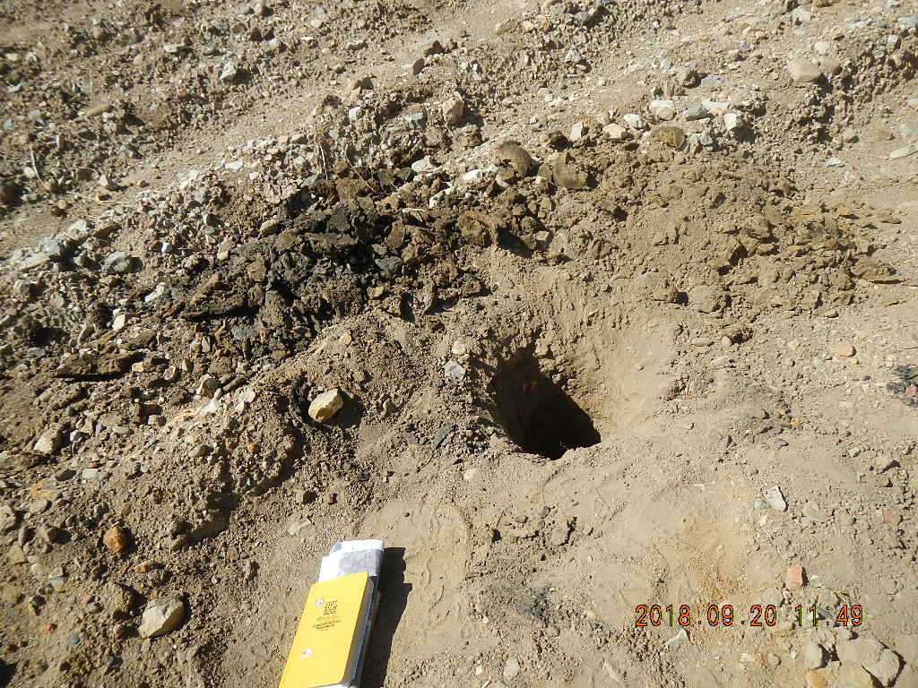
Inspection Photos
Location Name: Chevron Wilson Creek
CE&P Facility ID 149002
Berm worn down
Sample location

Slide 3
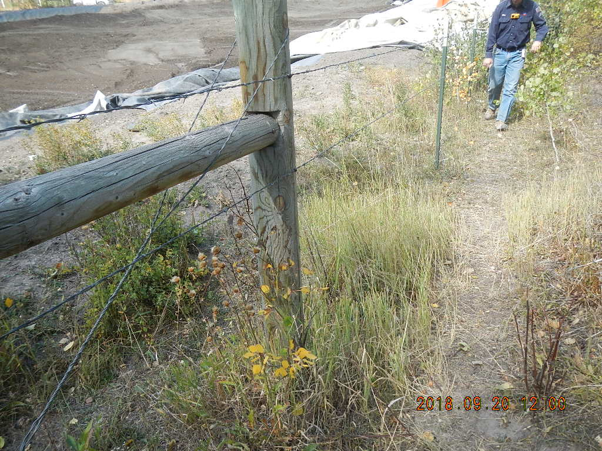
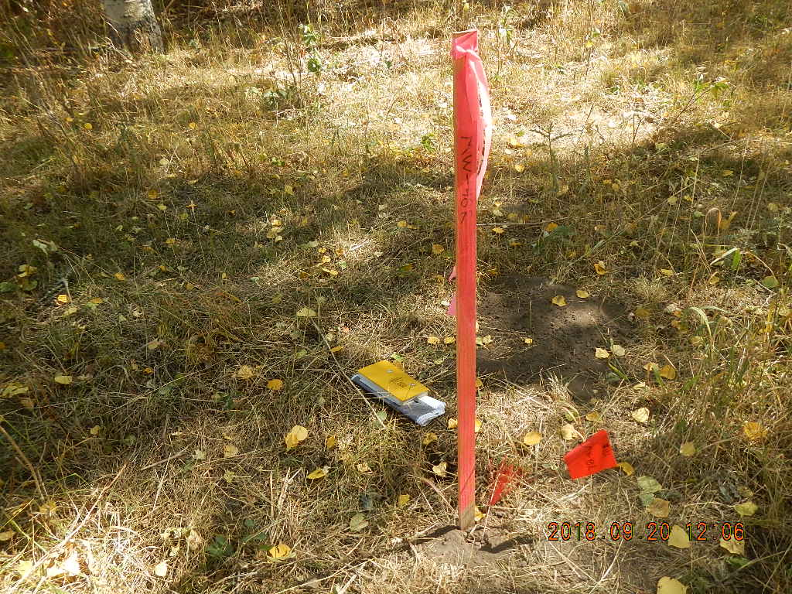
Inspection Photos
Location Name: Chevron Wilson Creek
CE&P Facility ID 149002
Compromised fence
MW 46 bore hole and MW 46R location

Slide 4
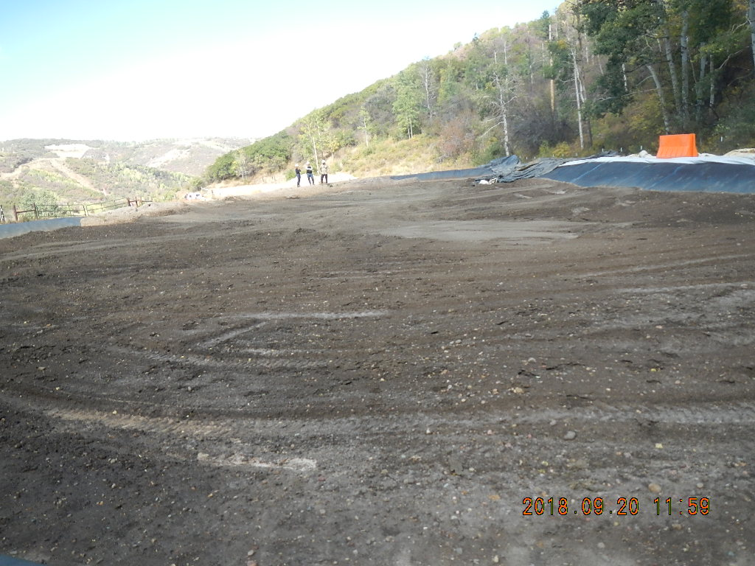
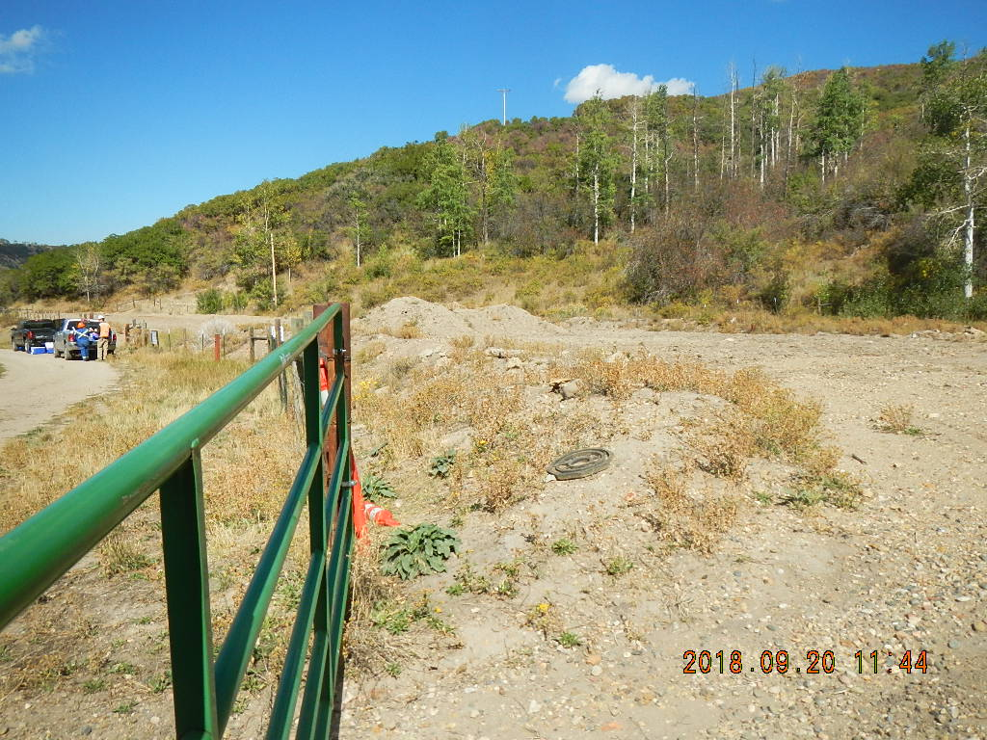
Inspection Photos
Location Name: Chevron Wilson Creek
CE&P Facility ID 149002
Lined treatment cell
Soil stockpile

