Slide 1
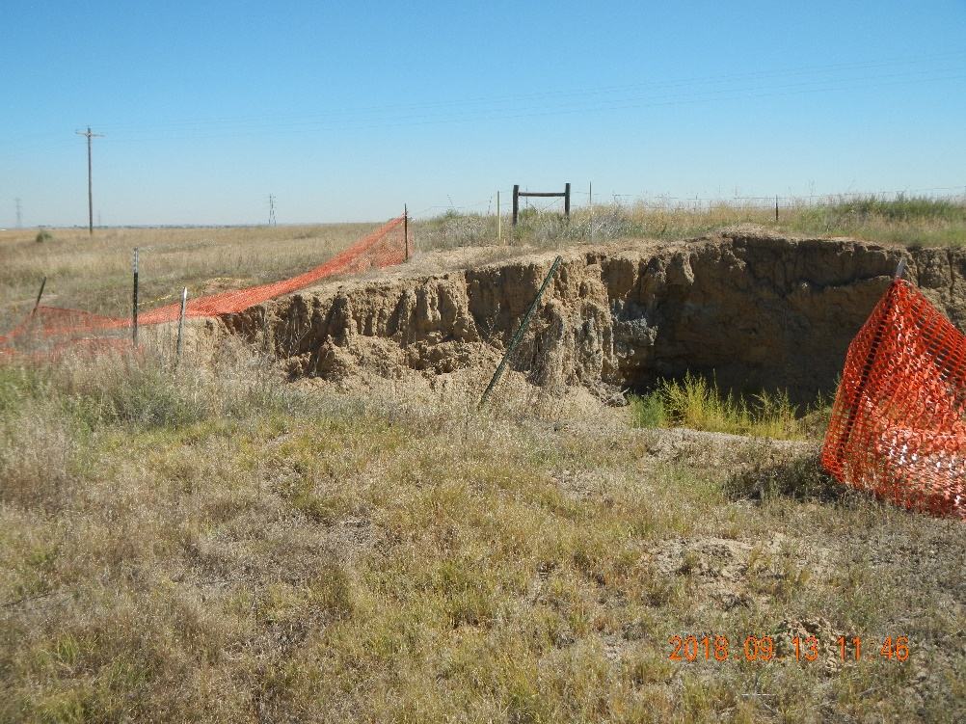
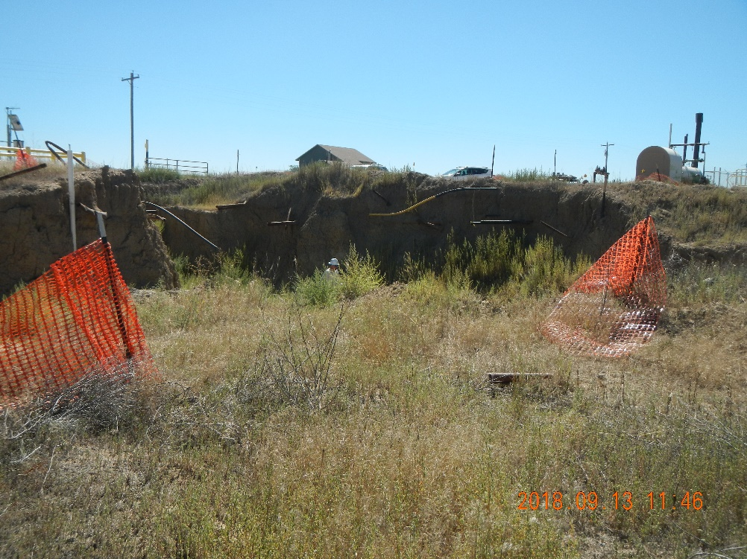
Inspection Photos – 09/13/2018
Lauridson-61N67W 18NESE
Facility: 317934, REM 9971
Open excavation.
Temporary safety fencing is down.
Open excavation.
Temporary safety fencing is down.

Slide 2
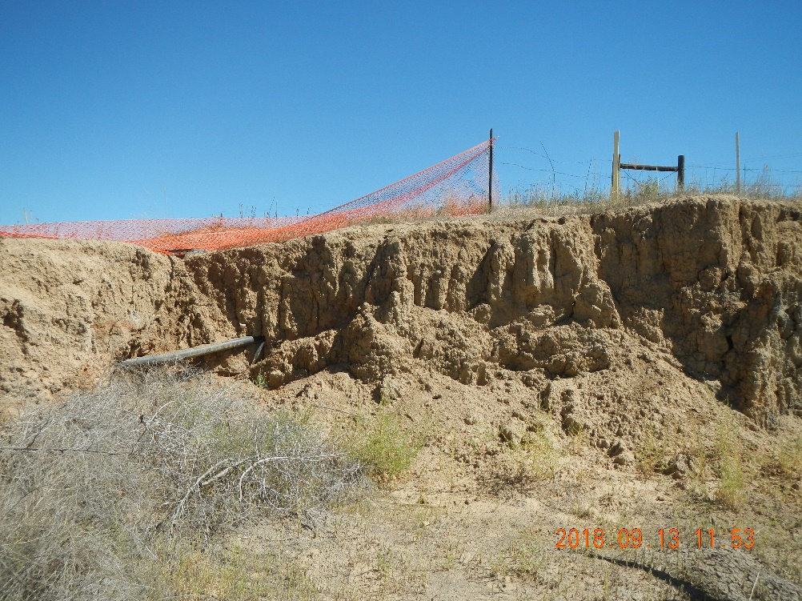
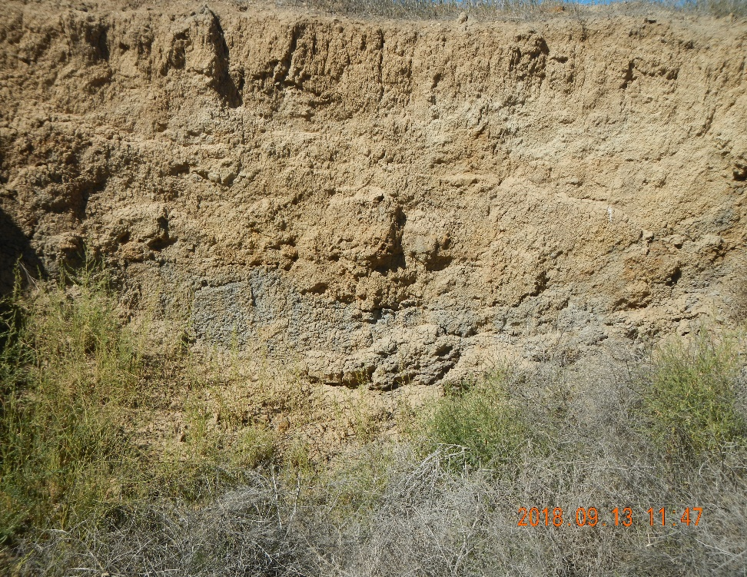
Inspection Photos – 09/13/2018
Lauridson-61N67W 18NESE
Facility: 317934, REM: 9971
Open excavation.
Temporary safety fencing is down.
Impacted soils in excavation sidewall (west side, adjacent to former partially-buried vessel)

Slide 3
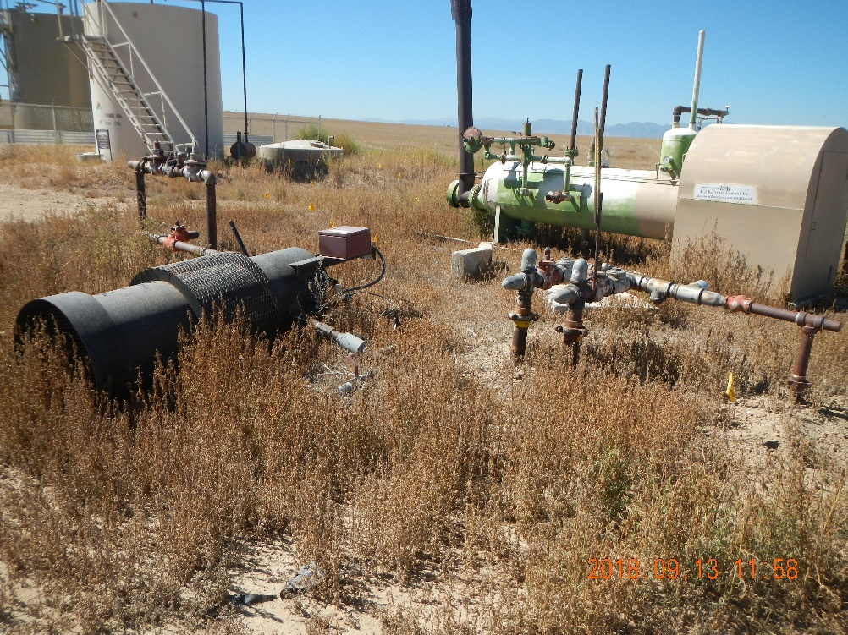
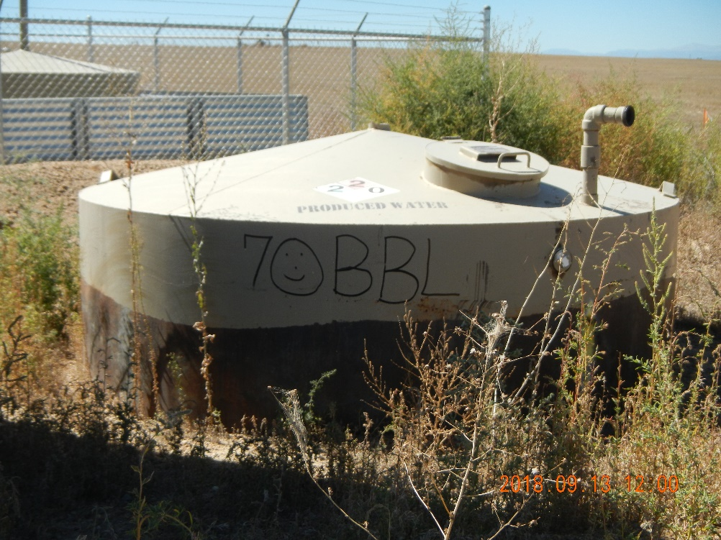
Inspection Photos – 09/13/2018
Lauridson-61N67W 18NESE
Facility: 317934, REM: 9971
Unused equipment & weeds
Unused partially-buried vessel

Slide 4
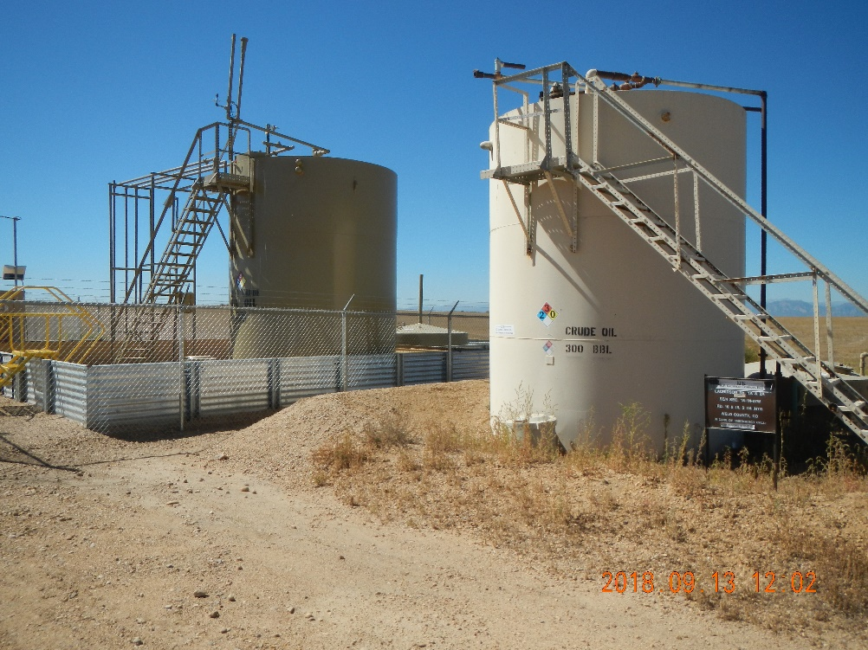
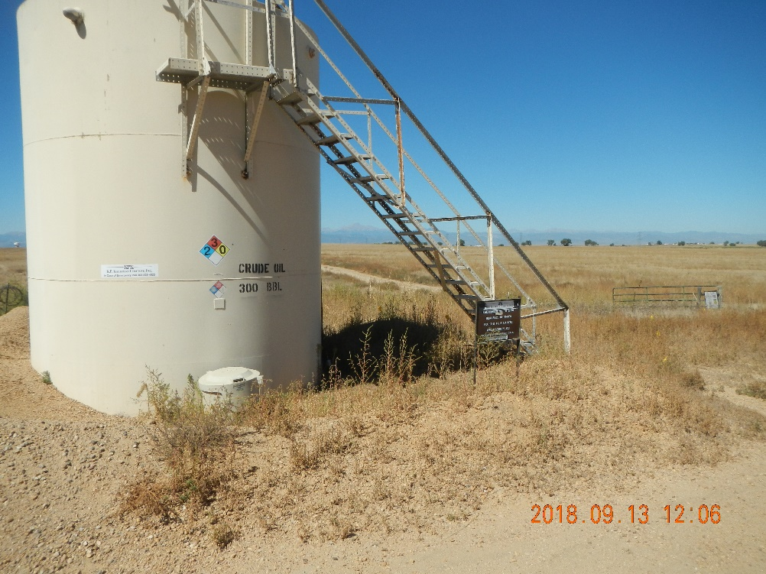
Inspection Photos – 09/13/2018
Lauridson-61N67W 18NESE
Facility: 317934, REM: 9971
Eroded berms & weeds
Eroded berm & weeds

Slide 5
Inspection Photos – 09/13/2018
Lauridson-61N67W 18NESE
Facility: 317934

Slide 6
Inspection Photos – 09/13/2018
Lauridson-61N67W 18NESE
Facility: 317934

Slide 7
Inspection Photos – 09/13/2018
Lauridson-61N67W 18NESE
Facility: 317934

Slide 8
Inspection Photos – 09/13/2018
Lauridson-61N67W 18NESE
Facility: 317934

