Slide 1
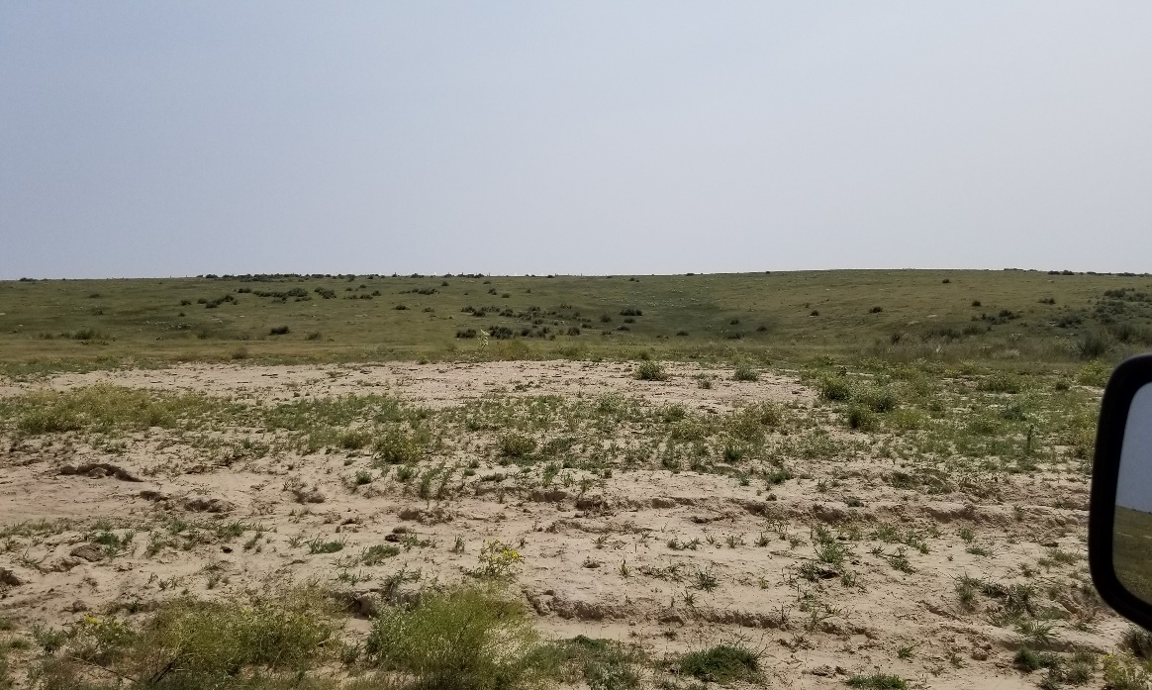
Inspection Photo
Location Name: Weyerman 6B-18
API: 05-125-09027
1. Location photo

