Slide 1
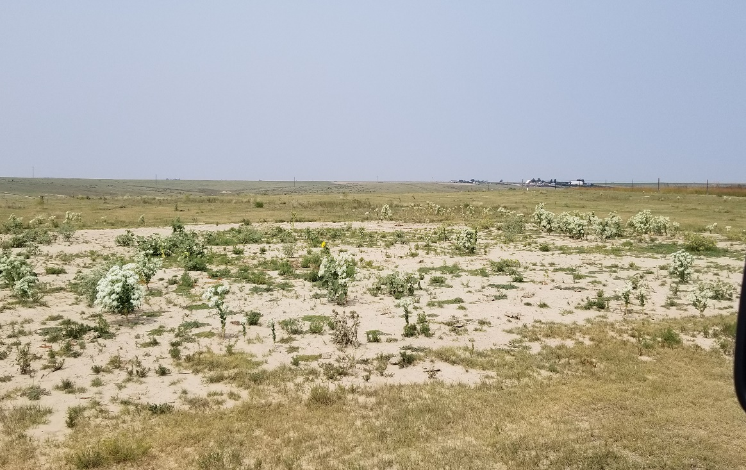
Inspection Photo
Location Name: Weyerman 6-18
API: 05-125-06706
1. Location photo

