Slide 1
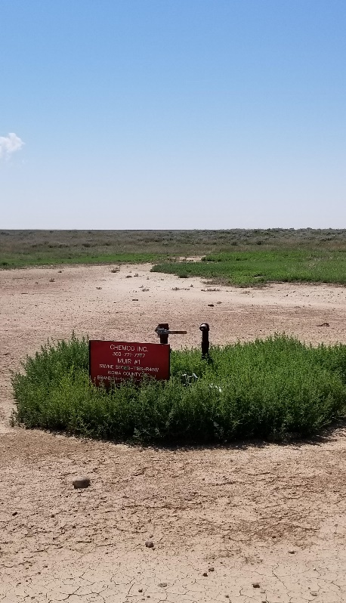
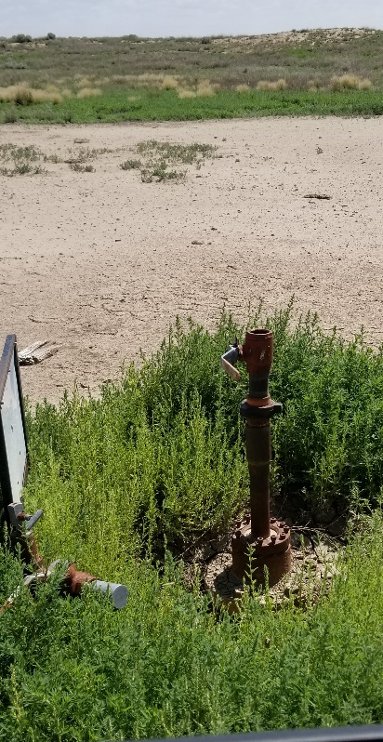
Inspection Photos
Location Name: Muir E J 1
API: 05-061-06084
1. Lease sign
2. Wellhead

