Slide 1
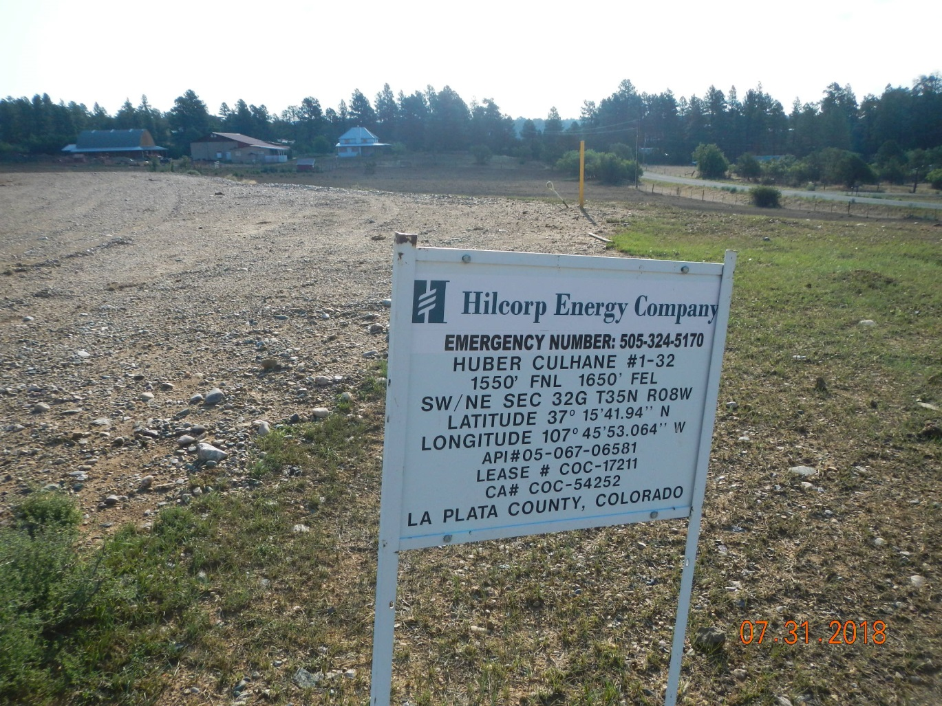
Inspection Photos
Location Name: Huber Culhane 1-32
API: 05-067-06581
Inspection Number: 685200526
Wellsign

Slide 2
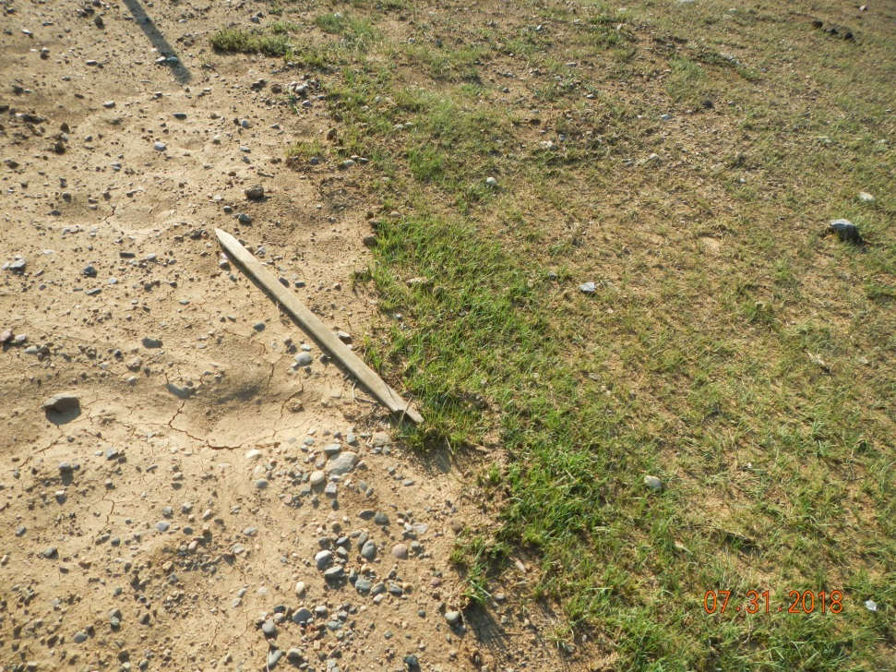
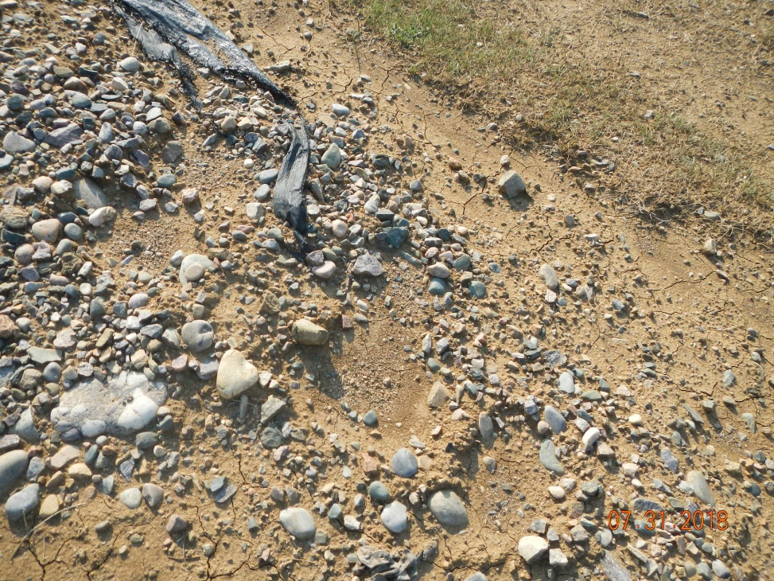

Inspection Photos
Location Name: Huber Culhane 1-32
API: 05-067-06581
Inspection Number: 685200526
Lath
Piece of synthetic liner marerial

Slide 3
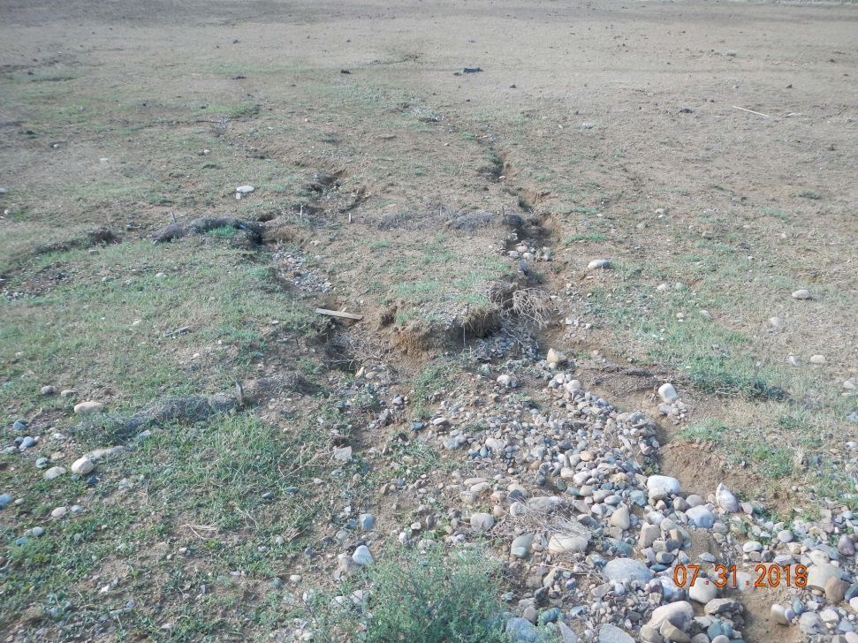
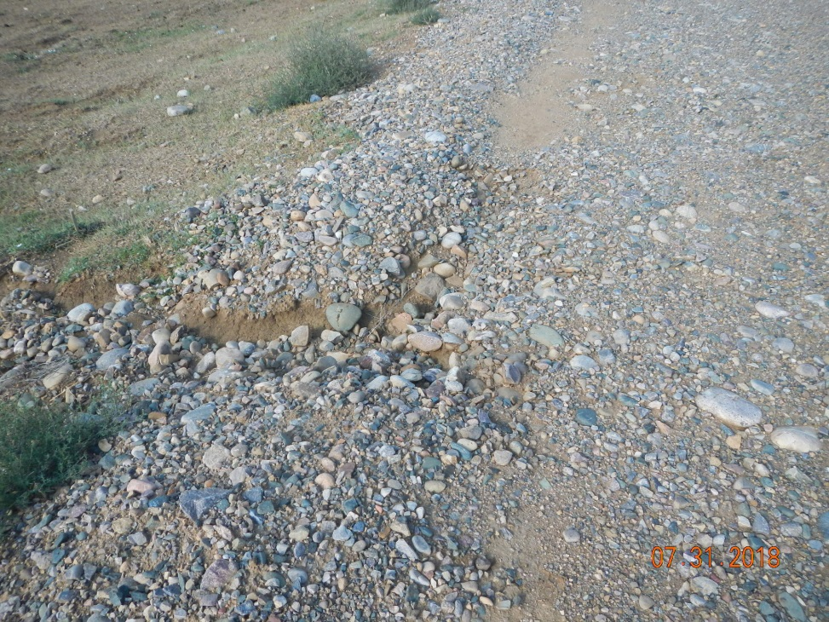
Inspection Photos
Location Name: Huber Culhane 1-32
API: 05-067-06581
Inspection Number: 685200526
Stromwater erosion and BMPs not maintained looking southeast off southeast corner of pad.
Erosion off SE corner of pad

Slide 4
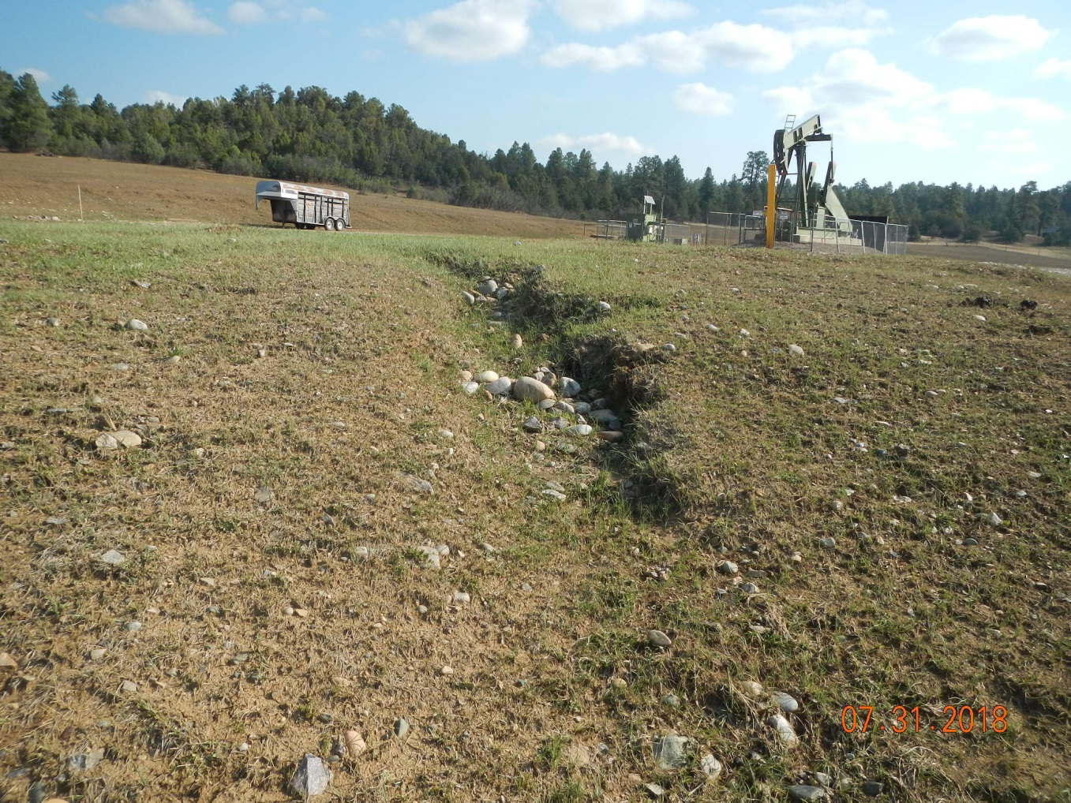
Inspection Photos
Location Name: Huber Culhane 1-32
API: 05-067-06581
Inspection Number: 685200526
Channel off SW corner of pad

Slide 5
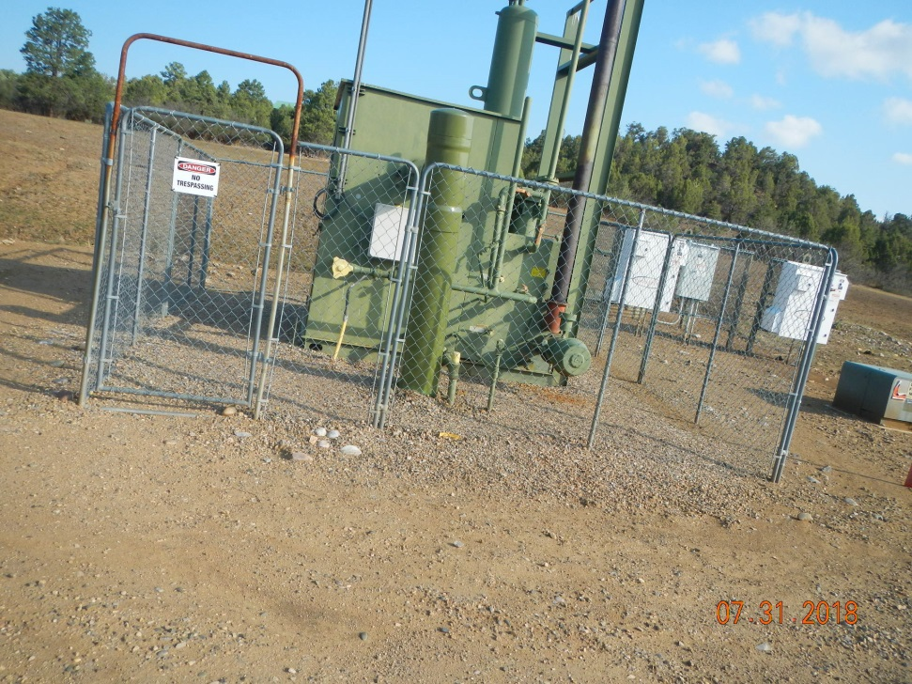
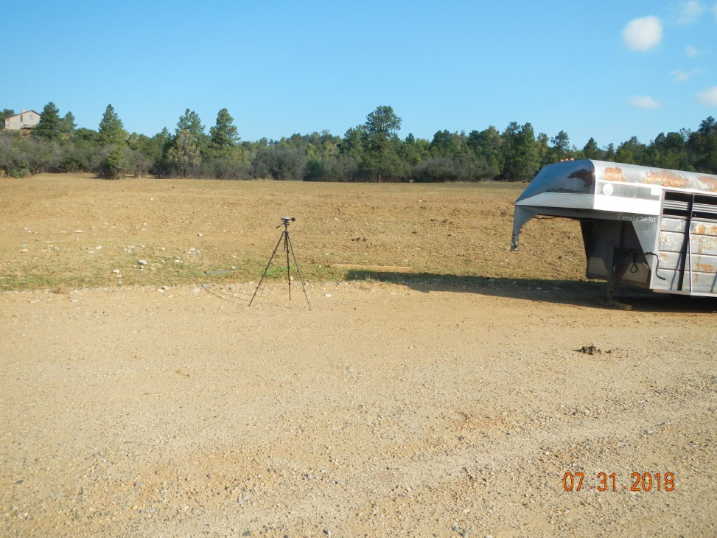
Inspection Photos
Location Name: Huber Culhane 1-32
API: 05-067-06581
Inspection Number: 685200526
Separation, meter and controller equipment.
Sound meter placement and landowner trailer

