Slide 1
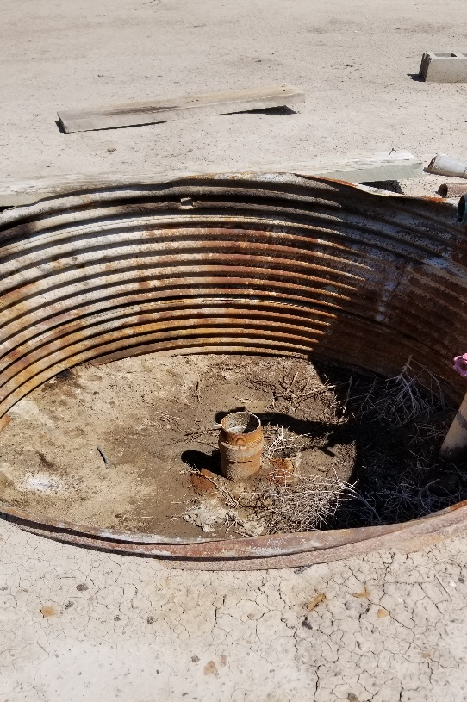
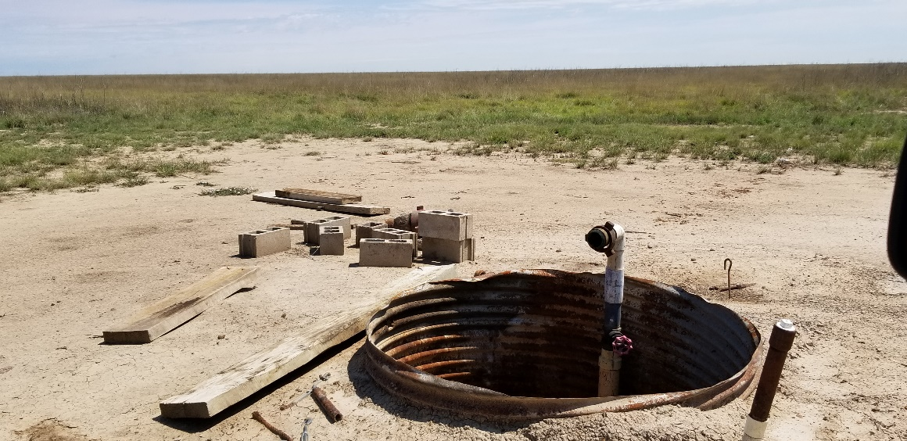
Inspection Photos
Location Name: Alpine Kliesen #1
API: 05-017-06375
1. Wellhead/Cellar
2. Debris laying around location

