Slide 1
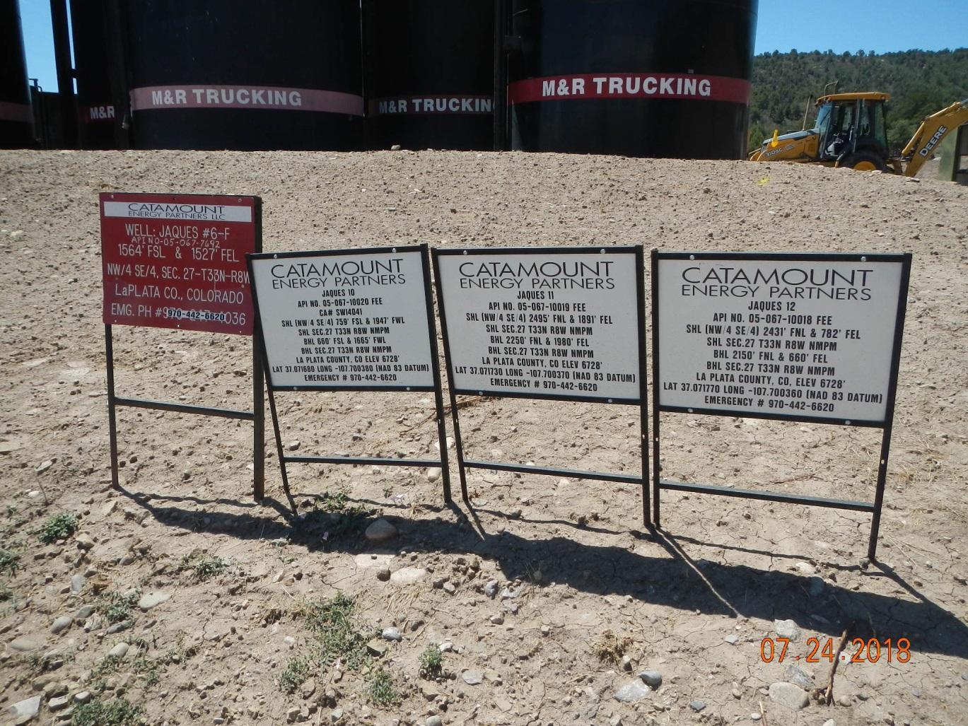
Inspection Photos
Location Name: Jaques 6F, 10,11,12
API: 05-067-10018,19,20
Inspection Number: 685200514
Well/Drilling signs

Slide 2
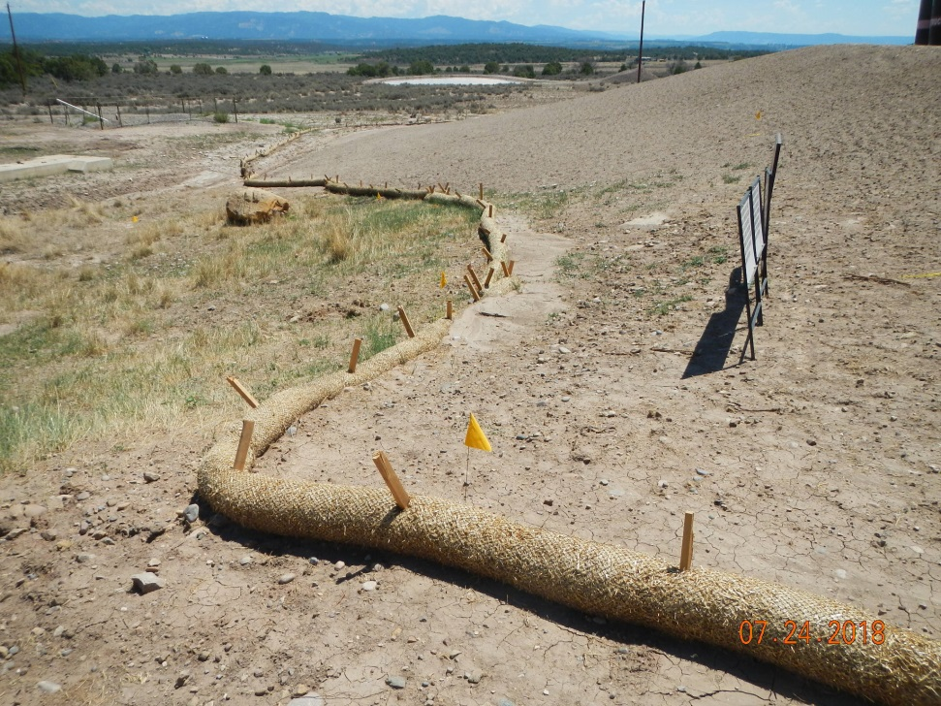
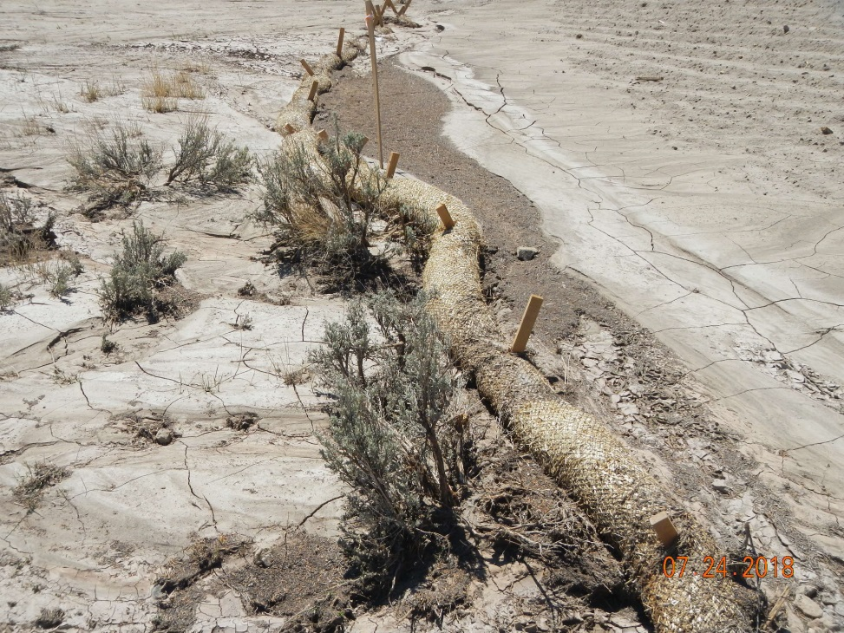

Inspection Photos
Location Name: Jaques 6F,10,11,12
API: 05-067-10018,19,20
Inspection Number: 685200514
Full wattles

Slide 3
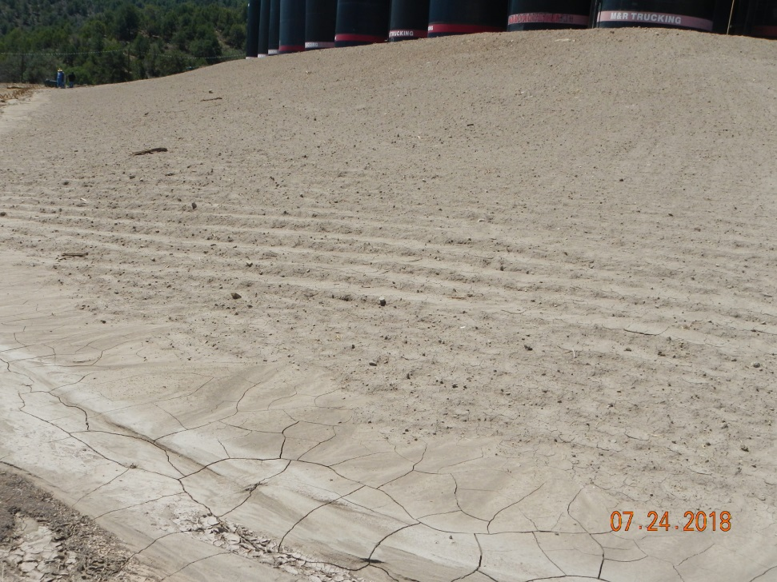
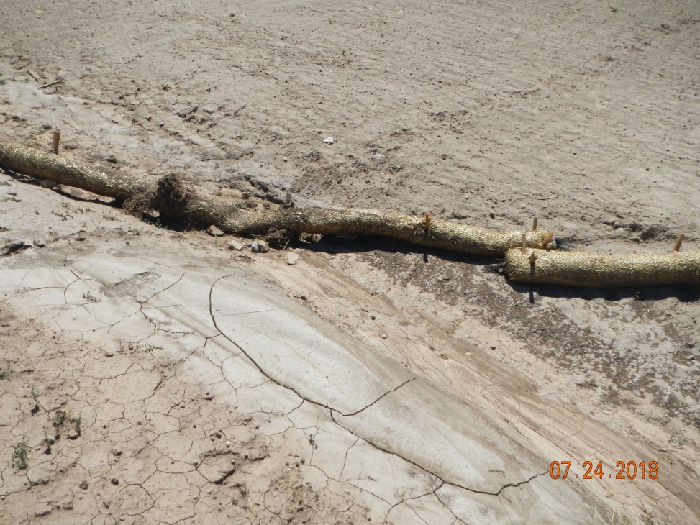
Inspection Photos
Location Name: Jaques 6F,10,11,12
API: 05-067-10018,19,20
Inspection Number: 685200514
Erosion on bare fill slopes
Ineffective wattles with sediment running underneath

Slide 4
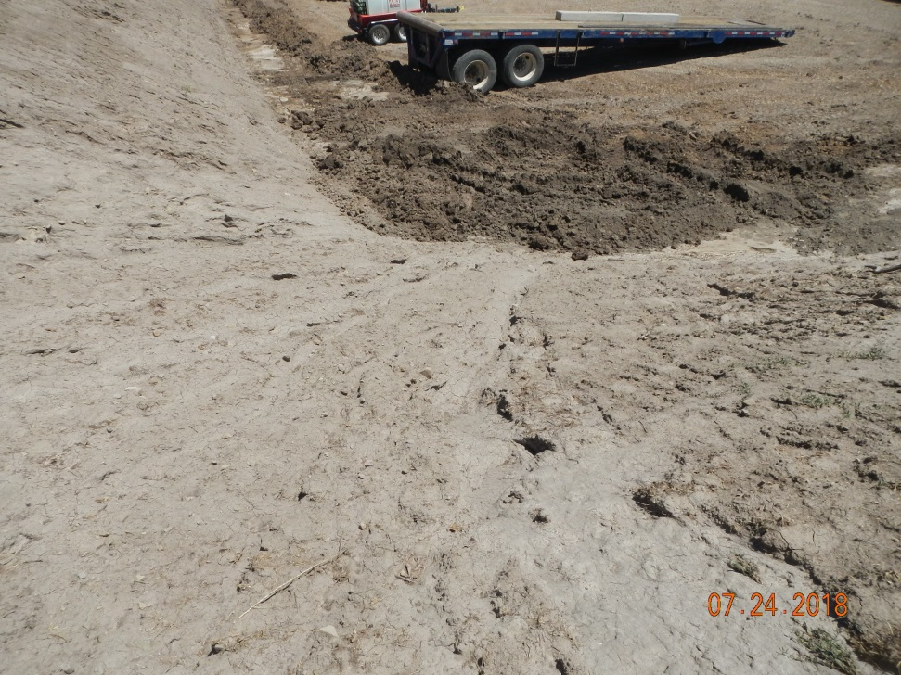
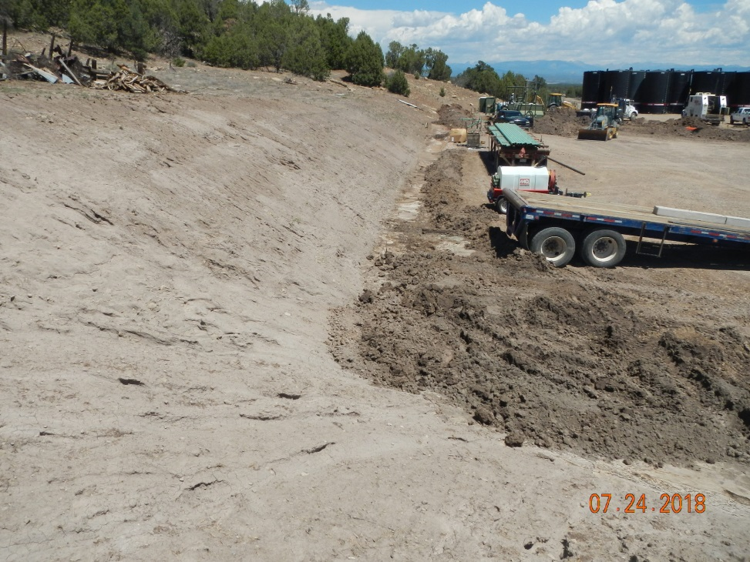
Inspection Photos
Location Name: Jaques 6F,10,11,12
API: 05-067-10018,19,20
Inspection Number: 685200514
Channel erosion of cut slope and sediment run on
Sediment pile, loose newly created berms to control location flooding

Slide 5
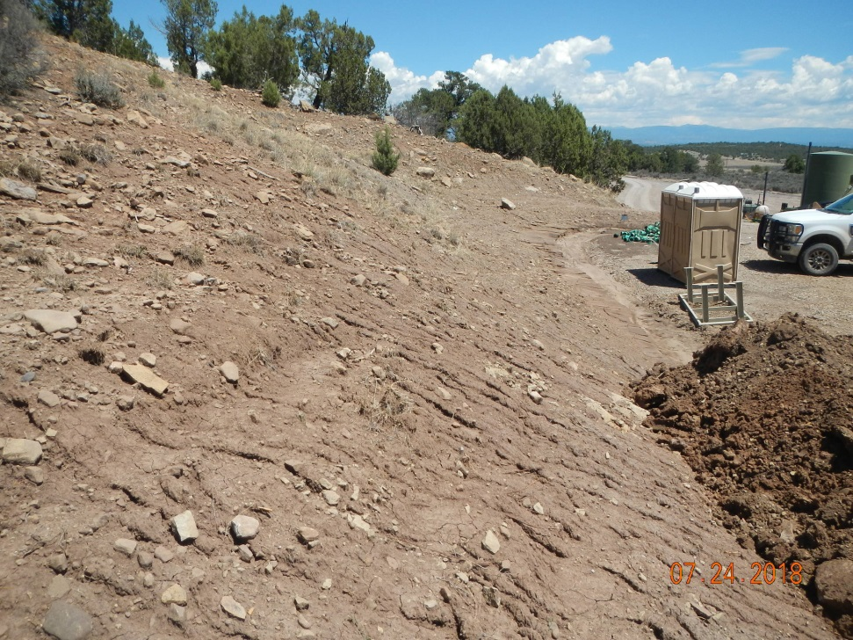
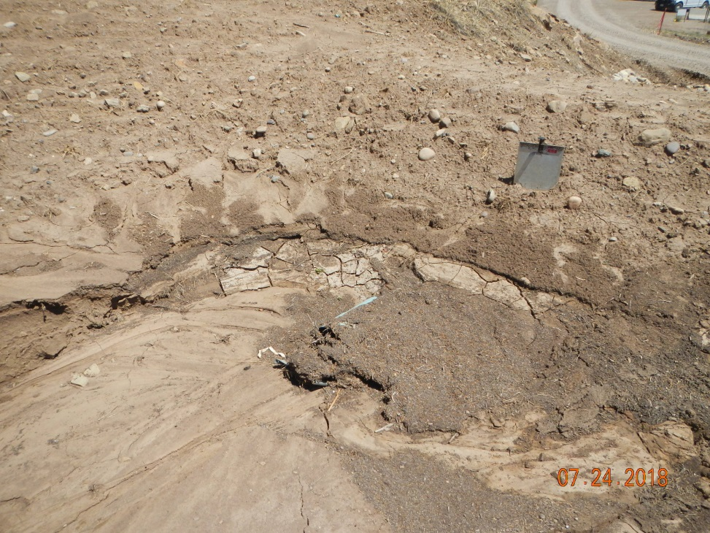
Inspection Photos
Location Name: Jaques 6F,10,11,12
API: 05-067-10018,19,20
Inspection Number: 685200514
Rill erosion on cut solpe
Mostly clogged stromwater drain

Slide 6
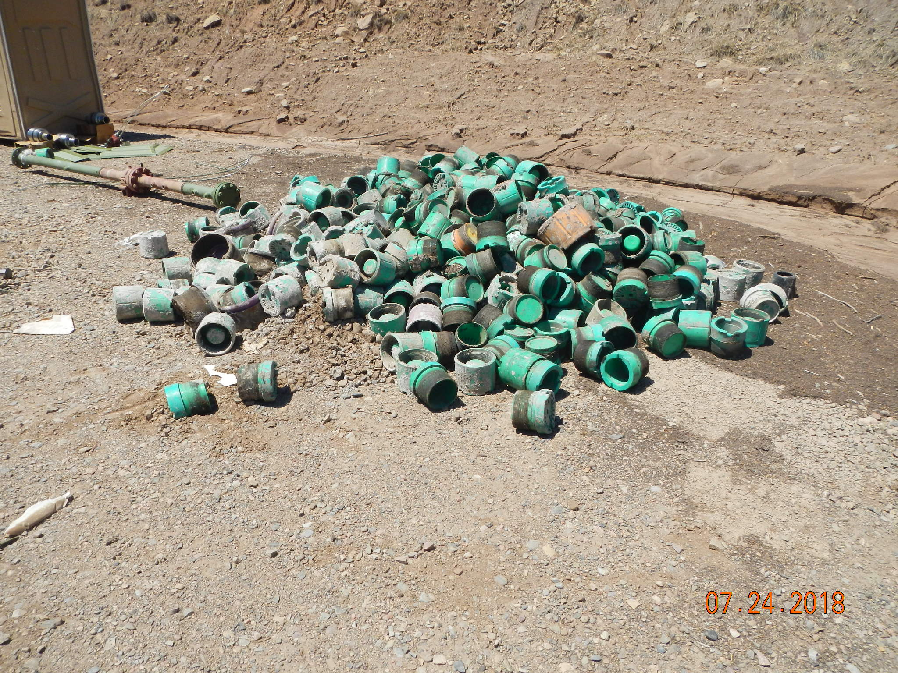
Inspection Photos
Location Name: Jaques 6F, 10,11,12
API: 05-067-10018,19,20
Inspection Number: 685200514
Greasy thread protectors improperly stored on location and near path of stromwater flowing through location (casing has been run and cemented)

