Slide 1

CM Production LLC/COGCC, Cannon 3-24
121-09996
Inspection #688301982
6/4/2018
ODO Inspection

Slide 2
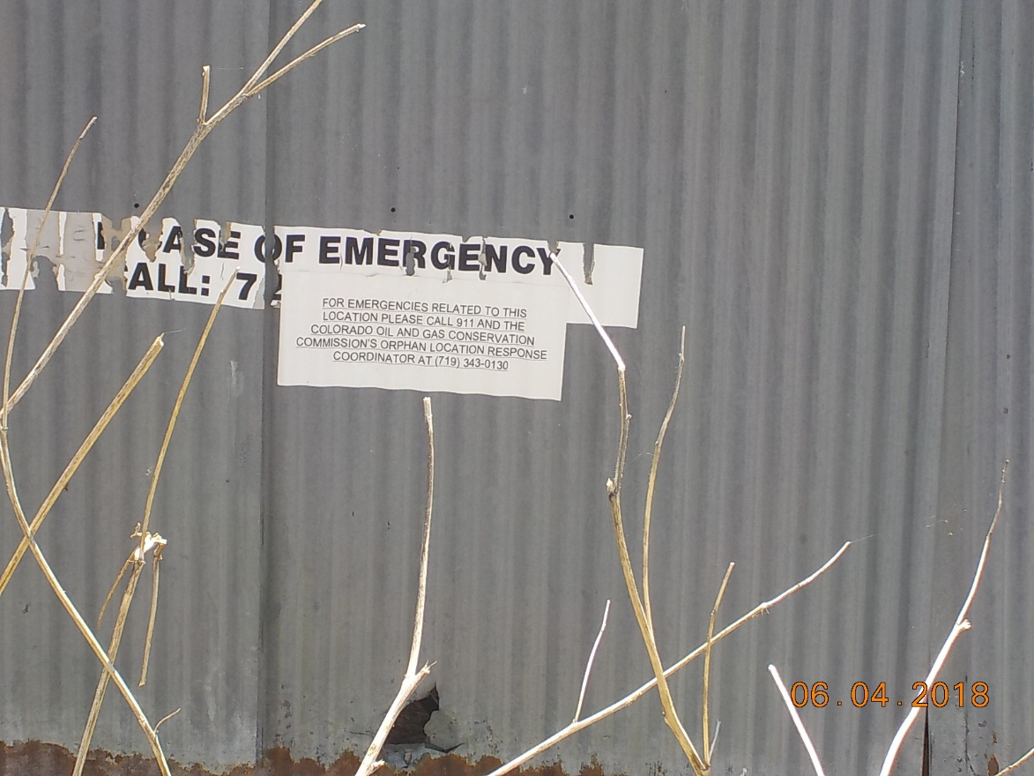

Slide 3
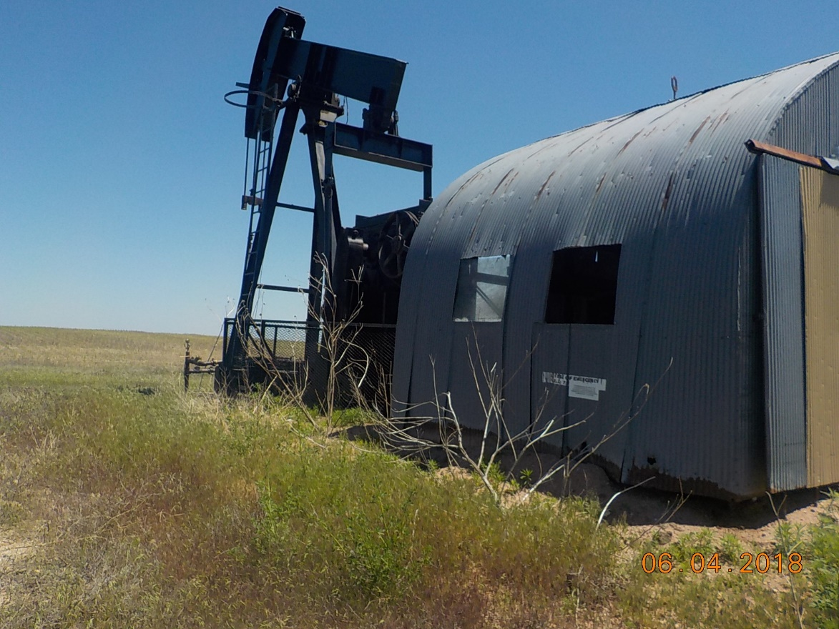

Slide 4
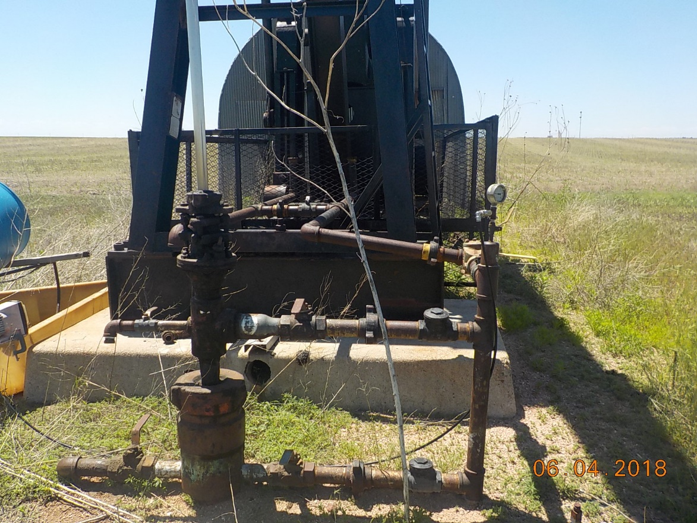

Slide 5
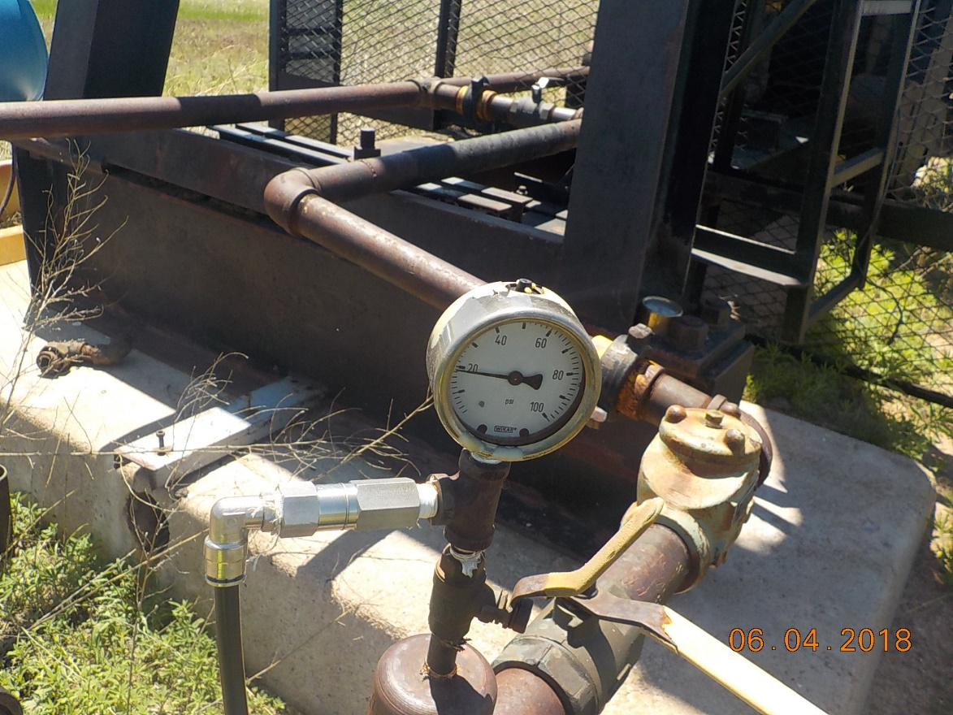

Slide 6
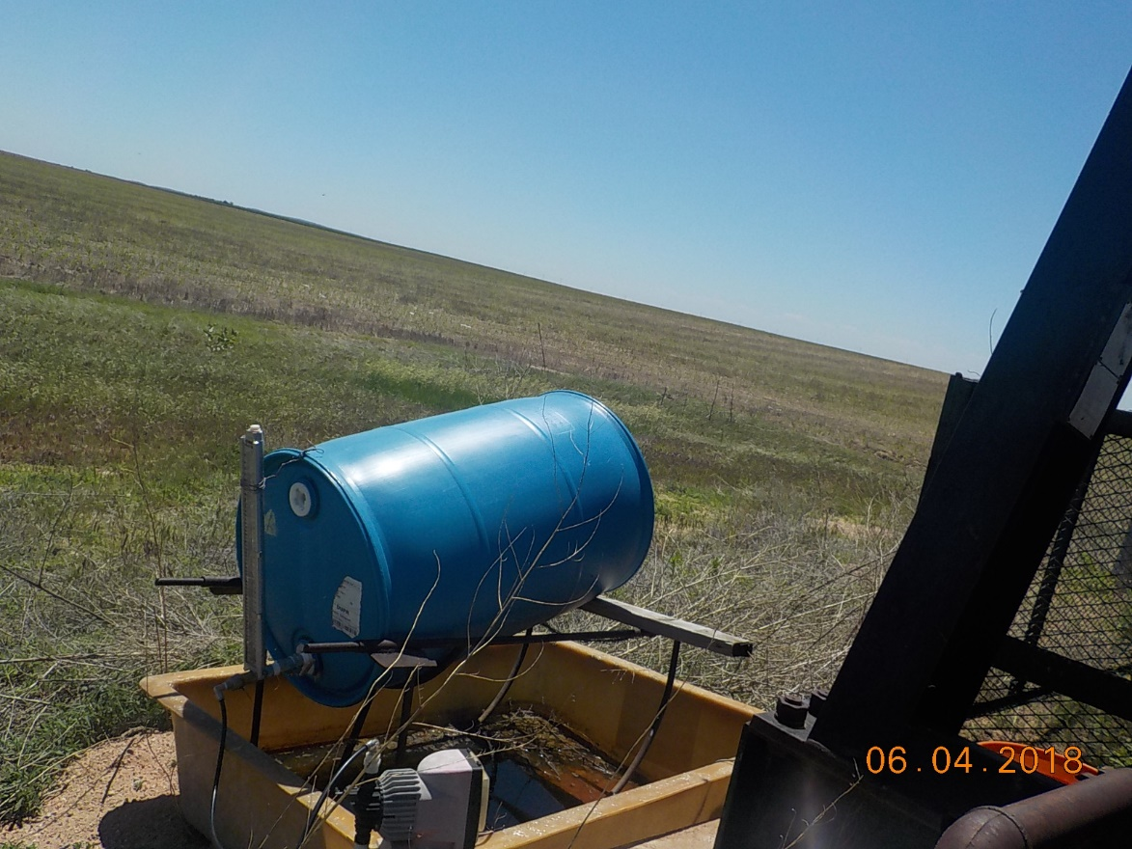

Slide 7
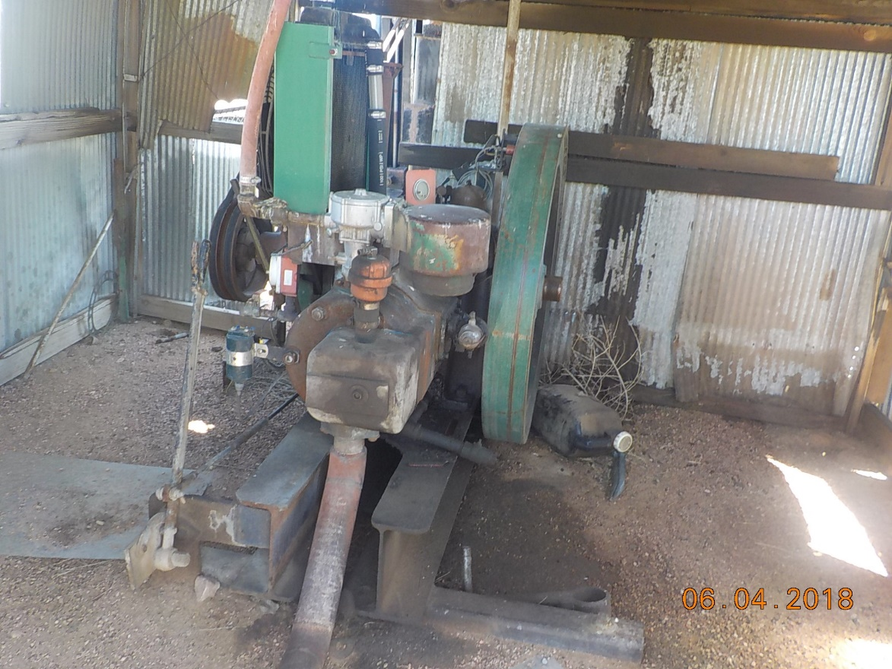

Slide 8


