Slide 1
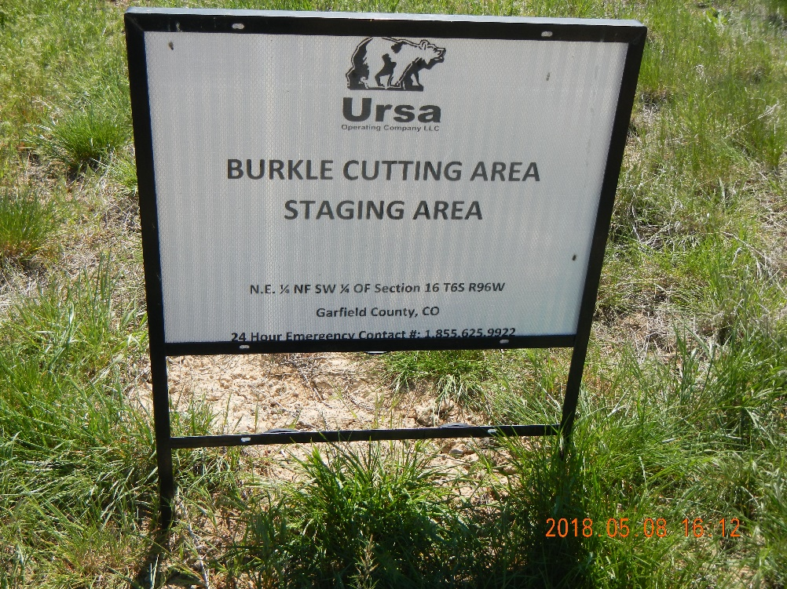
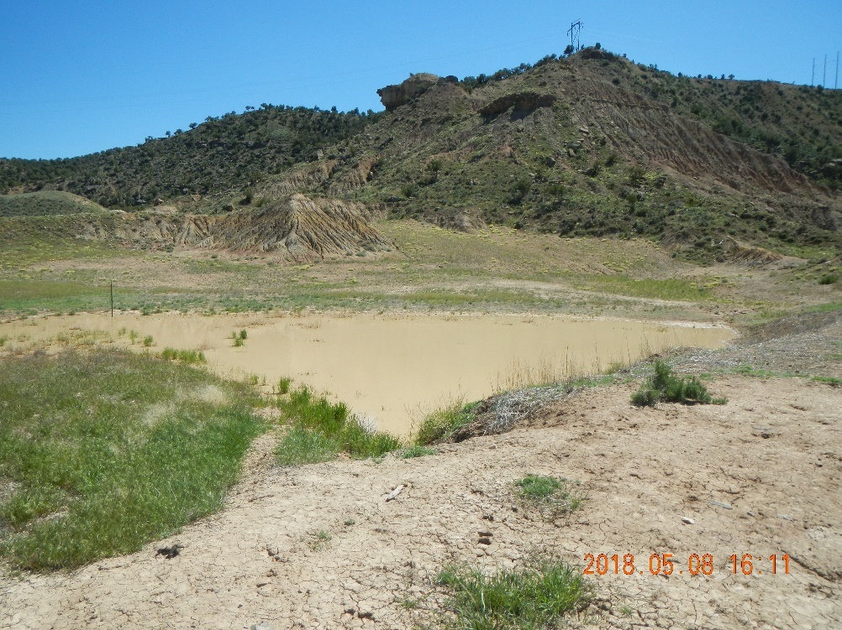
URSA
Burkle Cuttings Staging Area
Location ID #436196
Sign at the entrance
Cuttings staging area no longer in use

Slide 2
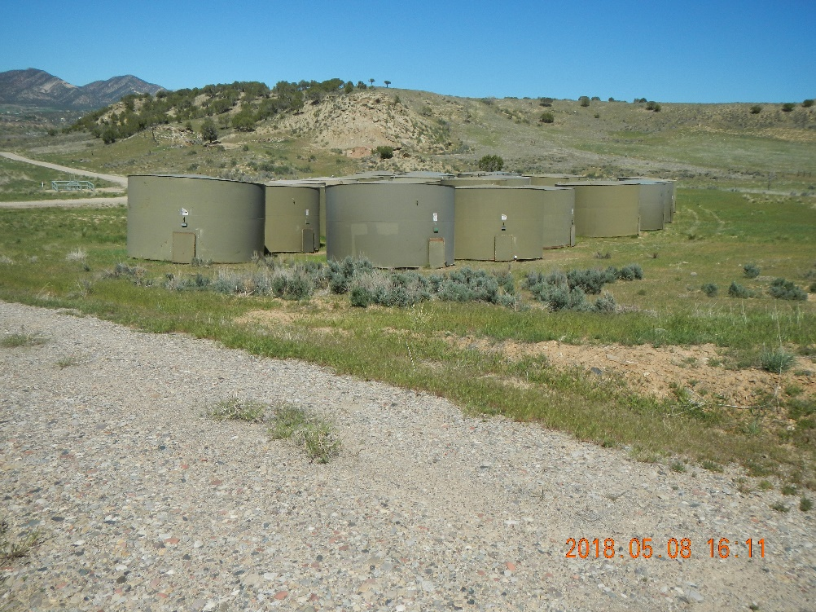
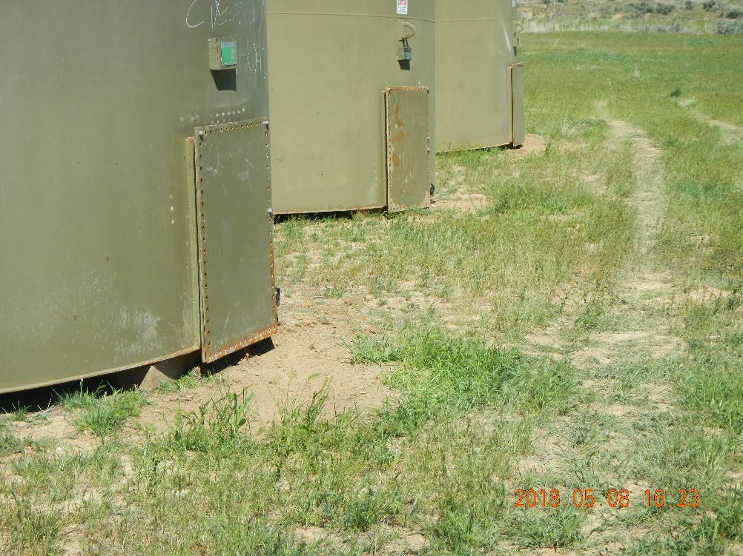
URSA
Burkle Cuttings Staging Area
Location ID #436196
Used tanks on URSA land (off pad and off staging area)
Black sand has been removed.

Slide 3
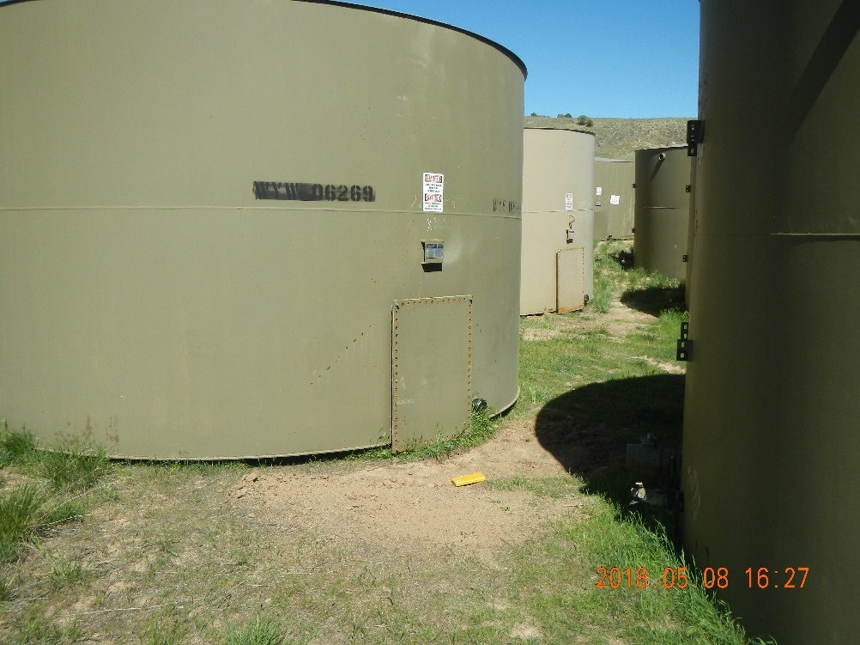
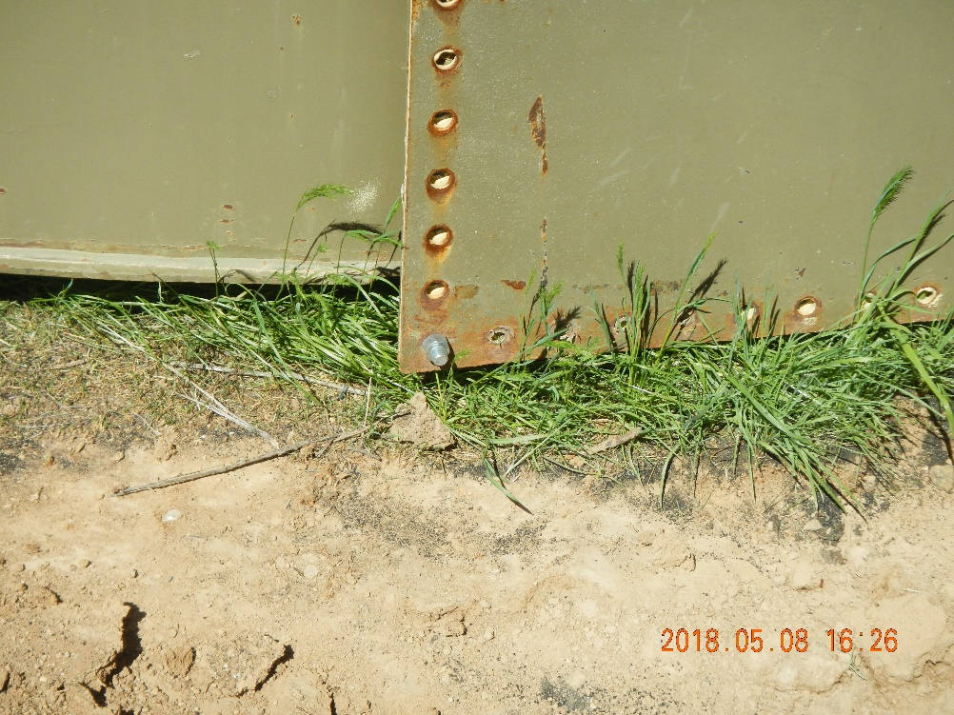
URSA
Burkle Cuttings Staging Area
Location ID #436196
Totes with black sand (possibly frac sand) were removed from location. Sand on the ground has been removed.
Remnants of black sand. Area looks clean.

