Slide 1
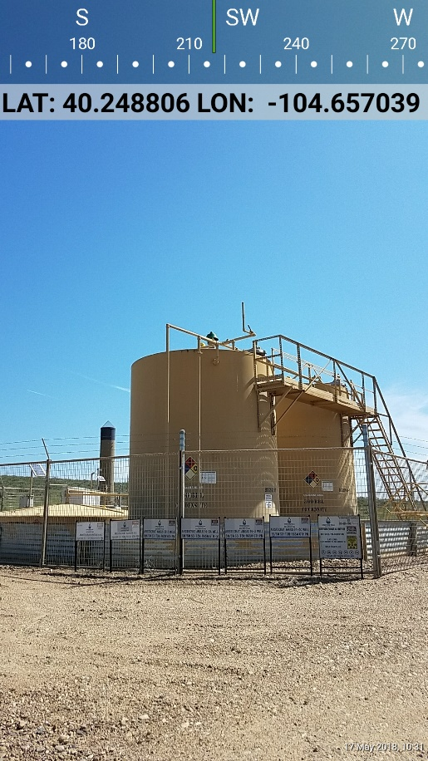
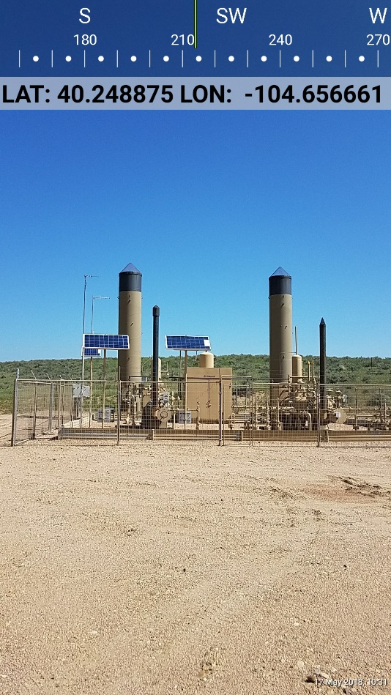
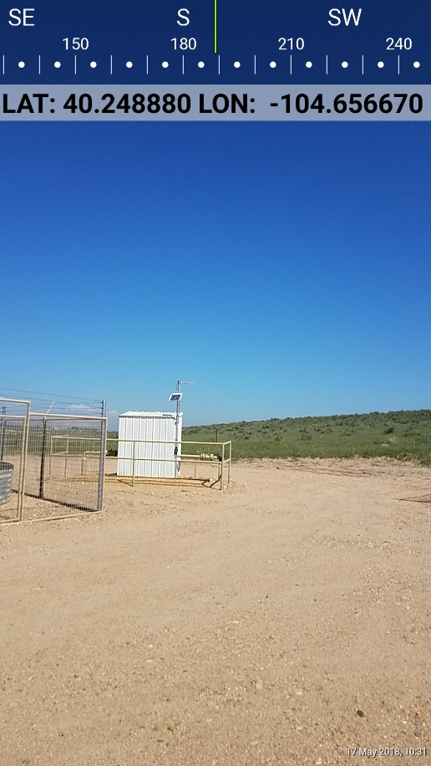
Inspection Photos
Location Name: ARISTOCRAT ANGUS 63N65W 35SWSW #Multiwell Pad
Location Number: 333137
Photo 1 Tank Battery
Photo 2 Production Equipment
Photo 3 Gas Meter Run

