Slide 1
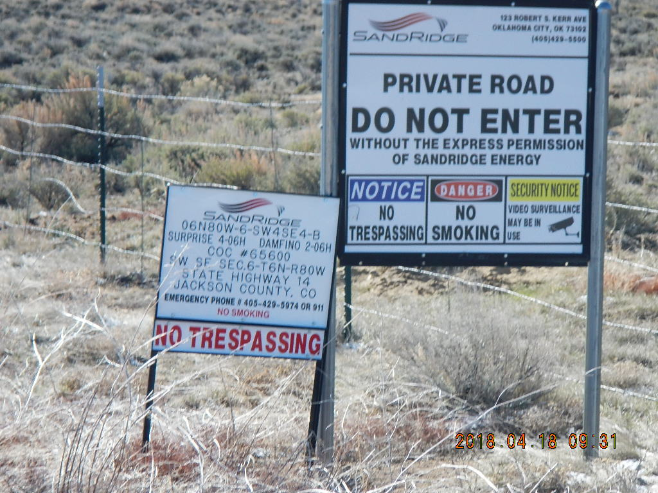
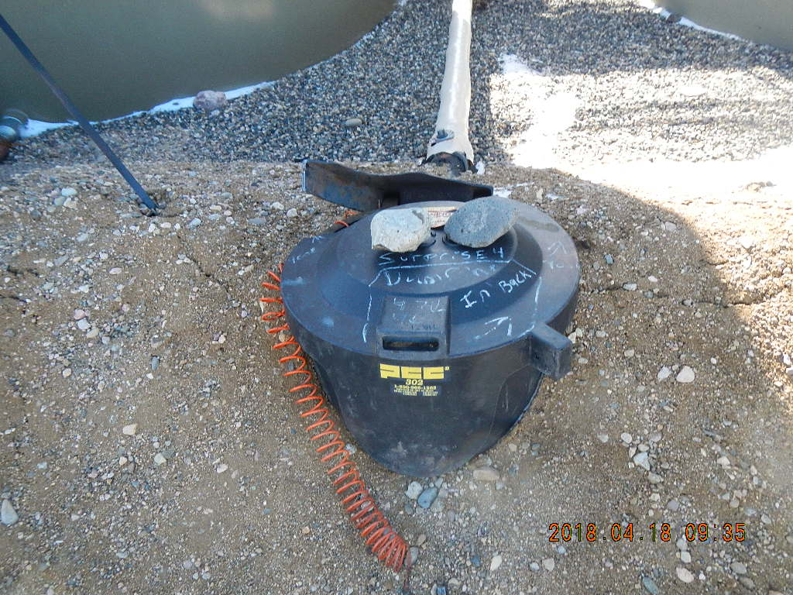
Inspection Photos
Location Name: Surprise 4-06H and Damfino 2-06H
Location 416626
Location 416625
Containment Catchment

Slide 2
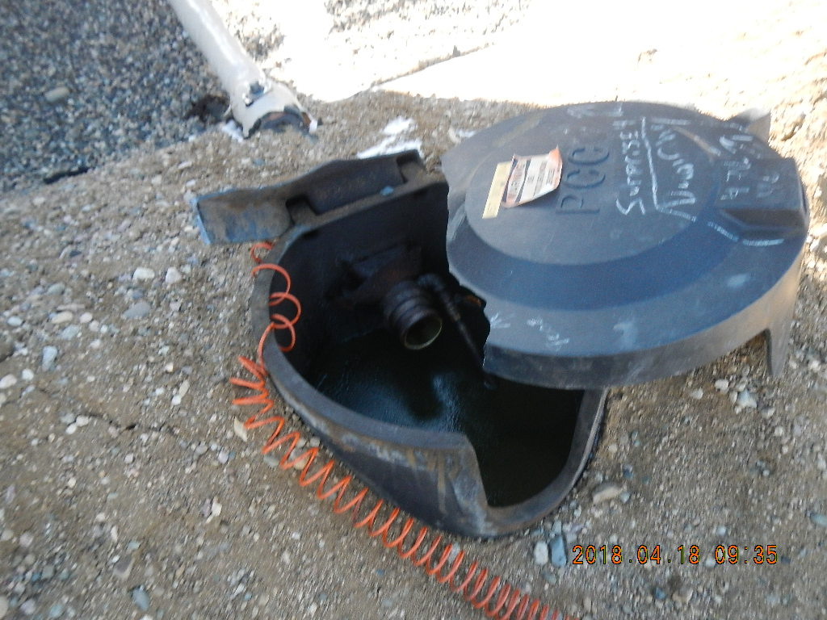
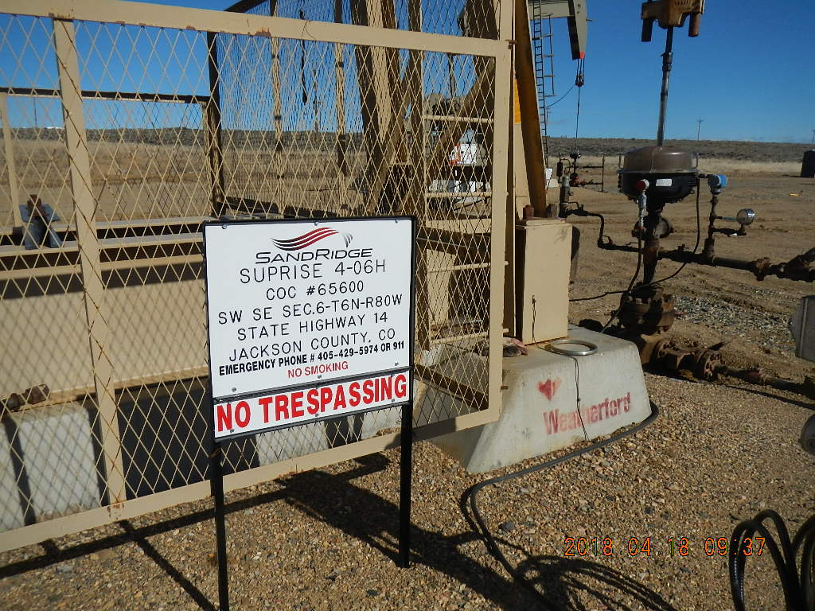
Inspection Photos
Location Name: Surprise 4-06H and Damfino 2-06H
Location 416626
Containment Catchment
API 057-06480, Surprise 4-06H

Slide 3
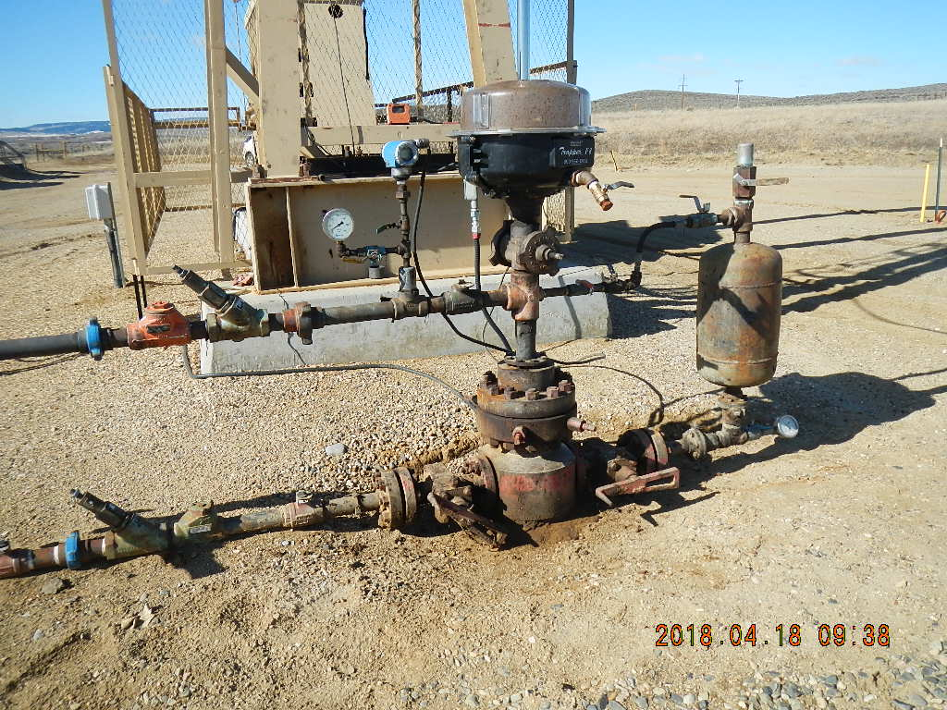
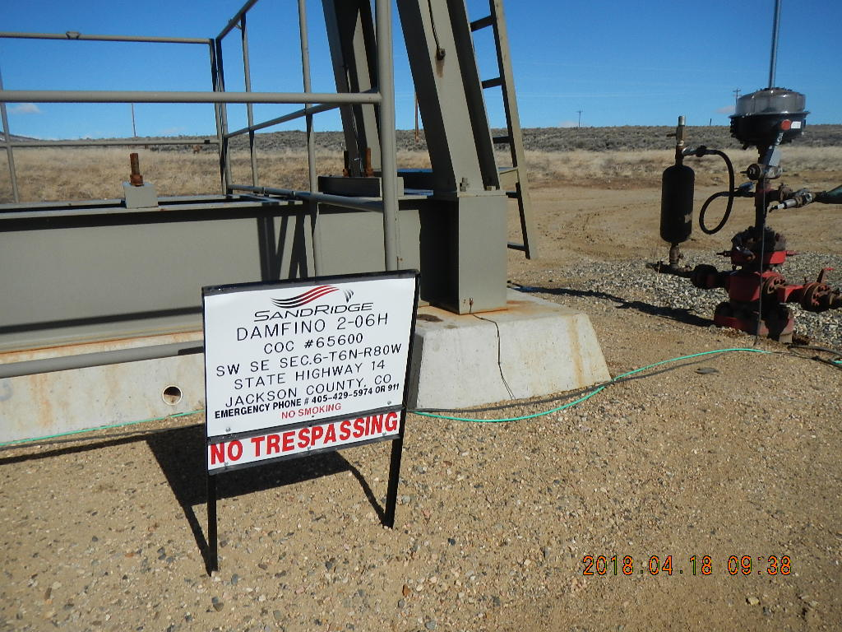
Inspection Photos
Location Name: Surprise 4-06H and Damfino 2-06H
Location 416626
API 057-06480, Surprise 4-06H
API 057-06482, Damfino 2-06H

Slide 4
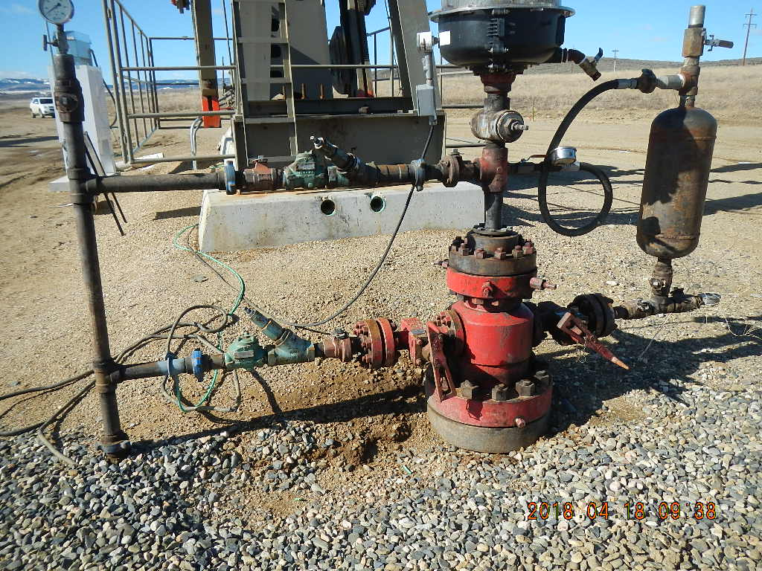
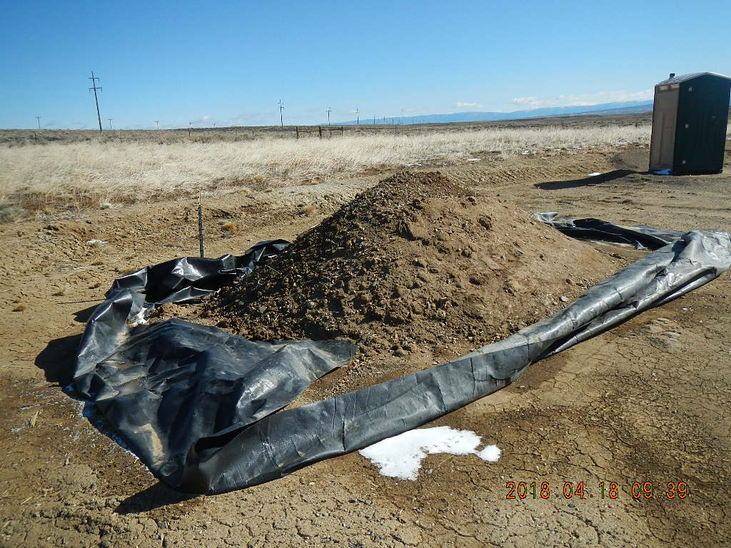
Inspection Photos
Location Name: Surprise 4-06H and Damfino 2-06H
Location 416626
API 057-06482, Damfino 2-06H
Soil stockpile

Slide 5
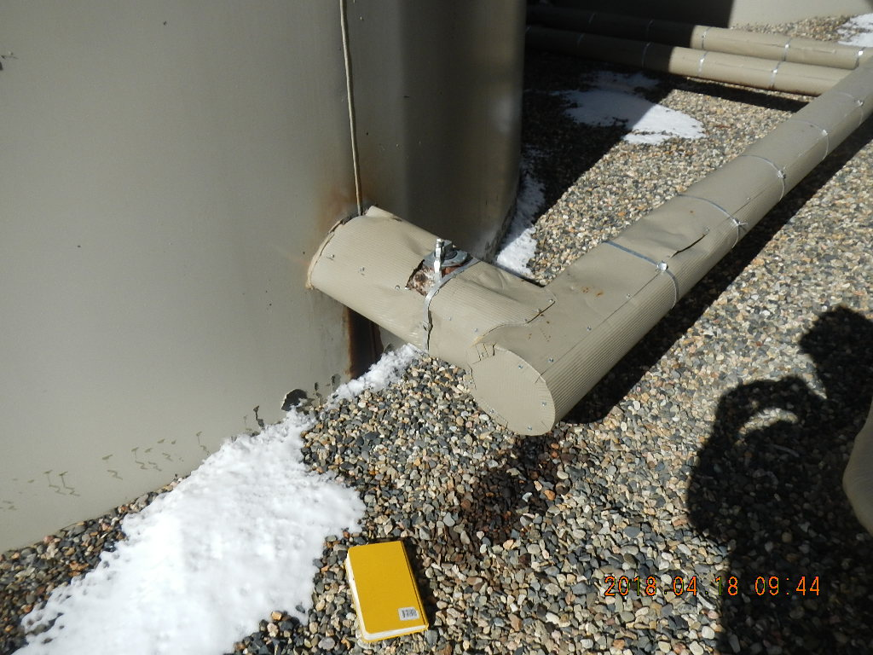
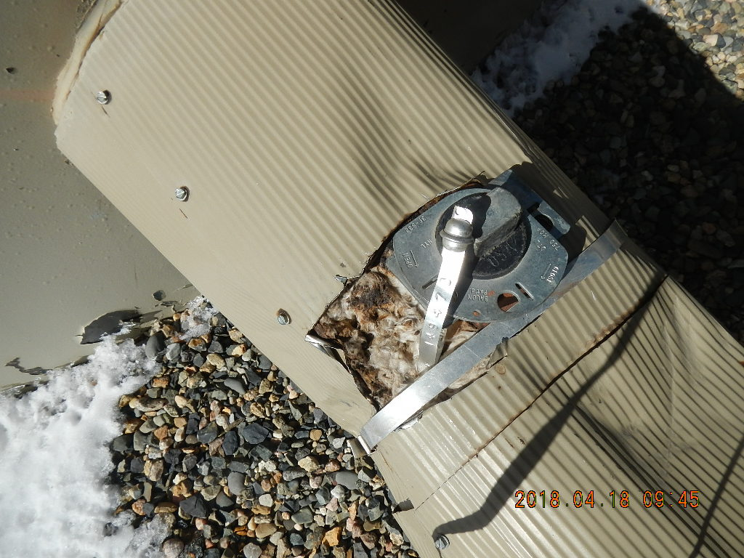
Inspection Photos
Location Name: Surprise 4-06H and Damfino 2-06H
Location 416626
Oil stain beneath valve and elbow Tank # 3947
Insulation with oil

Slide 6
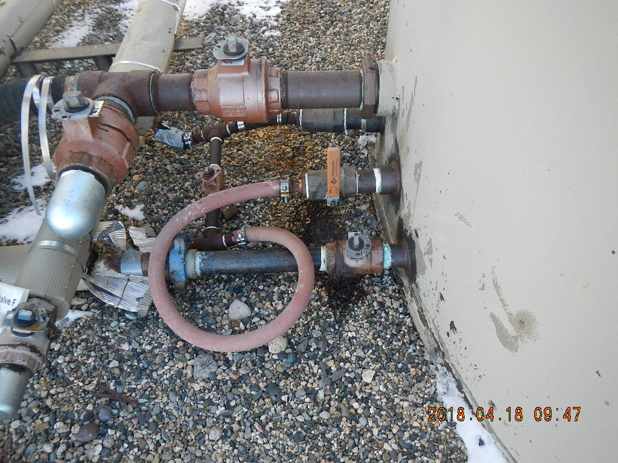
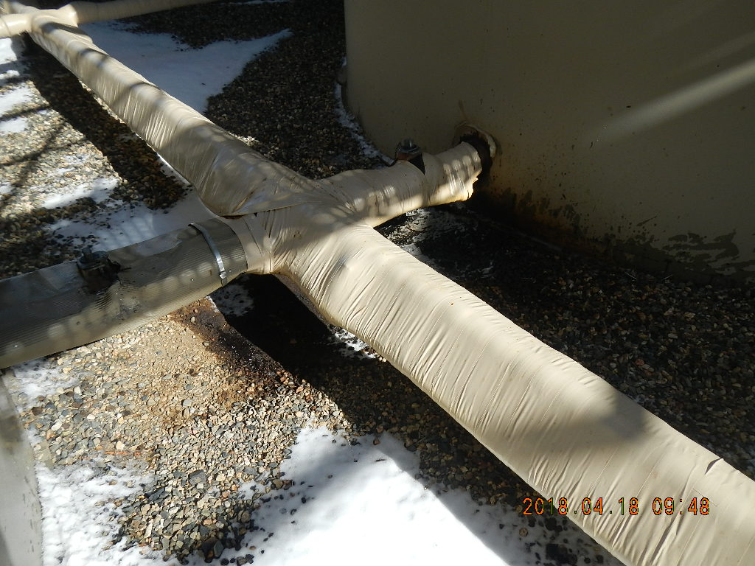
Inspection Photos
Location Name: Surprise 4-06H and Damfino 2-06H
Location 416626
Oil staining beneath valve. Appears to be weeping oil.
Oil staining.

