Slide 1
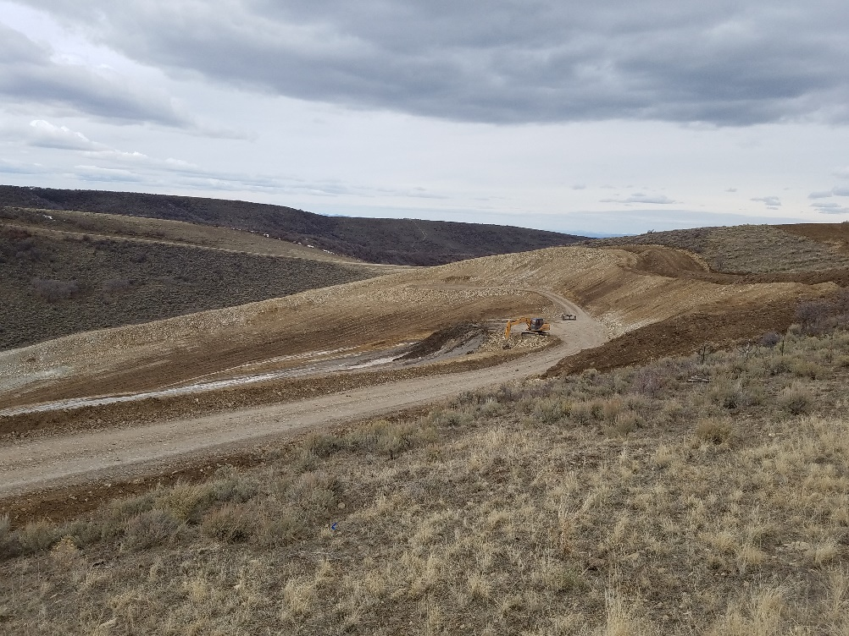
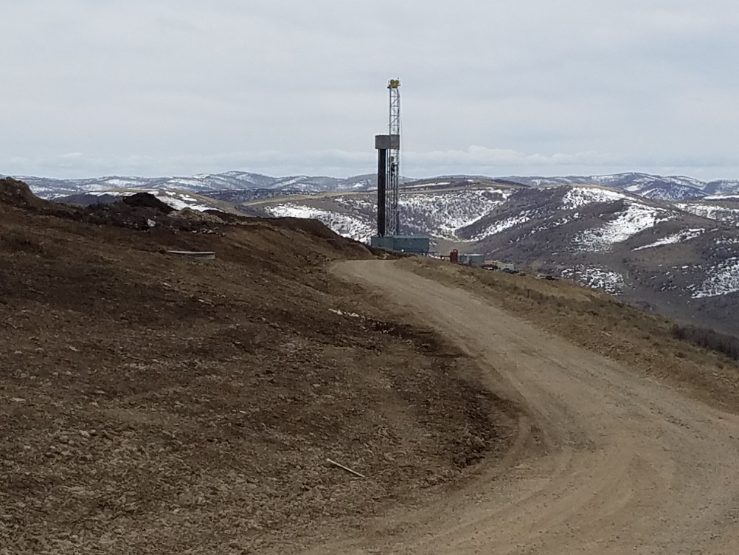
Inspection Date: April 05, 2018
Cutting Pad of UWF H04 596
Location ID #433573
Looking west. Cutting pad associated to the H04 drilling pad. Surface of pad slopes to the south; surrounded by berms.
Looking south. Photo taken from the same location as the previous one. According to Caerus, 20 wells will be drilled on the H04 pad.

Slide 2
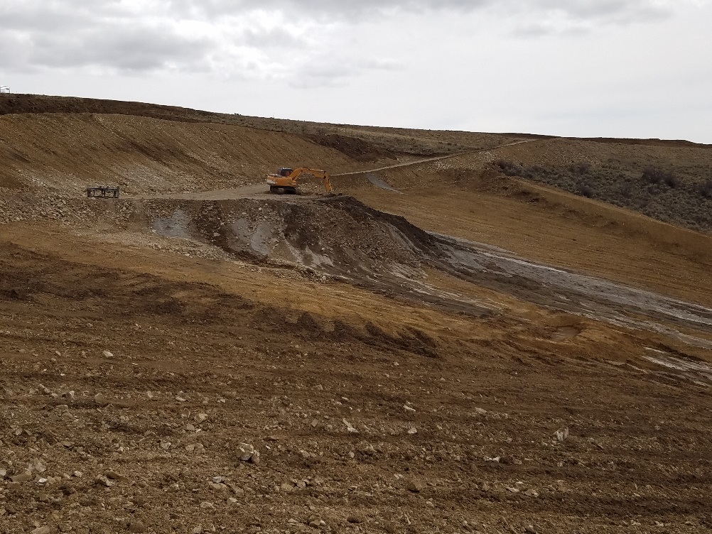
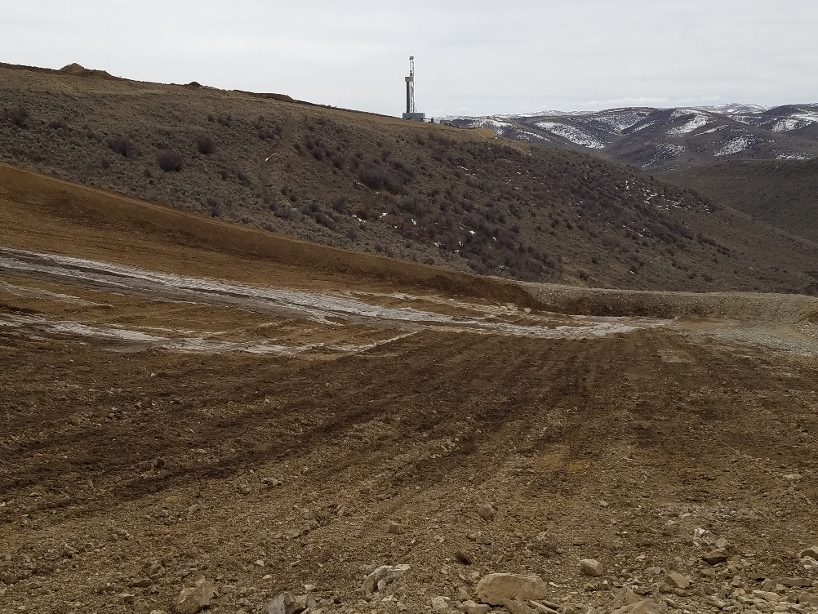
Inspection Date: April 05, 2018
Cutting Pad of UWF H04 596
Location ID #433573
Looking east. Cuttings have been transported to the Cutting Pad. Fluid from the cuttings are flowing downgradient (to the south).
Surface of the sloping pad has been tilled, resulting in a more permeable soil.

Slide 3
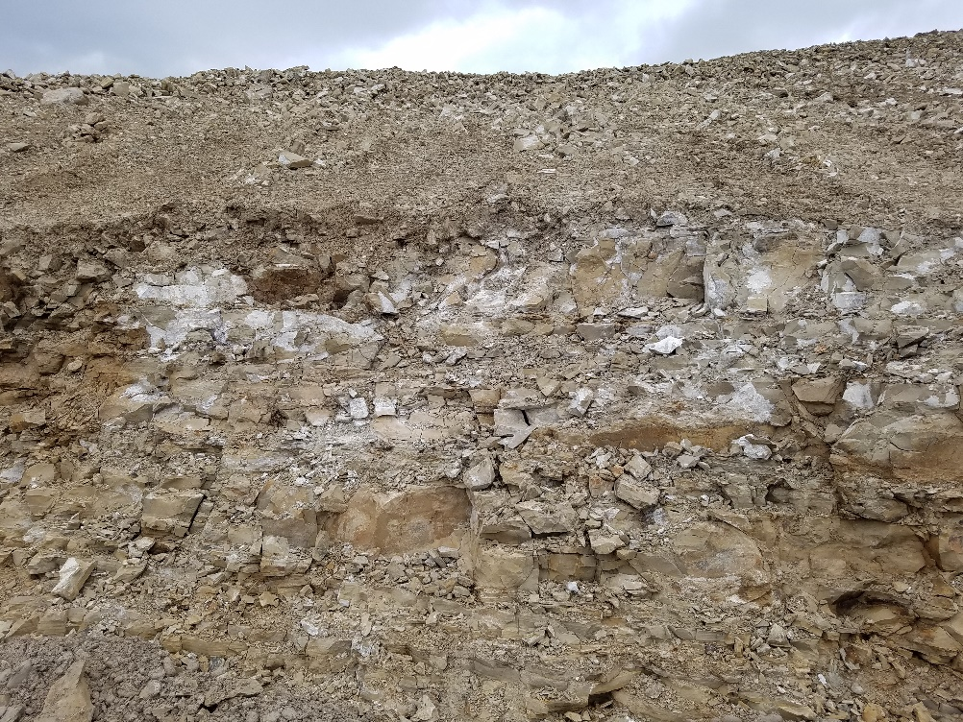
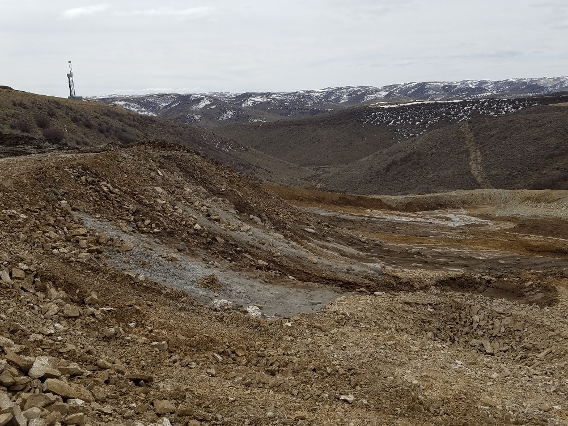
Inspection Date: April 05, 2018
Cutting Pad of UWF H04 596
Location ID #433573
Cut slope of the access road. Although some fracture is due to the road construction, this photo suggests that the rock underneath the soil cover is weathered and fractured, facilitating infiltration.
Looking east. Observe discharged cuttings (brown) and drilling mud (grey).

Slide 4
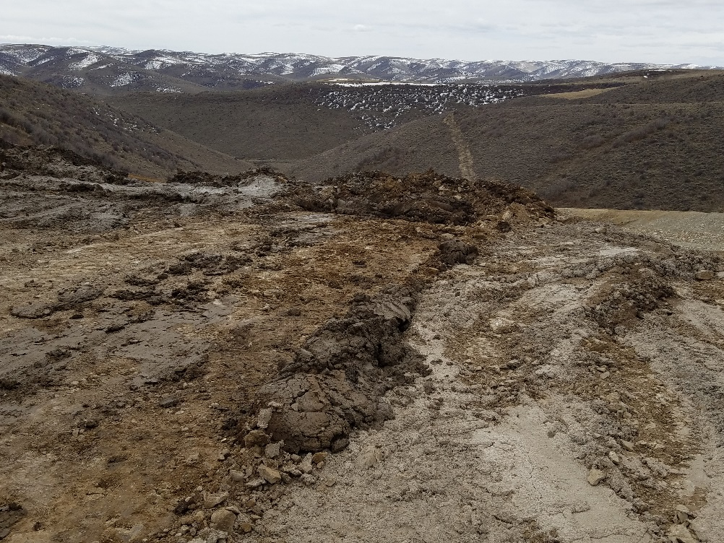
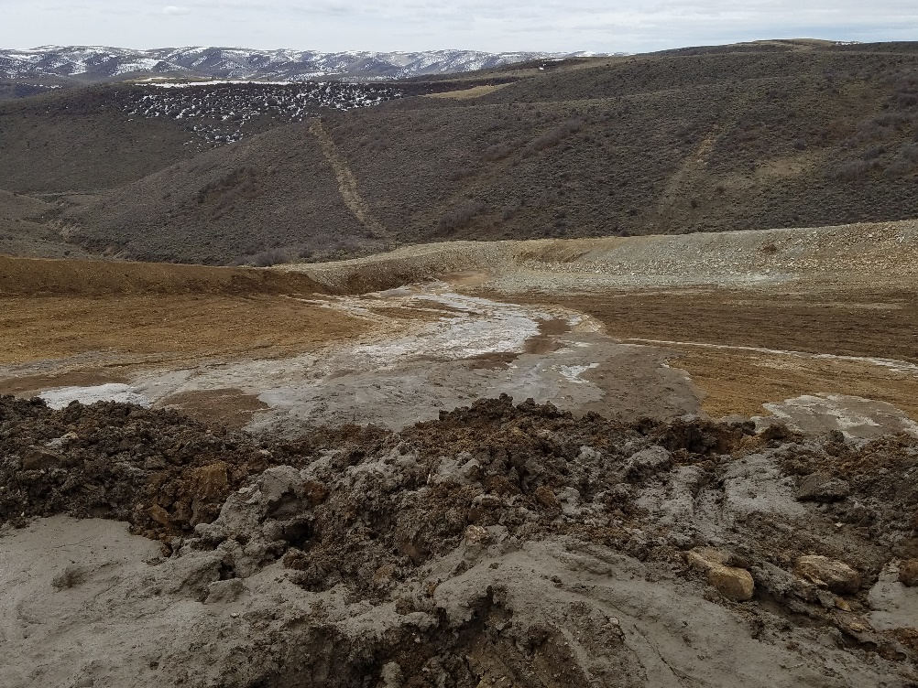
Inspection Date: April 05, 2018
Cutting Pad of UWF H04 596
Location ID #433573
Looking south. Cutting are being pushed down from the access road and working area.
Looking south. Drilling mud (mostly bentonite) and cuttings close to the photographer. Fluids draining downgradient and accumulating in the lower/south corner of the pad.

Slide 5
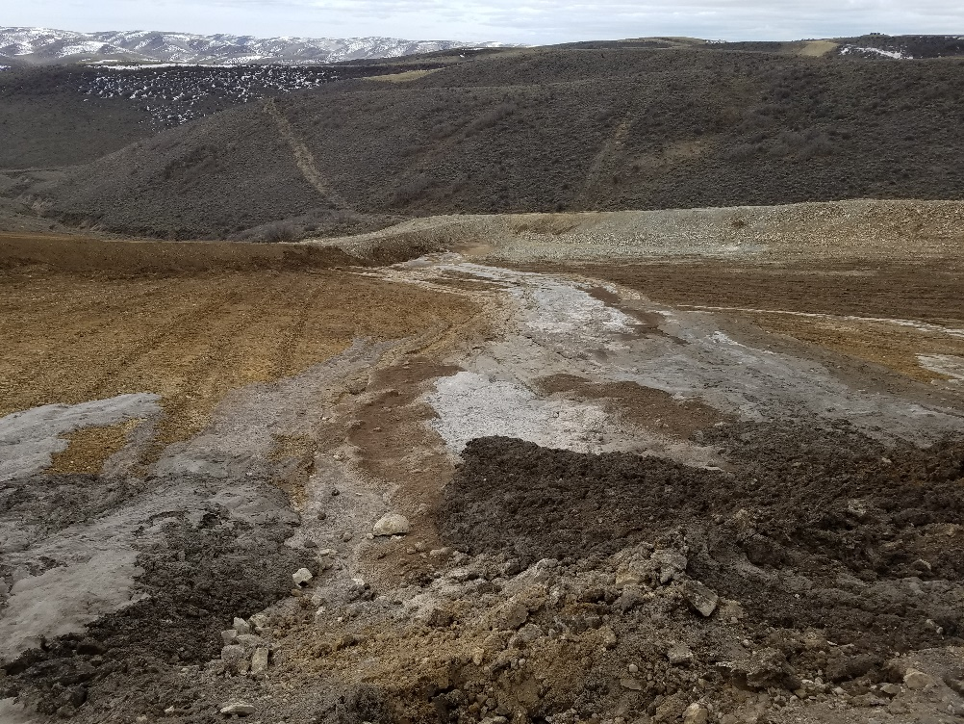
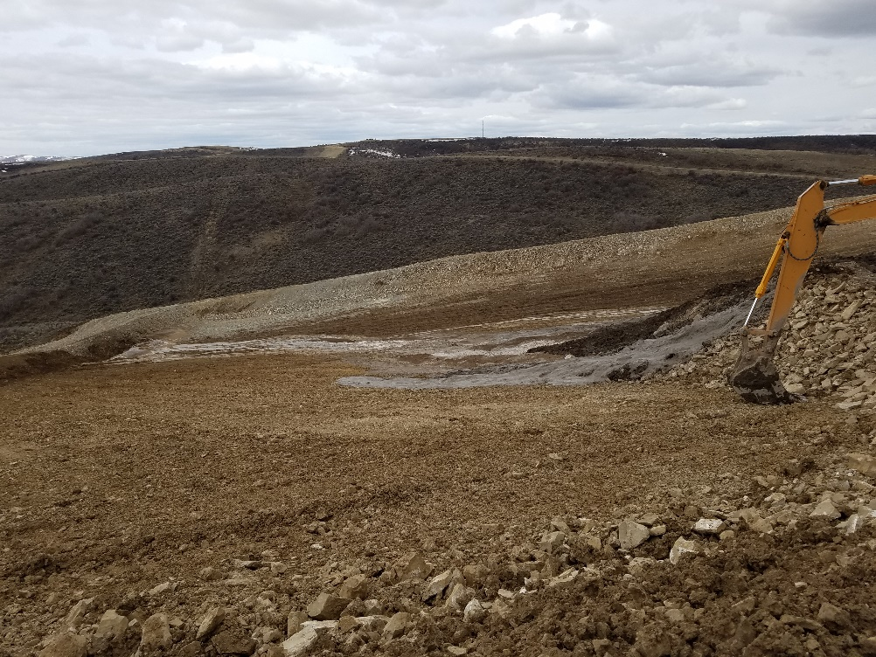
Inspection Date: April 05, 2018
Cutting Pad of UWF H04 596
Location ID #433573
Fluids released from the cuttings/drilling mud flow downhill toward the lower/south corner of the pad.
Looking southwest.

Slide 6
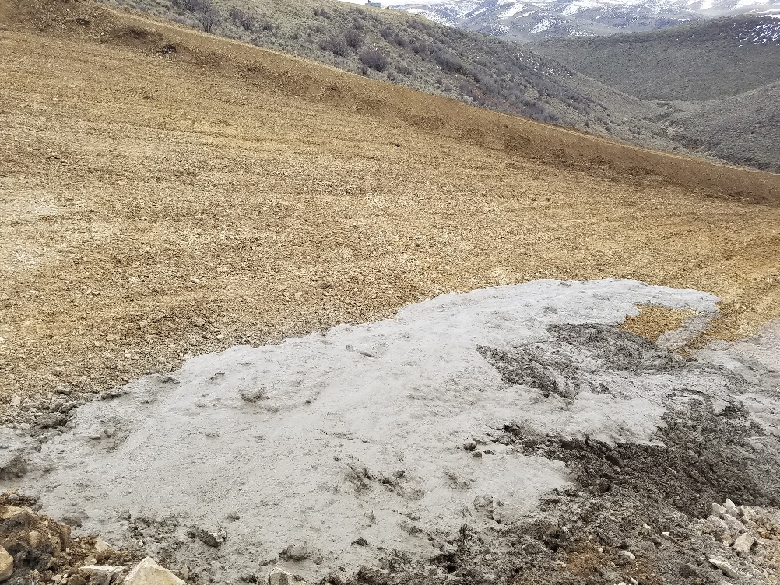
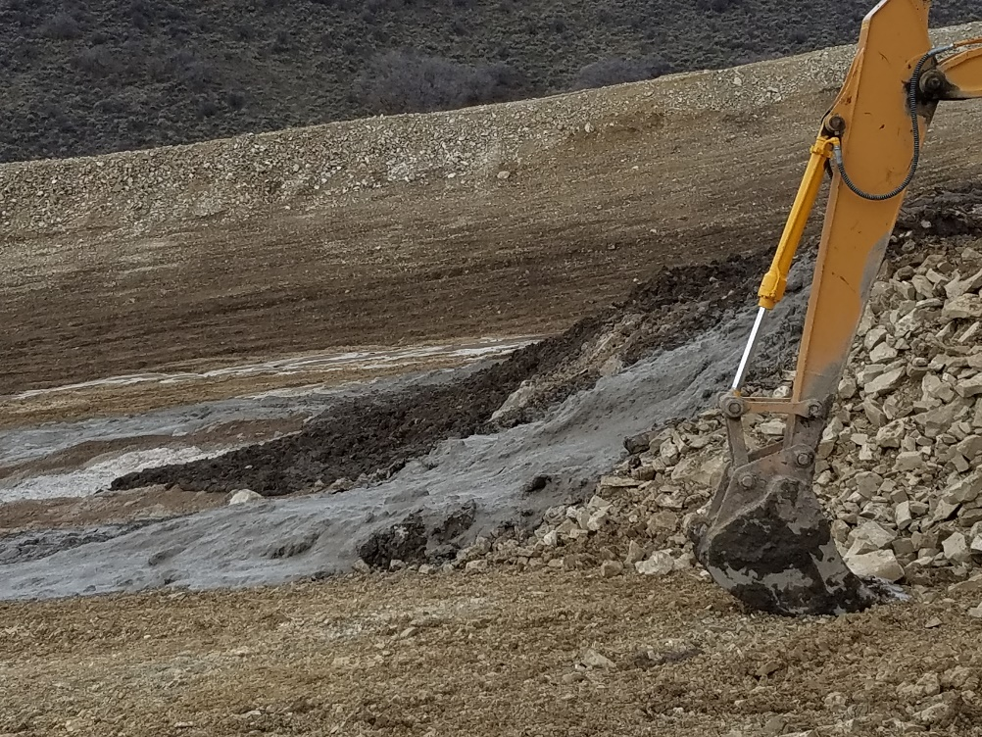
Inspection Date: April 05, 2018
Cutting Pad of UWF H04 596
Location ID #433573
Close-up of drilling fluids discharged with the cuttings
Grey sludge is mostly drilling mud. Dark soil is mostly cuttings.

