Slide 1
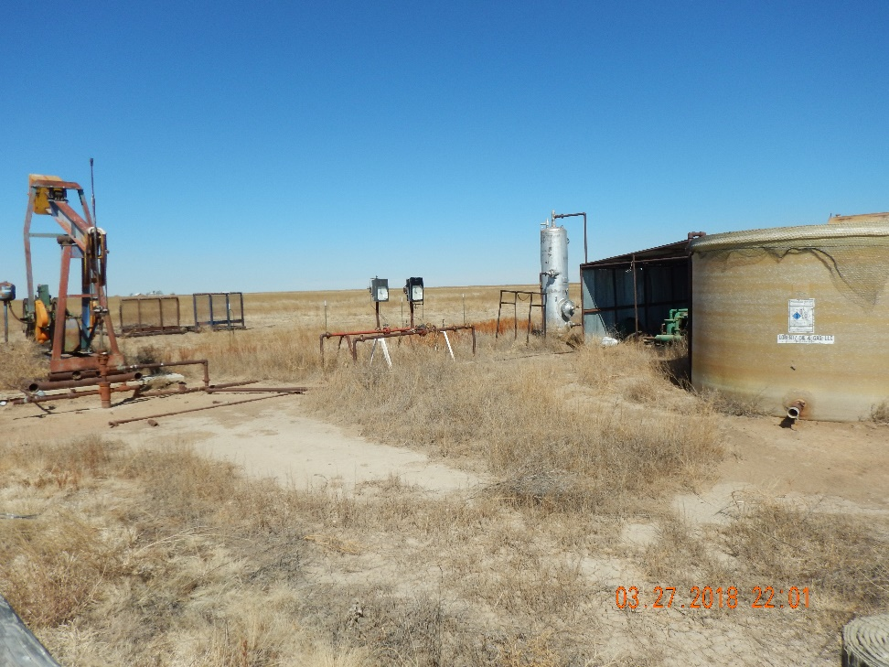
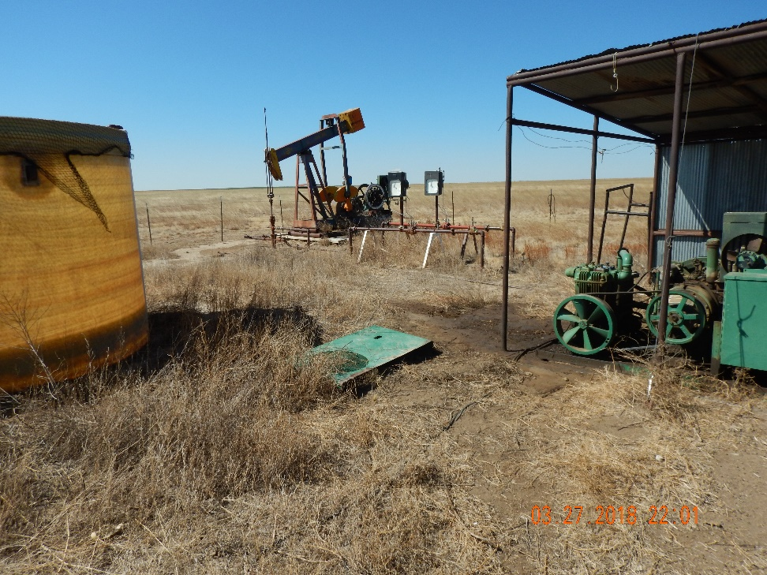
Inspection Photos
Location Name: Lippoldt 1-14
API: 05-009-06553
1. Unit and wellhead. Weeds across location
2. Water tank is connected with no berms for containment. Lube oil stain still present. Belt guard laying around

