Slide 1
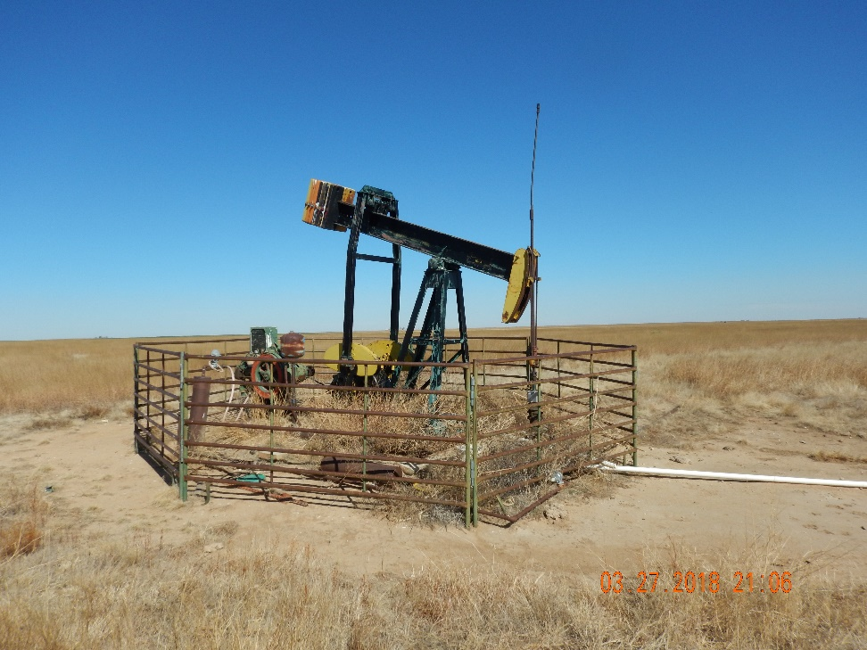
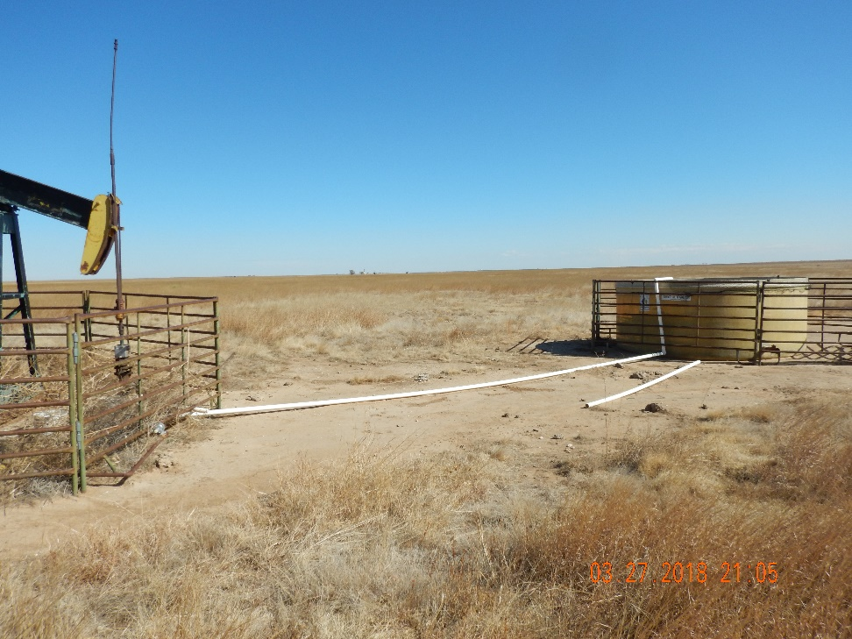
Inspection Photos
Location Name: Lippoldt 1-23
API: 05-009-06554
1. Unit and wellhead. Weeds need cleaned out
2. Water tank is connected but still has no berms for containment

