Slide 1
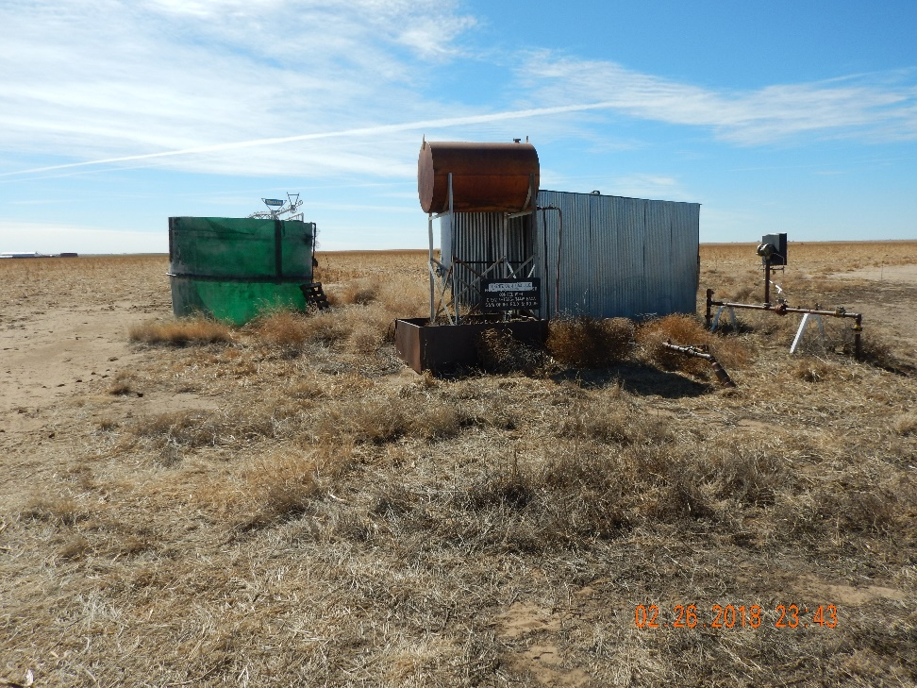
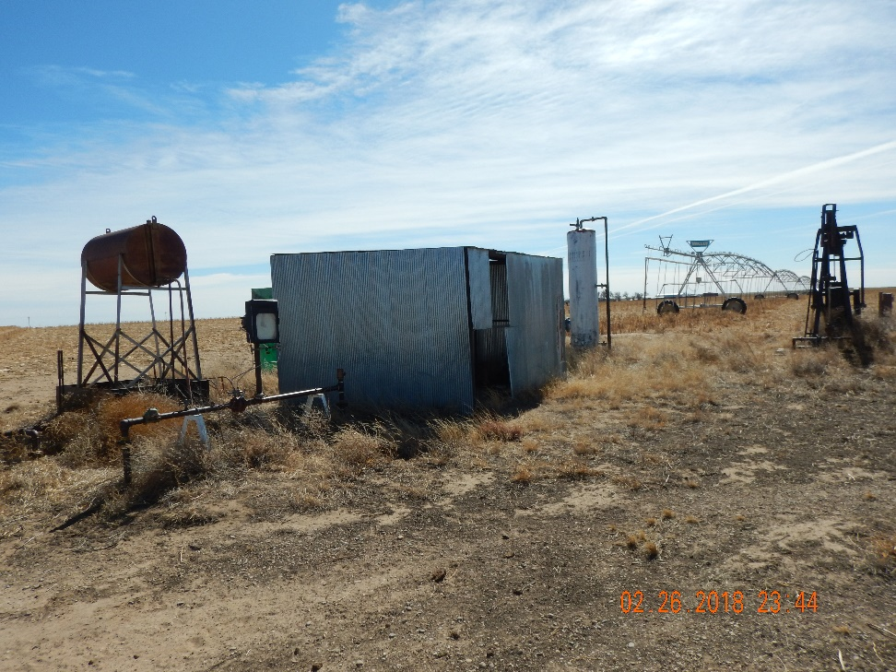
Inspection Photos
Location Name: Konkel 1-4
API: 05-009-06552
1. North side of location looking south
2. Northwest corner of location looking southeast. Weeds still need to be maintained

Slide 2
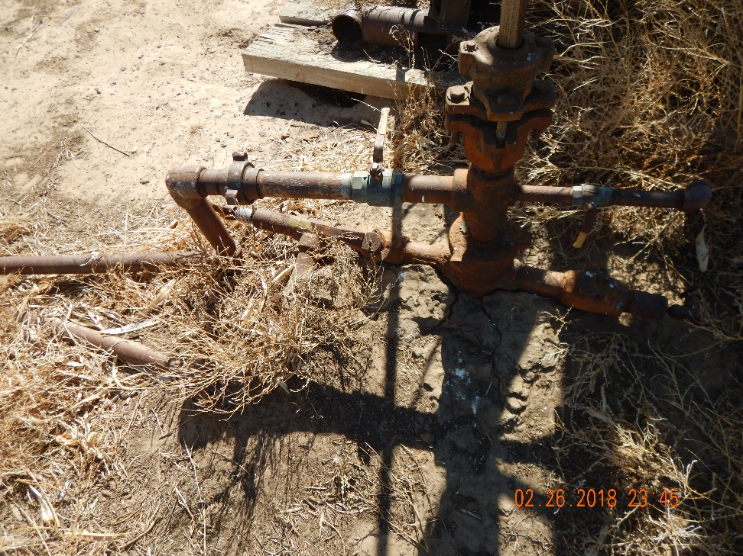
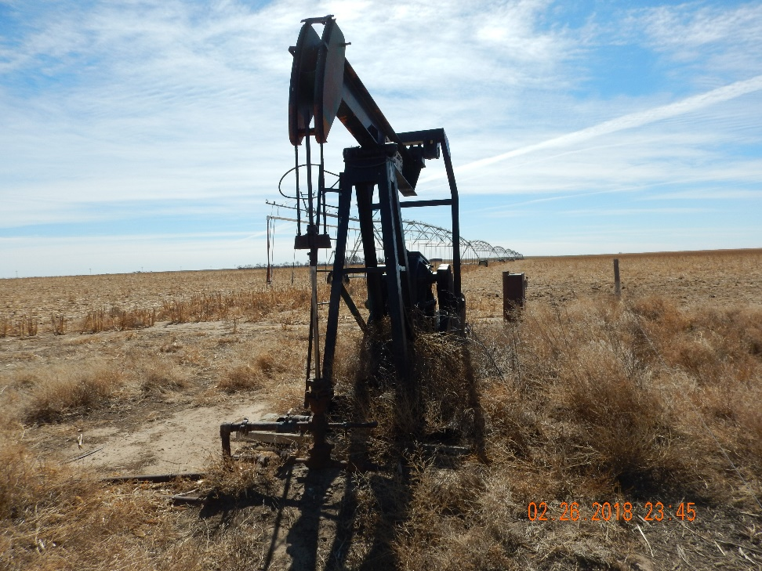
Inspection Photos
Location Name: Konkel 1-4
API: 05-009-06552
3. Well is producing
4. Weeds around pumping unit

Slide 3
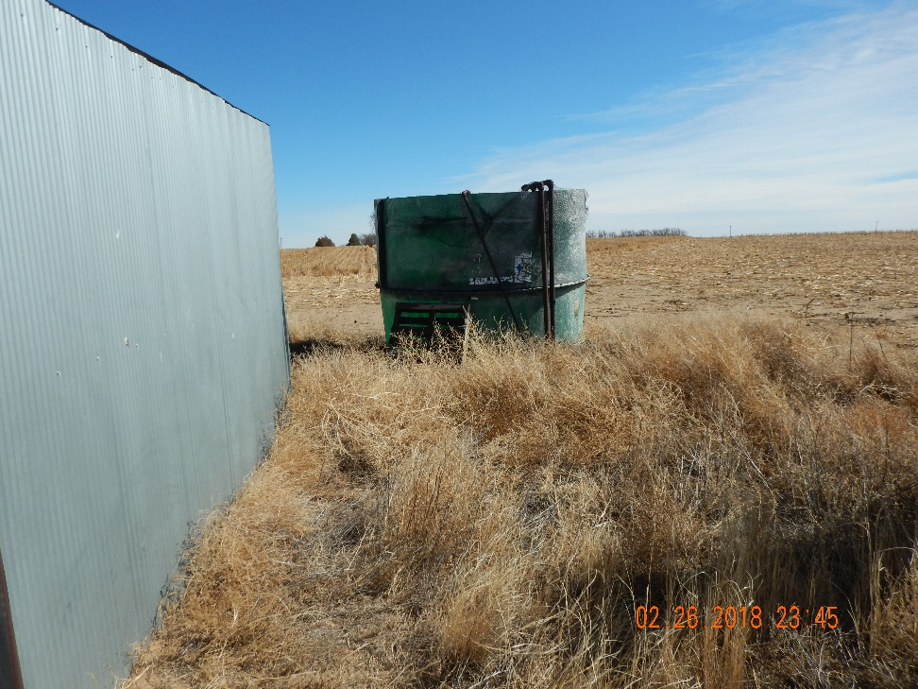
Inspection Photos
Location Name: Konkel 1-4
API: 05-009-06552
5. Water tank doesn’t have berms or labeling. It is still plumbed into production

