Slide 1
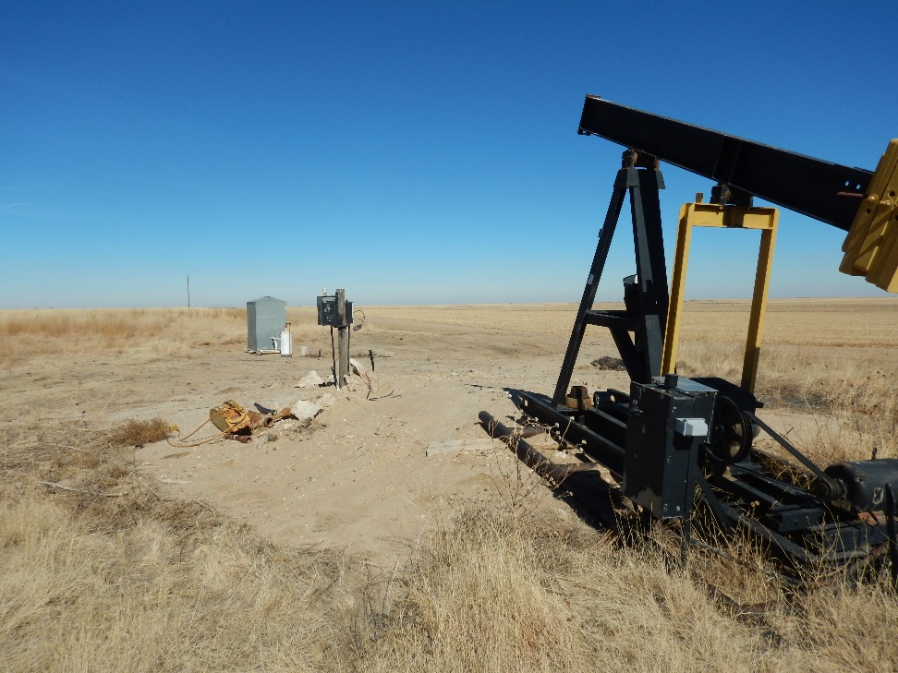
Inspection Photo
Location Name: Loflin 1-8
API: 05-009-06322
Loflin 1-8 on 2/7/18
Remove equipment from location to begin final reclamation

