Slide 1
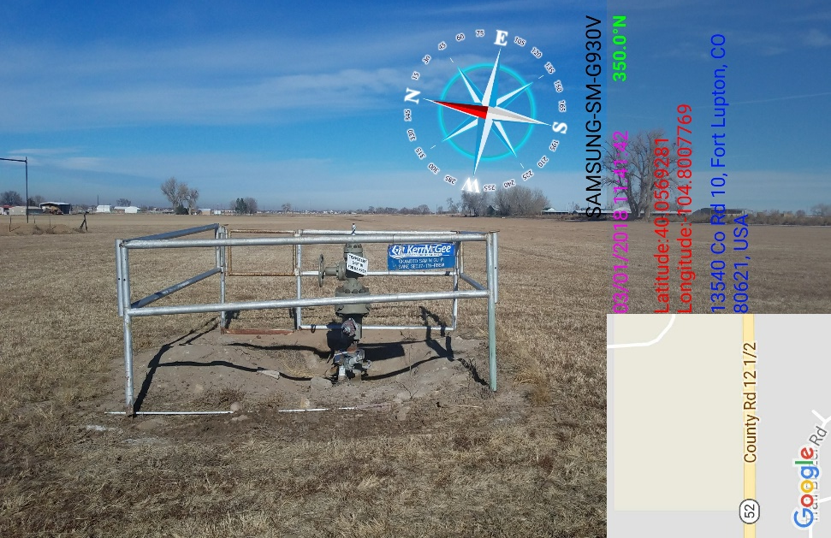
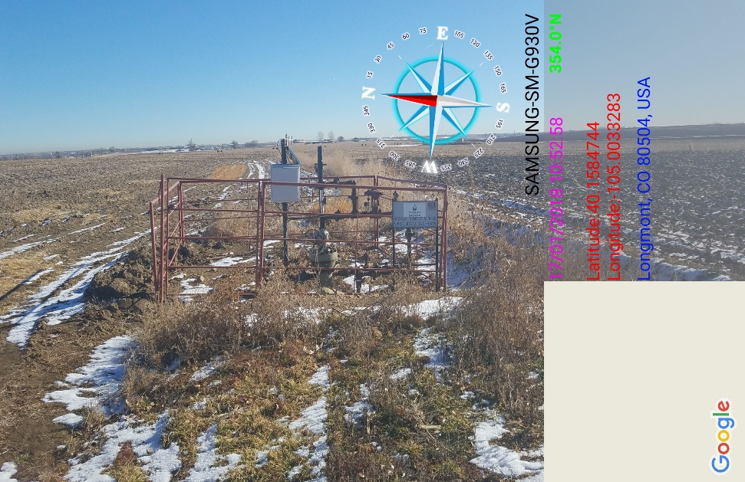
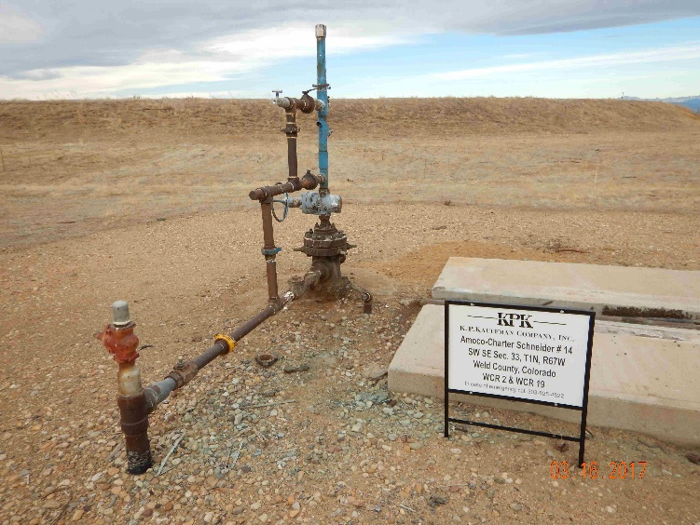
Inspection Photos
Location Name: Crestone Regnier Farms 31-19
Location # 05-123-24655
Wellhead weeds around wellhead

